Slide 1







l
R
U
L
E
Can a country bankrupt?
PROFESSOR: PAUL Angles
PRESENT BY
Metrey
Dalin
Varith
Sotheara
LaiSreng

Slide 2
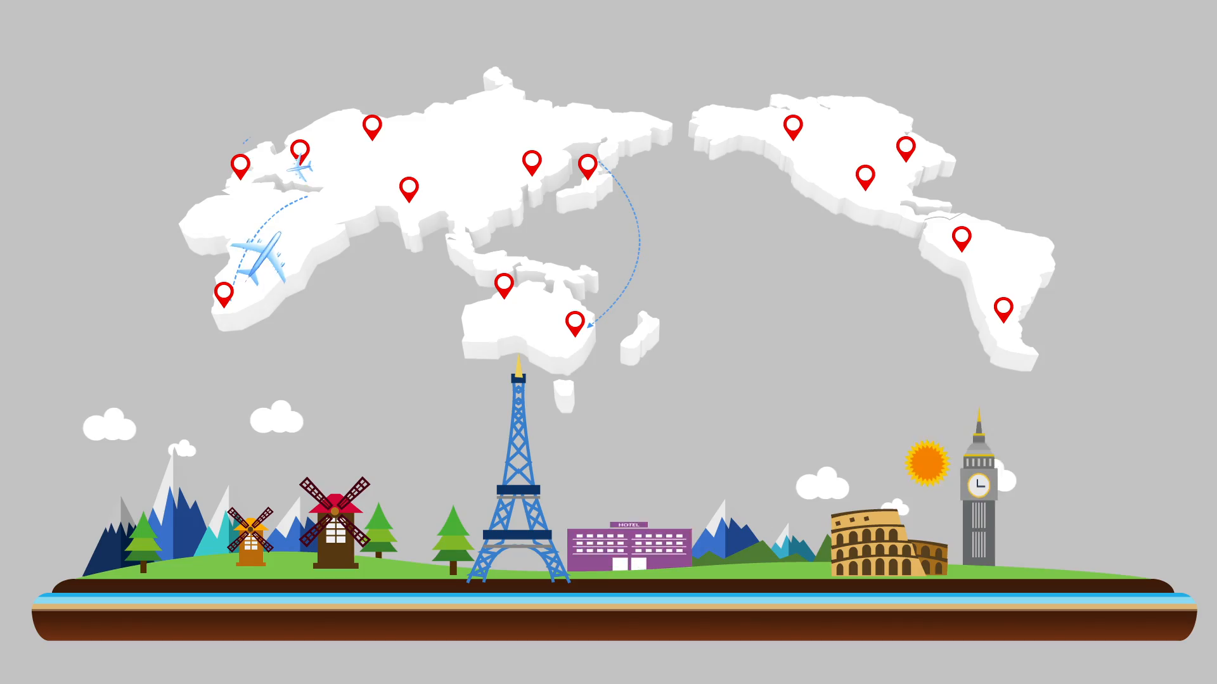
02
01
How can a country go bankrupt
How Government debt work
03
04
What happen after a country default
Case study: Venezuela

Slide 3
How Government debt work
Government debt also known as public debt, national debt and sovereign debt that owed by a government.
Government debt can be categorized as internal debt and external debt.
Government create debt by issuing government bonds and bills, creditworthy countries, sometimes borrow directly from world bank or international financial institutions.

Slide 4
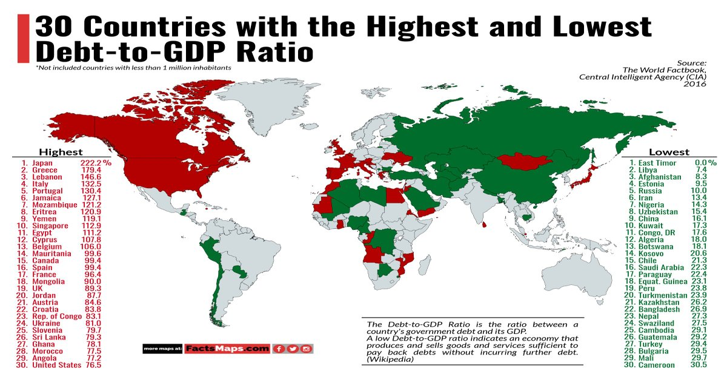

Slide 5
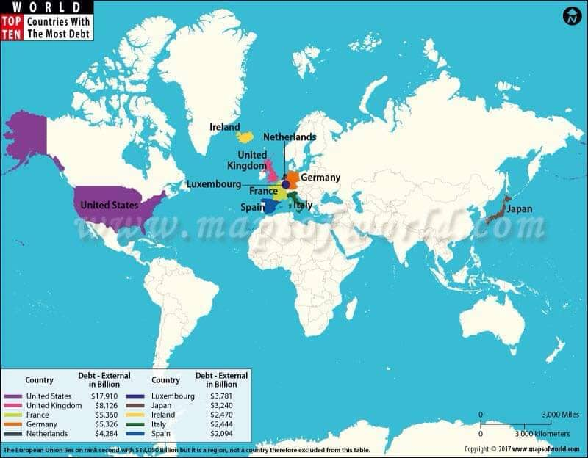

Slide 6
Source of borrowing:
Internal source of government borrowing on include rich individual citizens, organization, financial institution like the central bank and commercial bank
External source of government borrowing include multination financial institution like international bank, world bank and the international monetary fund.

Slide 7
Why government borrow money?

Slide 8








Reason for government borrowing
To Produce War Materials
To Finance Deficit Budget
Emergency
Fluctuation of National Income
Balance of Payments Disequilibrium
Servicing of Loan
To Finance A Huge Capital Project
To Provide Employment Opportunities

Slide 9





Expenses
Income
Investment
Social welfare
Infrastructure
Taxation
Country
Borrow money
Deficit
Surplus
Expense > Income
Expense < Income

Slide 10


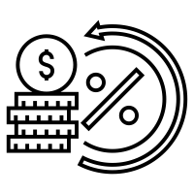
GDP
Ratio of debt compare to GDP
Economist
Interest rate of bond
Depend on the number of investors who confident that they can get their money back

Slide 11


Economics climate
Investors
Rating Agencies
Country
Political stability
AAA
AA
A
BBB
BB
B
CCC
CC
C
D
Monetary and Budgetary policy
Low Interest rate
High interest rate

Slide 12
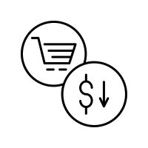

After a country default
The creditor can do for the default’s country is to renegotiate the term of loan.
Rescheduled Payment
Reducing value
Notes:
Insert a picture of one of the geographic features of your country.

Slide 13




The effects of default
The immediate cost of defaulting is the loss of principle and capital of creditor resulting from either partial debt or debt restructuring
Notes:
Insert a picture illustrating a season in your country.

Slide 14
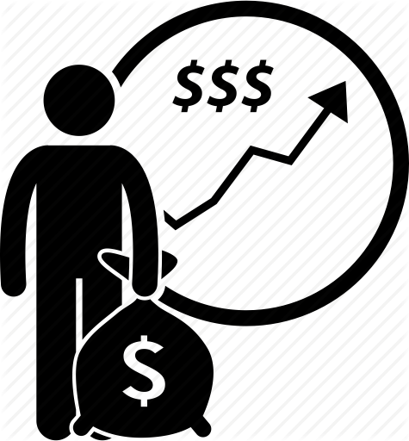
Opportunity for investment
Default maybe deters domestic and foreign investment.
Notes:
Insert a picture of an animal and or plant found in your country.

Slide 15

Is defaulting the only way out?
Due to the cost default, a country will choose to default only if it is better off not paying its debts.
Paul Blustein
“Defaulting on loan maybe a boon than a bane for a heavily indebted country despite its consequential effects.”
Notes:
Insert a picture illustrating a custom or tradition here.

Slide 16
Venezuela Case study
Defaulted
Hyperinflation

Slide 17
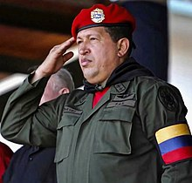
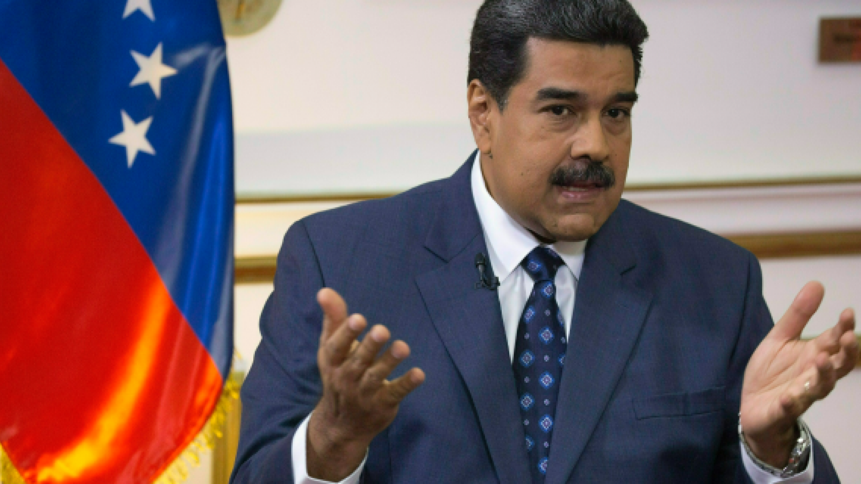
Origin of the crisis
1998 National election- the year of success in politic career of Hugo Chávez
Early 2000s, Bolivarian mission was implemented
On 02 June 2010, the date of declaring Economic war in Venezuela
National election, 2013 Nicolás Maduro won this competition
Arriving another problem for Venezuela, the Great Recession- Financial crisis 2008

Slide 18
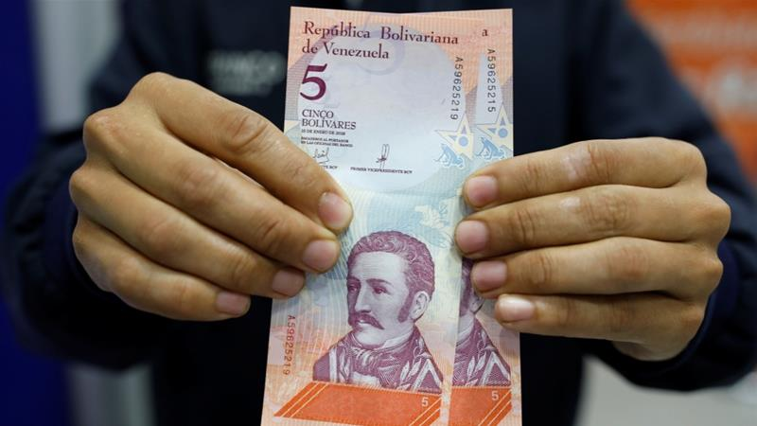
In August 2018, Introduce new currency into the economy

Slide 19

Effects
Inflation
2019
2,688,670%
2017
4,000%
2016
800%
2015
181%
2014
69%

Slide 20

Business and Industry & unemployment

Slide 21
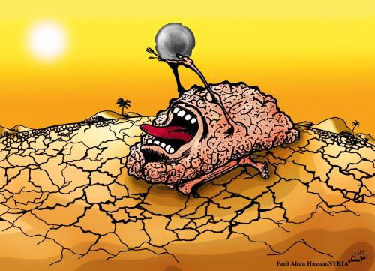
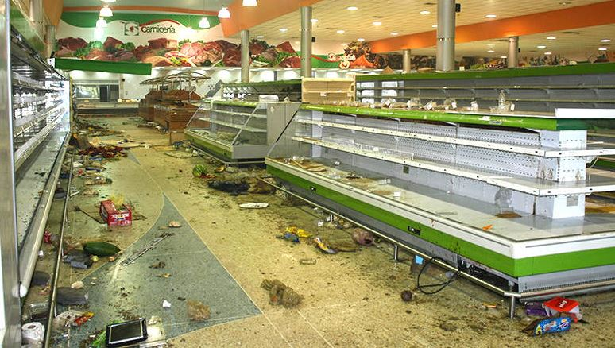
Shortage
Shortage occurs in regular product and necessary product such as toilets paper, personal hygiene products, and even medicine
According to multi-university found that in 2016, 75% of Venezuelans lost weight due to hunger, with the average losing about 8.6 kg (19 lbs) due to the lack of food

Slide 22
Current situation
The aid from Brazil, organized by Venezuelan opposition leader Juan Guaidó
But Venezuela’s government refused to receive that aids
In a reason that, a US-orchestrated show

Slide 23

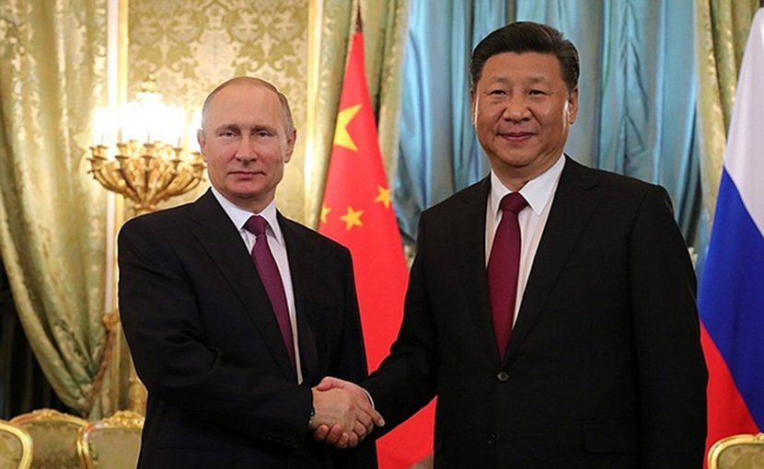
Current situation

Slide 24
Conclusion
One sovereign actually can go bankrupt but we do not say that a country go bankrupt, it is defaulted.

Slide 25
THE END
THANKS FOR YOUR ATTENTION

Slide 26
Q & A

