Slide 1

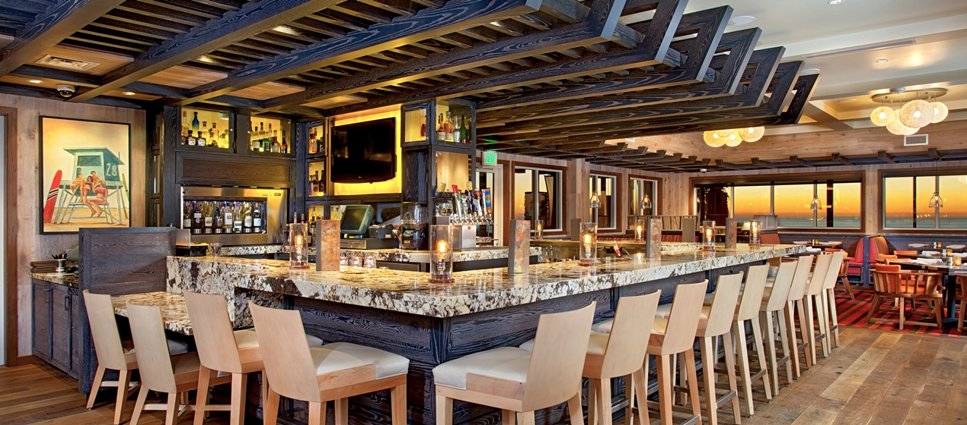
ROYAL UNIVERSITY OF LAWS AND ECONOMICS
FACULTY OF ECONOMICS AND MENAGEMENT FRENCH CORPERATION
BUSINESS PLAN PRESENTATION
SkyRiver Bar and Restaurant
Mr. LEM ChanSamrach
SVAY Metrey
ENG Dalin
PROEUNG Varith
SOK Sotheara
VORN LaiSreng
SAO Lihuy

Slide 2
Contents:
Business overview
Market analysis
  Macro analysis
  Five Forces analysis
Strategic analysis
Financial Statement
Document support

Slide 3

Business overview
Mission: Provide Unforgetable taste
Vision: Leader cruise serving service in Phnom Penh
Future Plan: Become a world class cruise one among the others

Slide 4
Team Management
Mr. PROEUNG Varith
General Manager
Mr. IM Theara
Technical Supervisor
Mr. SOK Sotheara
HR and Admin
Ms. SVAY Metrey
Sale and Marketing
Mr. SAO Lihuy
Accounting Supervisor
Ms. ENG Dalin
HR and Admin manager
Mr. VORN LaiSreng
Sale and Marketing manager

Slide 5

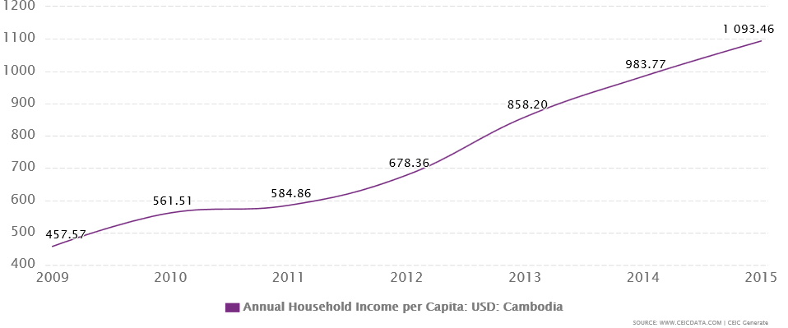
Market analysis
Political
Economy
Socio-economy
Technology
Regulatory Framework

Slide 6
Barriers to entry
Substitute
5 Forces
Suppliers
Competitor analysis
Customer analysis

Slide 7
Strengths
Weaknesses
-Clear vision
-Skillful management team
-High commitment
-Clear financial plan
-Lack of work experiences
-Lack of employee control
-Start-up business plan
SWOT
Opportunities
Threats
-Stability of economic growth
-Increase of the number of inhabitant
-Increase of utility function
-Market is still open
-Unpredictable politic after election
-Barrier from competitors
-Inflation

Slide 8
Operational Strategies
Sale and Growth strategy
HR
Internal and External

Slide 9
Pricing
communication
Product
7Ps
Place
Process
People
Physical Evidence

Slide 10
Risk
Mitigation
-Loss critically
-opportunity cost
-Lost motivation

Slide 11
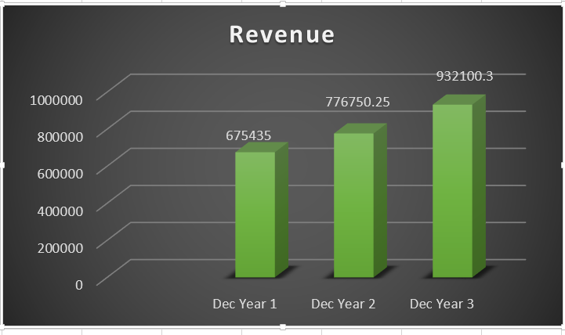
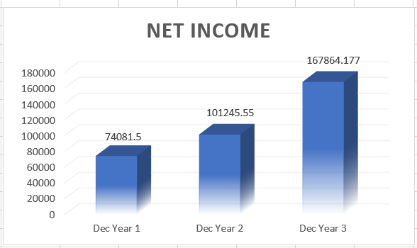
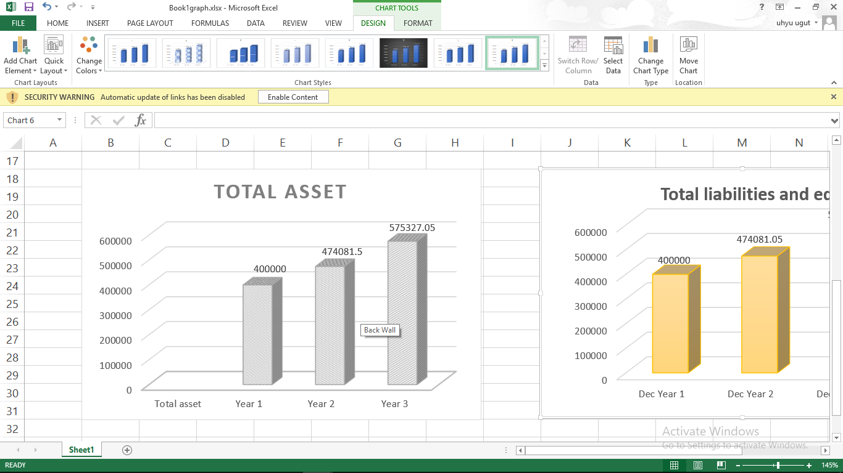
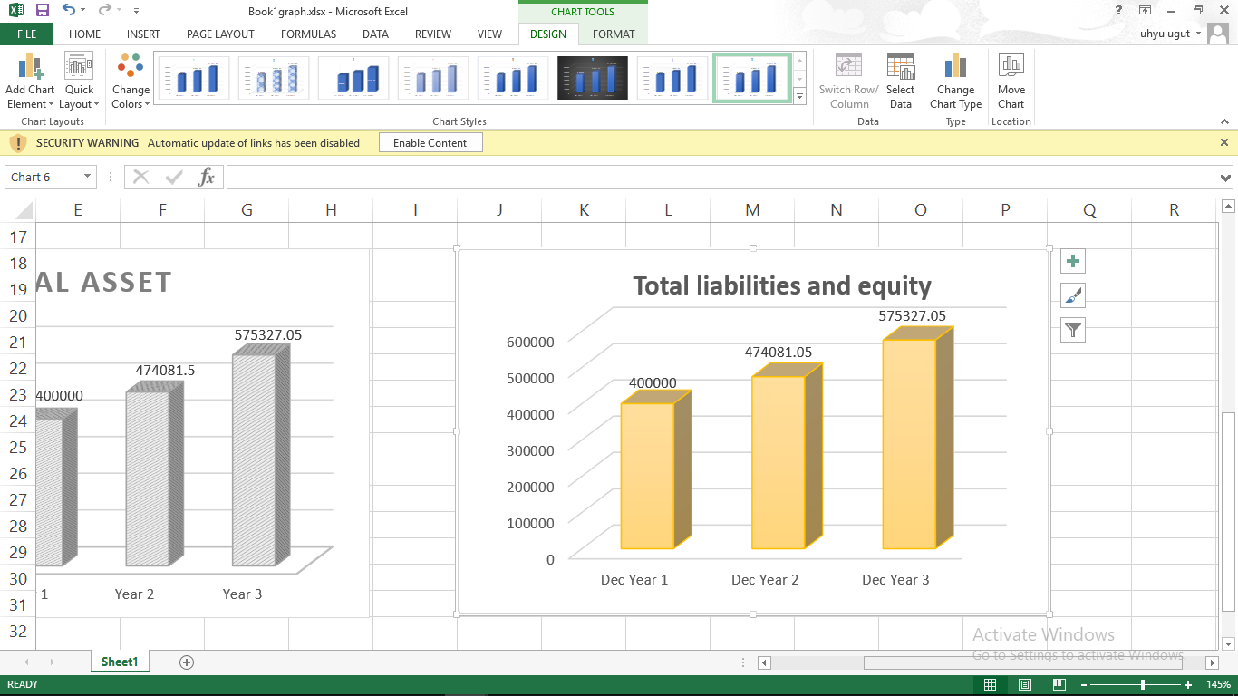
Financial
Management
Plan

Slide 12
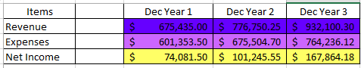
Important assumption

Slide 13
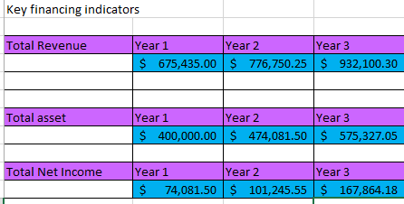
Key financing indicators

Slide 14
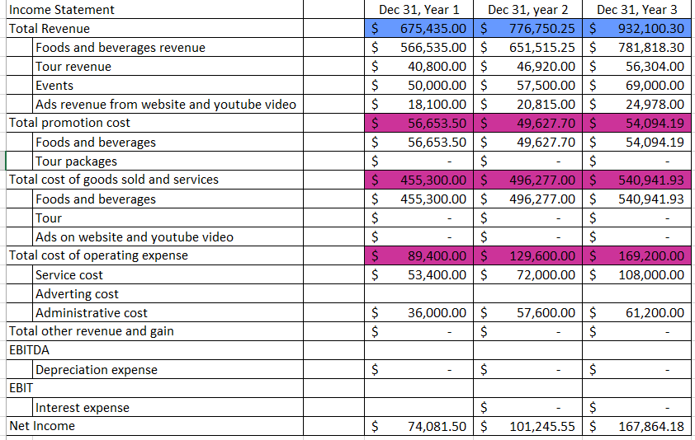
Profit and Loss

Slide 15
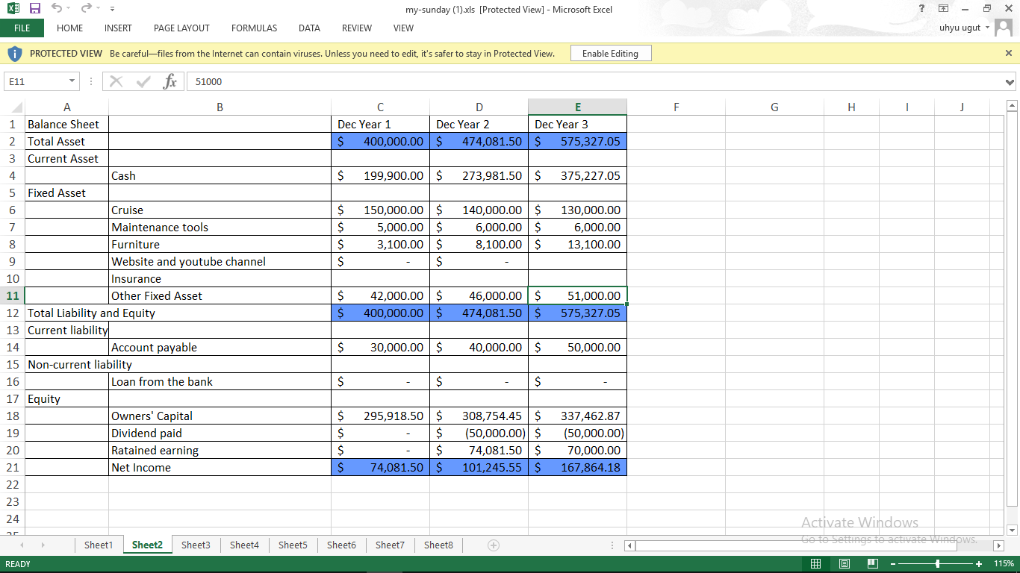
Balance Sheet

Slide 16
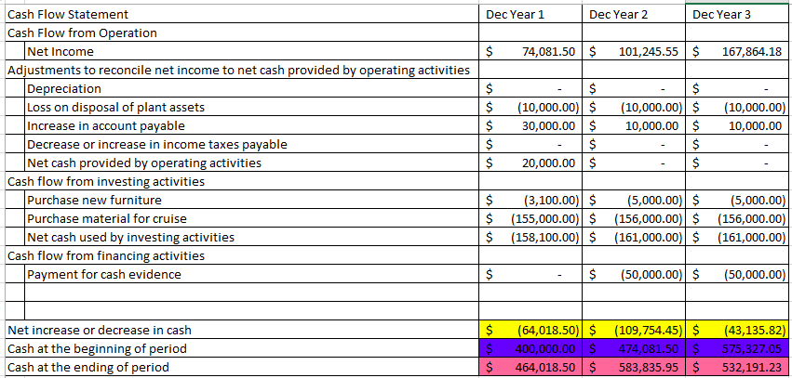
Statement of Cash Flow

Slide 17
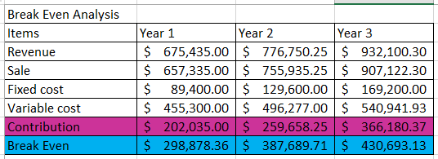
Break even

Slide 18
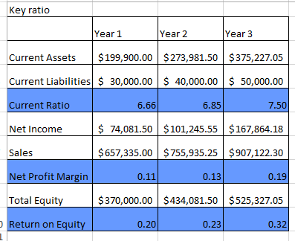
Key Ratio

Slide 19
Thank YOU…

