Slide 1
Marketing Mix:
4ps
Group 3 : Sok sotheara, Uy sovannarong, yon Sorakyos

Slide 2
Contents:
Introduction
Product
Price
Place
Promotion
Case Study

Slide 3
Introduction
What is the marketing mix?
  Marketing mix is about putting the right product or a combination thereof in the place, at the right time, and at the right price. The difficult part is doing this well, as you need to know every aspect of your business plan.
  The 4ps are the foundation of marketing mix. A marketing expert named E. Jerome McCarthy created the Marketing 4Ps in the 1960s. This classification has been used throughout the world

Slide 4
Introduction
The 4Ps of marketing mix are:
Product
Price
Promotion
Place

Slide 5
Product
What is a product?
  Product is defined as anything that can be offered to a market for attention, acquisition, use, or consumption that might satisfy a want or need. Products are not only tangible objectives, but product also include services, events, persons, places, organizations, and ideas.
  For example, iPhone, A Bugatti Chiron, and Brown Ice latte are products, but advice from doctor, business consultant is defined as product as well.

Slide 6
Levels of Product And services
Product planners need to think about products and services on three level such as:
Core benefit
Actual Product
Augmented product

Slide 7
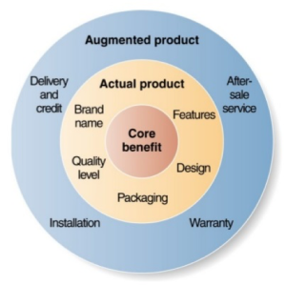
Level of Production and service

Slide 8
Price
When setting prices, a business owner needs to consider a wide range of factors including production and distribution costs, competitor offerings, positioning strategies and the business’ target customer base.
Normally, customers won’t purchase goods that are priced too high, your company won’t succeed if it prices goods too low to cover all of the business’ costs. Along with product, place and promotion, price can have a profound effect on the success of your small business.

Slide 9
Price
Here are some of the various strategies that businesses implement when setting prices on their products and services:
  Pricing at premium: With Premium pricing businesses set costs higher than their competitors. Premium pricing is often most effective in the early days of a product’s life cycle, and ideal for small businesses that sell unique goods.
  Pricing for marketing Penetration: Penetration Strategies aim to attract buyers by offering lower prices on goods and services. While many new companies use this technique to draw attention away from their competition, penetration pricing does tend to result in an initial loss of income for the business.

Slide 10
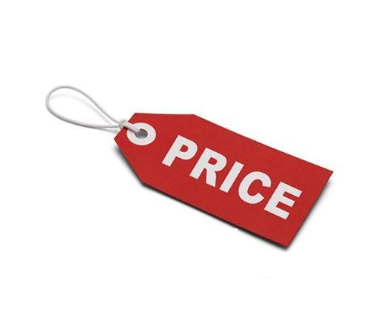
Price
  Economy pricing: Used by a wide range of businesses including generic food suppliers and discount retailers, economy pricing aims to attract the most price-conscious of consumers. With this strategy, businesses minimize the costs associated with marketing and production in order to keep product prices down. As a result, customers can purchase the products they need without extra pay.
  Price Skimming: Designed to help businesses maximize sales on new products and services, Price Skimming involves setting rates high during the introductory phase. The company then lowers prices gradually as competitor goods appear on the market

Slide 11
Price
  Psychology pricing: With the economy still jumping back to full health, price remains a major concern for most consumers. Psychology pricing refers to techniques that marketers use to encourage customers to respond on emotional levels rather than logical ones
  Bundle Pricing: With bundle pricing, small businesses sell multiple products for a lower rate than consumers would face if they purchased each item individually. Not only is bundling goods an effective way of moving unsold items that are taking up space in your facility, but it can also increase the value perception in the eyes of your customers, since you’re essentially giving them something for free.

Slide 12
Place
Place: refers to aspects related to the location at which or the distribution channel through which goods are delivered to customers.
There are 3 elements of place such as:
Types of intermediaries available for distribution
Marketing channels available
Transportation, warehousing, and inventory control

Slide 13
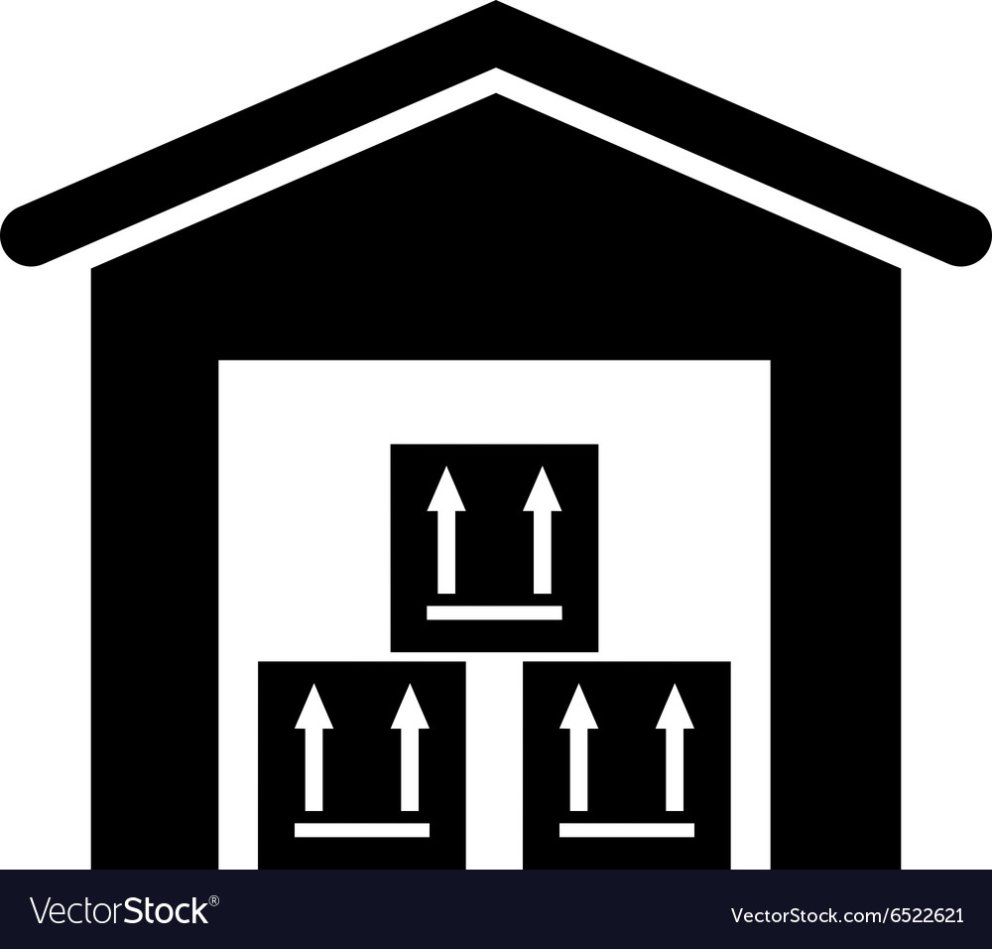
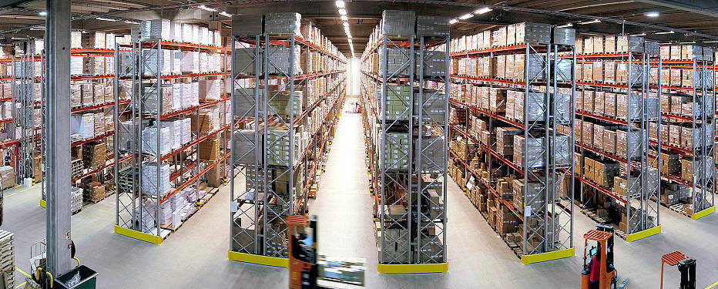
place
Types of intermediaries available for distribution
  Agents/Brokers
  Wholesalers
  Distributors
  Retailers

Slide 14


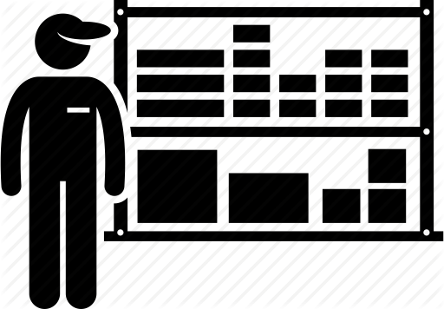

place
03
01
Distributor
Agent/Broker
Ally themselves to complementary product
Represent producer to final user in selling a product
02
04
Wholesaler
Retailer
Buy and sell to other intermediaries for higher price
Purchase from intermediaries then sell to the end user

Slide 15
place
Marketing channels available: A marketing channel is a set of practices or activities necessary to transfer the ownership of goods, and to move goods, from the point of production to the point of consumption and, as such, which consists of all the institutions and all the marketing activities in the marketing process.
THERE ARE 4 TYPES OF MARKETING CHANNELS:
  Direct Selling
  Selling Through Intermediaries
  Dual Distribution
  Reverse Channels

Slide 16



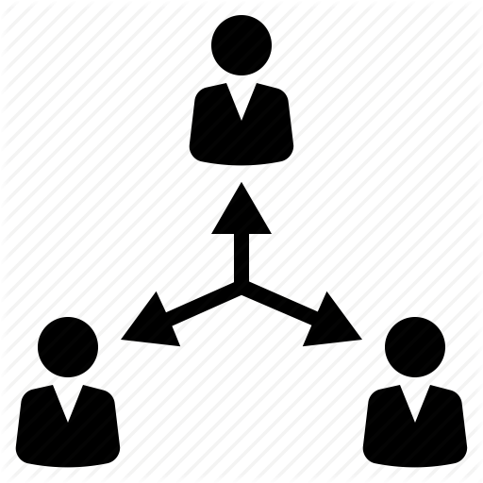
Place
01
03
Direct selling
Dual distribution
Sell products directly to customer
02
04
Selling Through Intermediaries
Reverse channels

Slide 17
place
Marketing channels available
  Direct Selling
  Selling Through Intermediaries
  Dual Distribution
  Reverse Channels
Transportation, warehousing, and inventory control

Slide 18
place
Transportation, warehousing, and inventory control
  Transportation: how we transport our product to customer with good delivery performance, good condition of the goods, and low cost. Ex: Truck, rail, water, pipeline, and air.
  Inventory control: maintain the balance between carrying too much inventory and too little. Ex: JUST-IN-TIME logistics systems, small inventories enough for a few days of operation then new supplies will be available when needed.
  Warehousing: a company must decide on how many and what type of warehouse and where they will be located. Ex: Storage warehouse and distribution center.

Slide 19
promotion
Promotion: The art of communicating a product’s benefits to customers and convincing them to acquire the product once, or, ideally, a repeated number of times.

Slide 20
promotion
The major promotion tools are defined as follows:
Advertising
Sale promotion
Personal selling
Public relations
Direct and digital marketing
Corporate image
Sponsorship
Guerrilla marketing
Product placement

Slide 21
promotion
The major promotion tools are defined as follows:
Advertising
Sale promotion
Personal selling
Public relations
Direct and digital marketing
Guerrilla marketing
Product placement

Slide 22
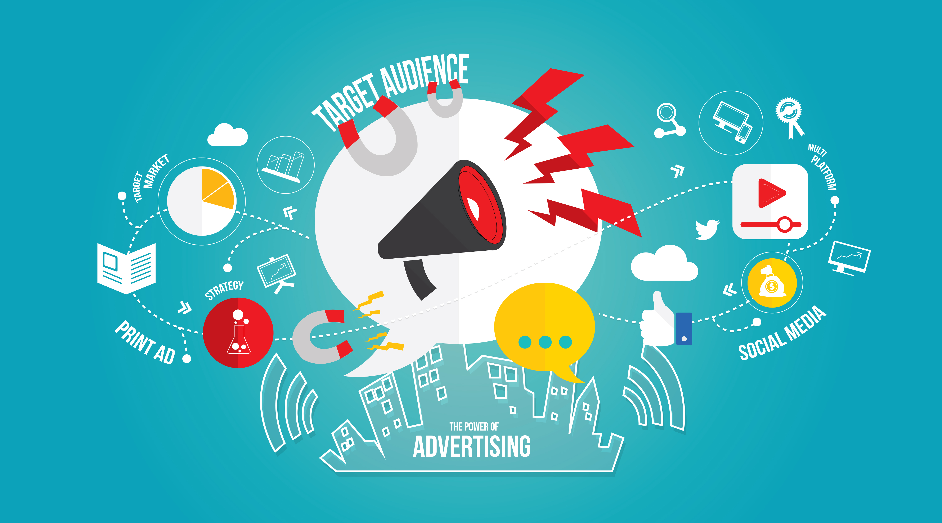
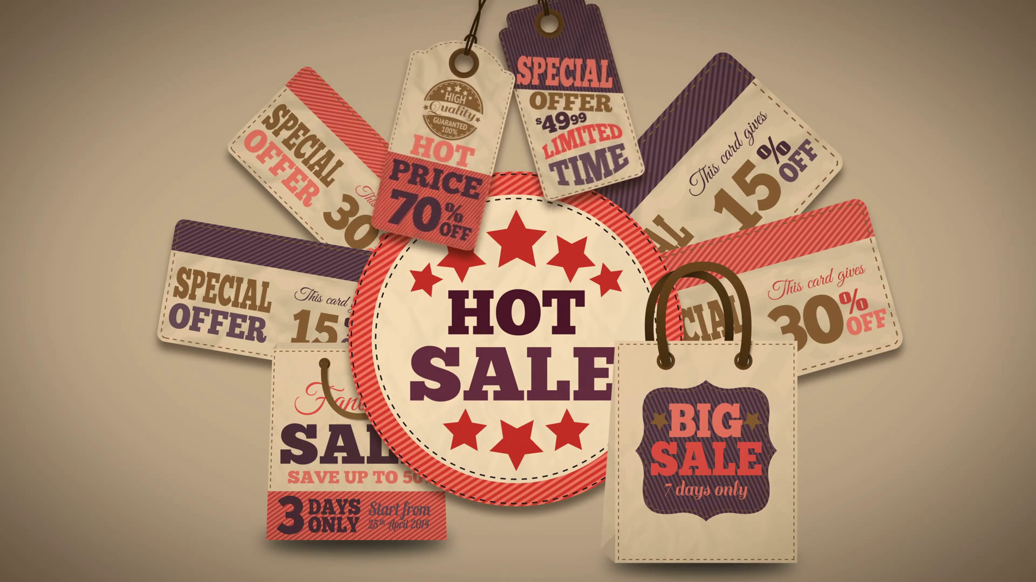
Promotion
advertising
Sale promotion

Slide 23

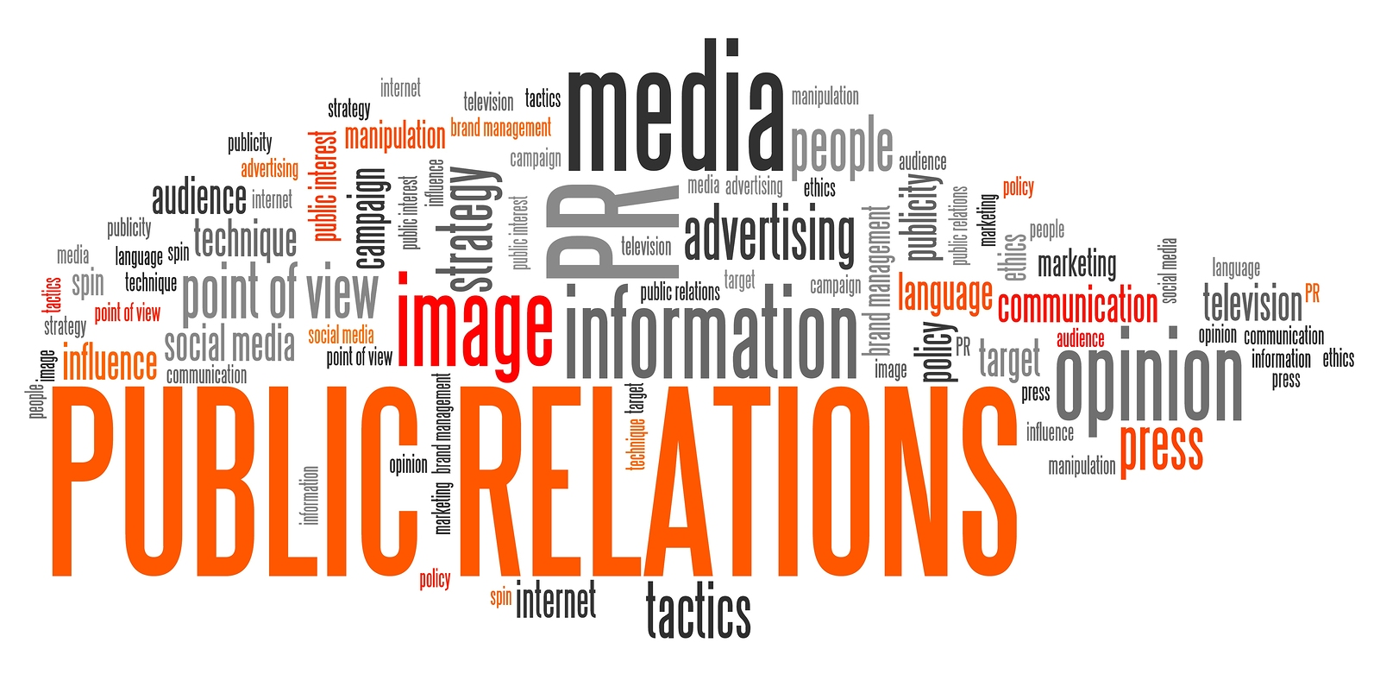
promotion
Personal selling
Public relation

Slide 24

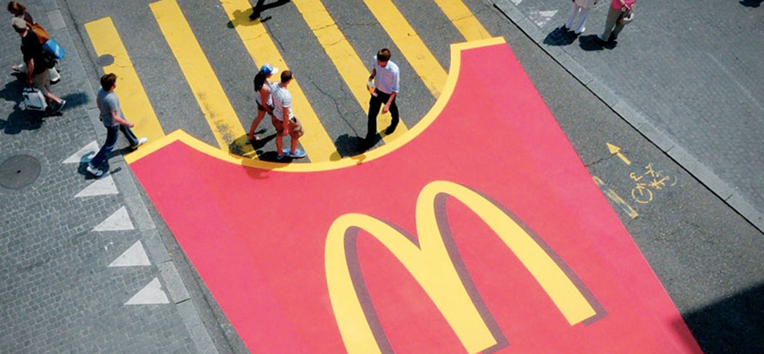

promotion
Direct and digital marketing
Guerilla marketing
Product placement

Slide 25
Case Study :
Cambodia beverage company LTd
Coca Cola is a very popular carbonated soft drink in United State and around the globe. With the demand of 1.9 billion bottles per day serving in 200 different countries, Coca Cola had become the world largest No. 1 beverage distribution system.
Coca cola company had join Cambodia market in 1993, known as Cambodia Beverage Company LTD.
+ Their first warehouse and production line is located on national road No. 5, Sangkhat Jrang Jomres 1, Khan Ressey keo, Phnom Penh.

Slide 26
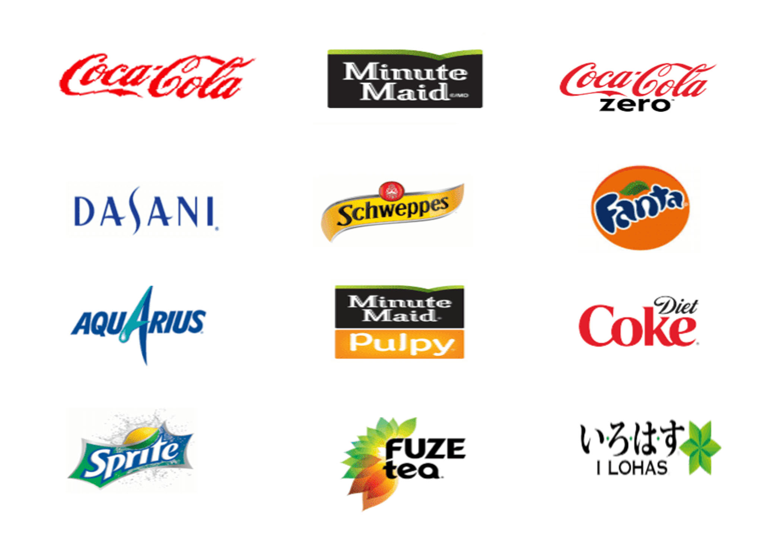
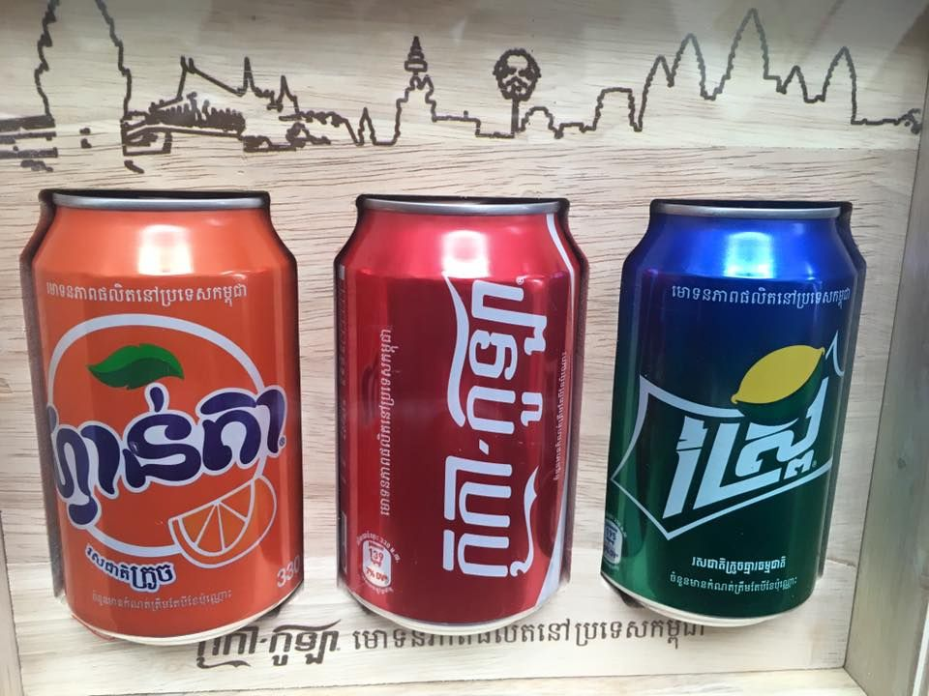
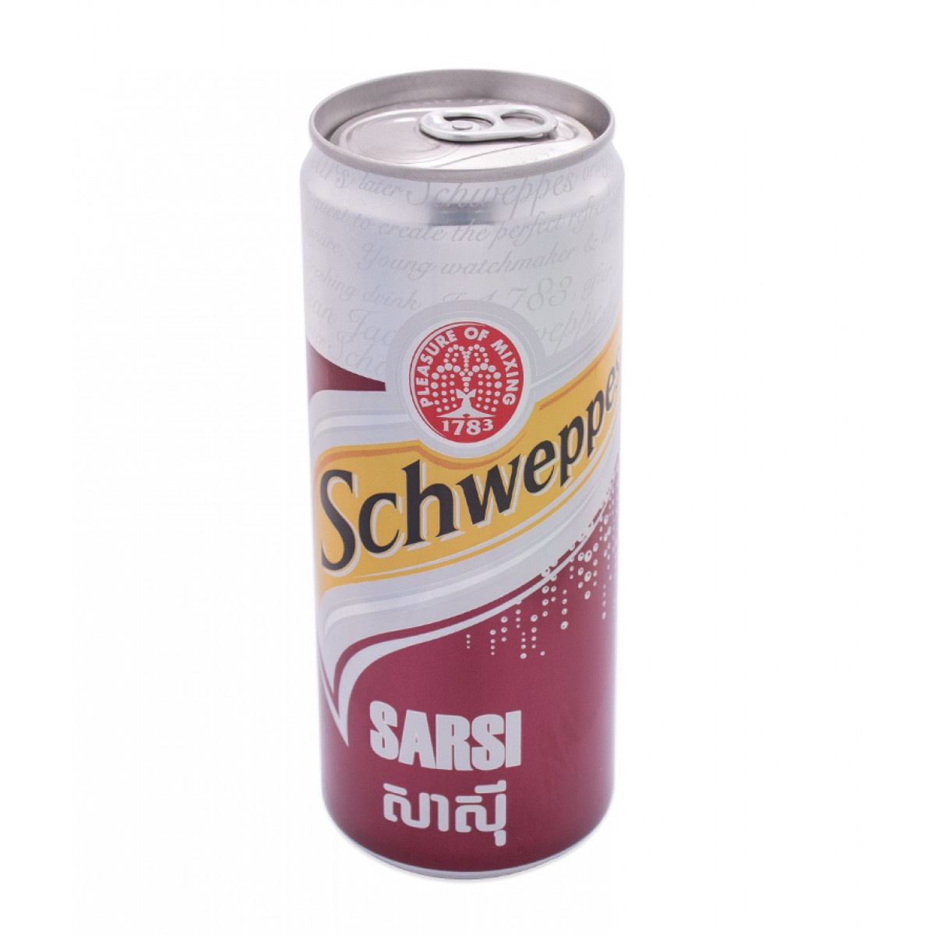
Case Study :
Cambodia beverage company LTd
Product:
+ In 1993, Coca Cola had launch four main beverage brand in Cambodia market.
+ Nowadays, there are more than 12 different brand of beverage served in the market.

Slide 27
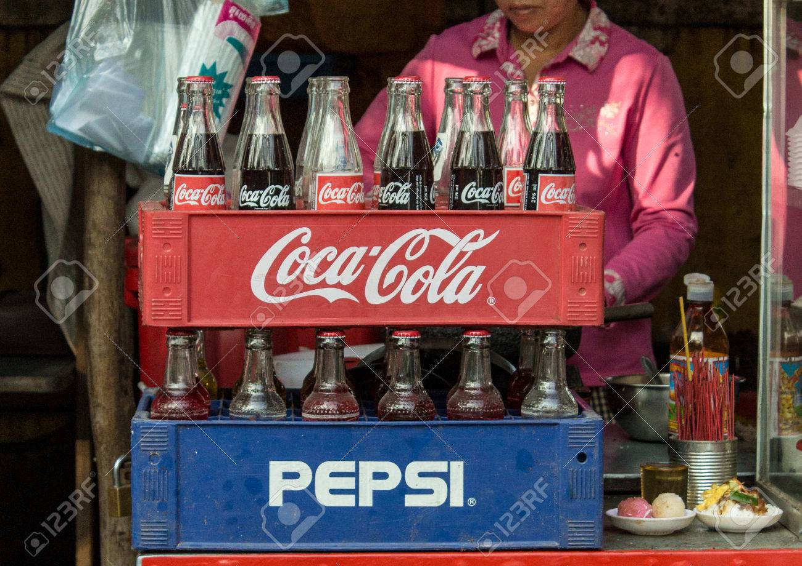
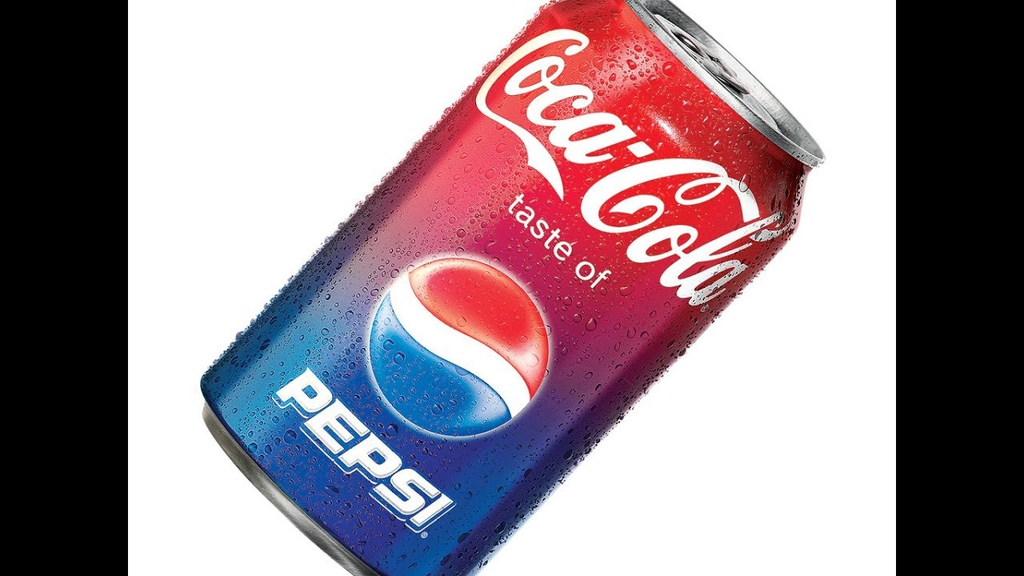
Case Study :
Cambodia beverage company LTd
Why Coca Cola seem to be a unique product compared to it competitor ?
The unique taste of different product : Coca Light, diet…
High distribution system to fulfil the demand
Invest more to increase the quality and quantities

Slide 28
Case Study :
Cambodia beverage company LTd
Price:
+ This is one of the main strategy where Coca Cola company seem to influence more by its competitor, Pepsi.
+ Both of these competitive company would think neither not to give a high price that customer can’t afford nor to give a low quality of product.
There are four different pricing strategies that Coca Cola had used in Cambodia market to insure and guarantee that they can win over their competitor such as: Psychological Pricing, Promotional Pricing,
Segmented Pricing and Discriminatory Pricing.

Slide 29
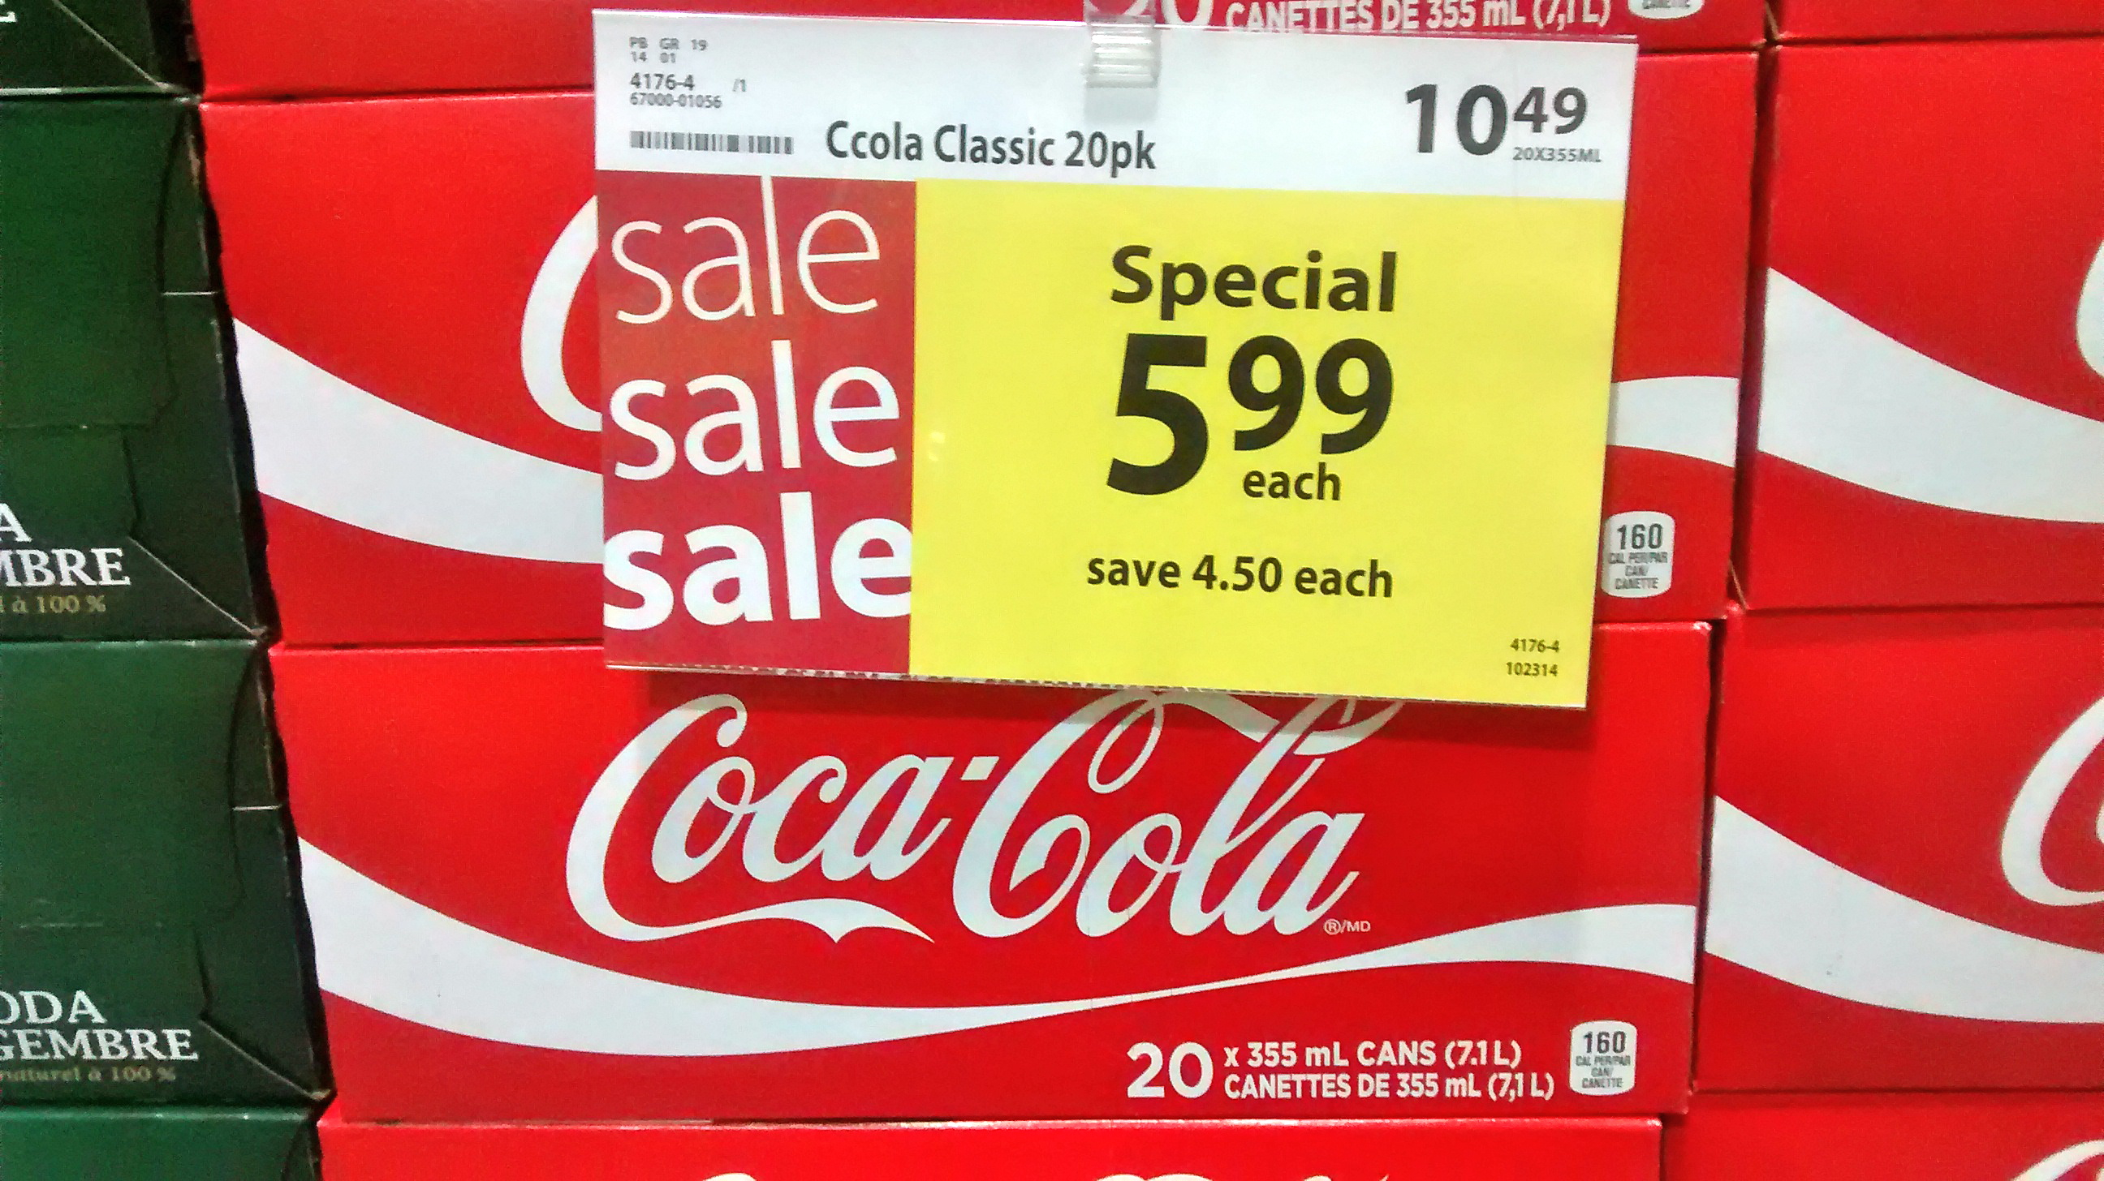
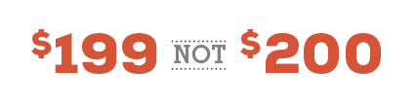
Case Study :
Cambodia beverage company LTd
+ Psychological Pricing:
Coca Cola company had used the psychological pricing strategy in 2009 which derive a very effective way to attract and engage the feeling of their customer by influence them to think that price of the coke is lower than other non-alcoholic products or its competitors.

Slide 30
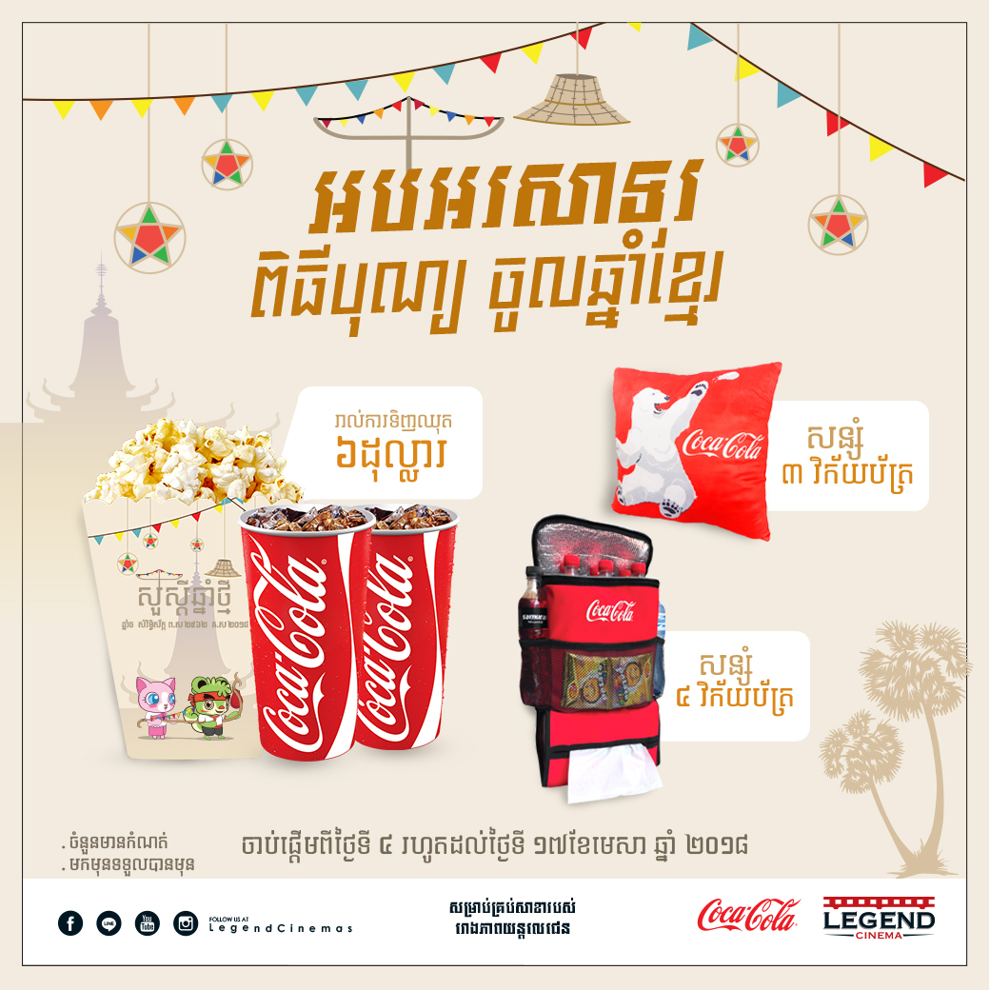
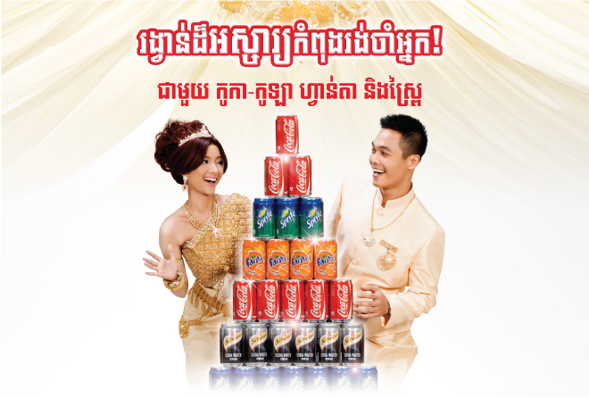
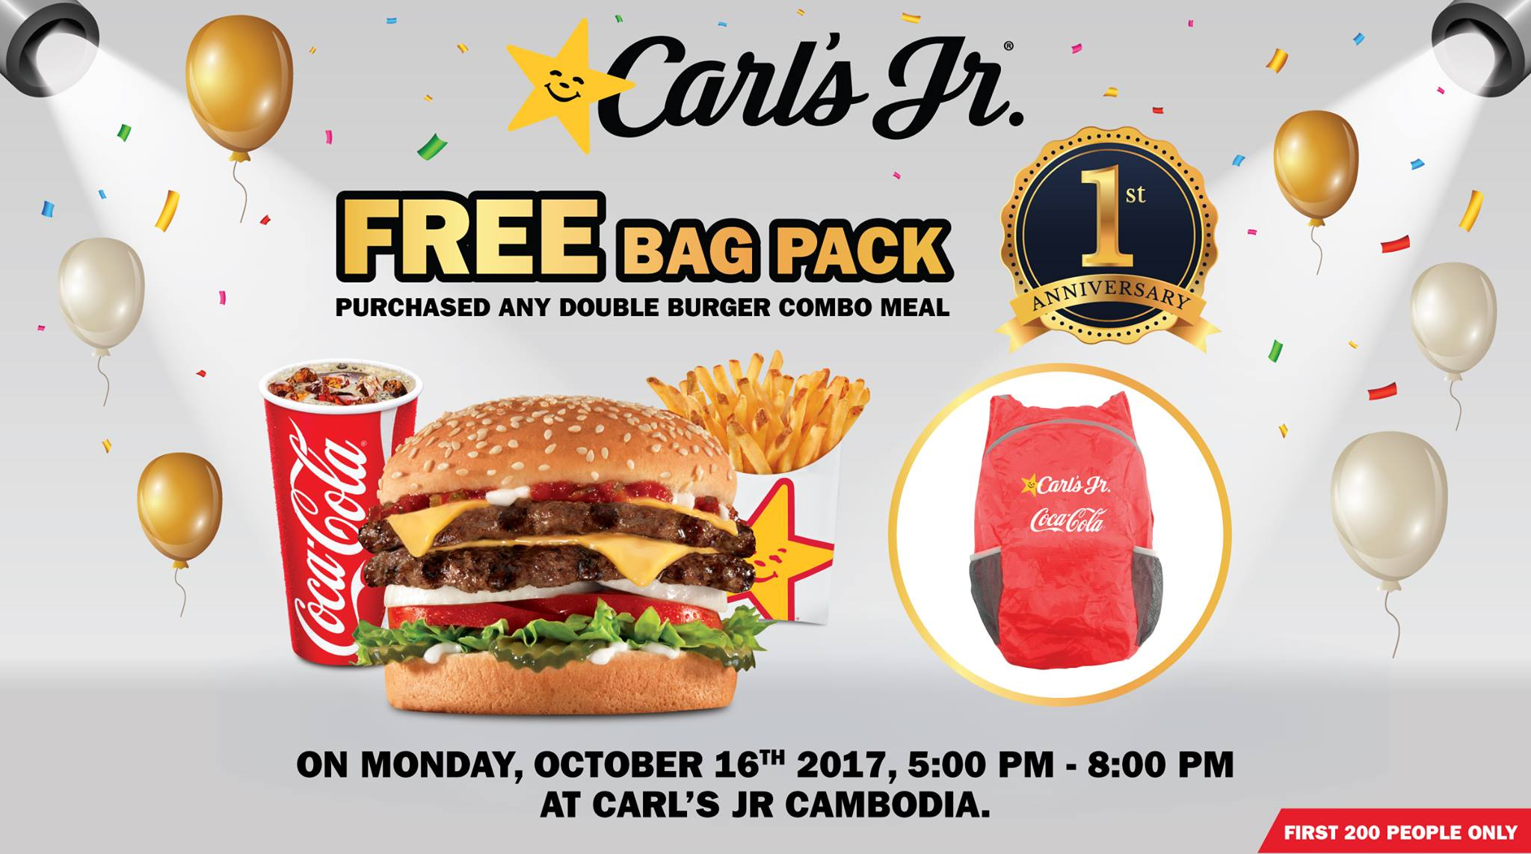
Case Study :
Cambodia beverage company LTd
+ Promotional Pricing:
Within the promotional pricing strategy that Coca Cola company imposed, Cambodian people seem to be more thrilled since the price of coke is lower so they could buy more of it.
Mostly the company would implement different marketing strategy to strengthen and
encourage their distributor channel such as store, retailer, middle men by using both
monetary incentive and non-monetary incentive.

Slide 31
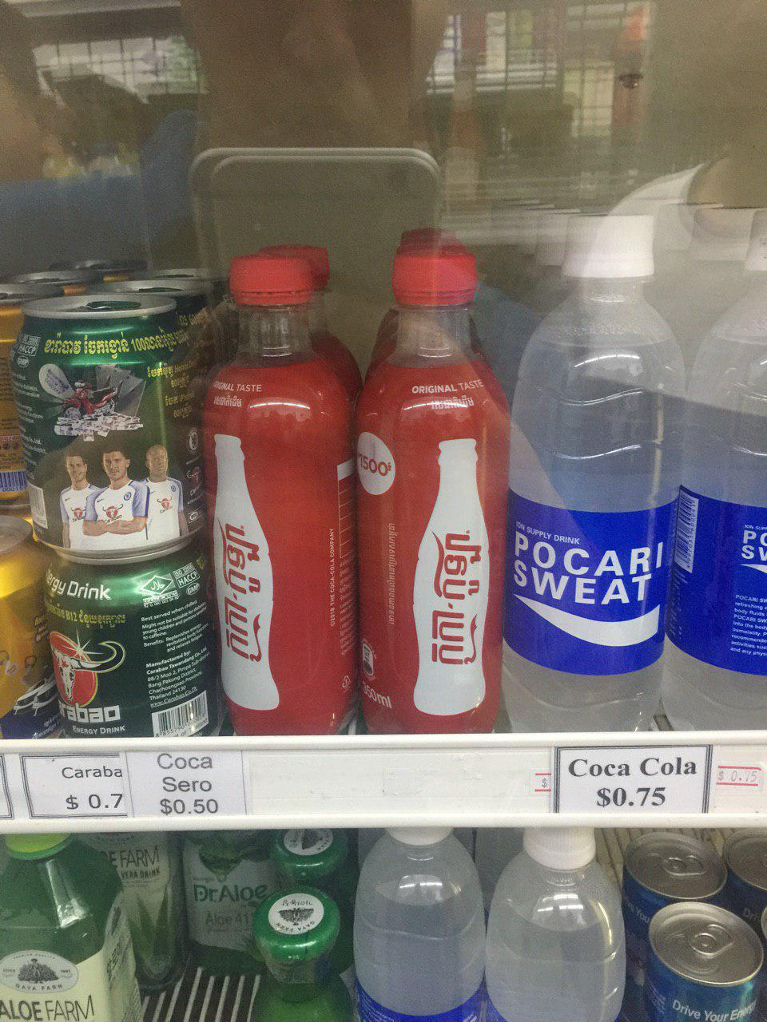
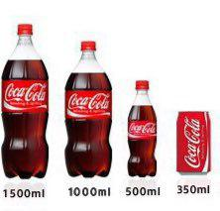
Case Study :
Cambodia beverage company LTd
+ Segmented Pricing:
This pricing strategy is used to increase the sale and profit, since different product will sell at the different price. However there isn’t much cost required to manufacture a product at the same level.
There are many different packaging that serve with different price: 1.5l, 1l, 0.5l as plastic bottle and 350ml, 250ml as aluminum cans.

Slide 32
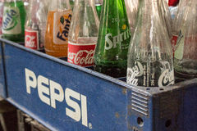
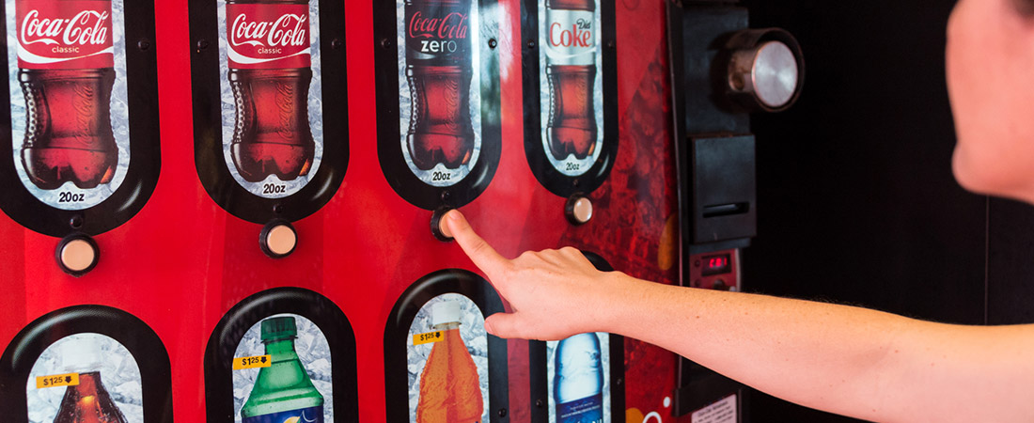
Case Study :
Cambodia beverage company LTd
+ Discriminatory Pricing:
Pricing tactics used to sold for different channel on the market: wholeseller, distributor, store, Automated teller machines (AMTs)….
There are two different way that Coca Cola sell it product:
- Direct selling
- Indirect selling

Slide 33
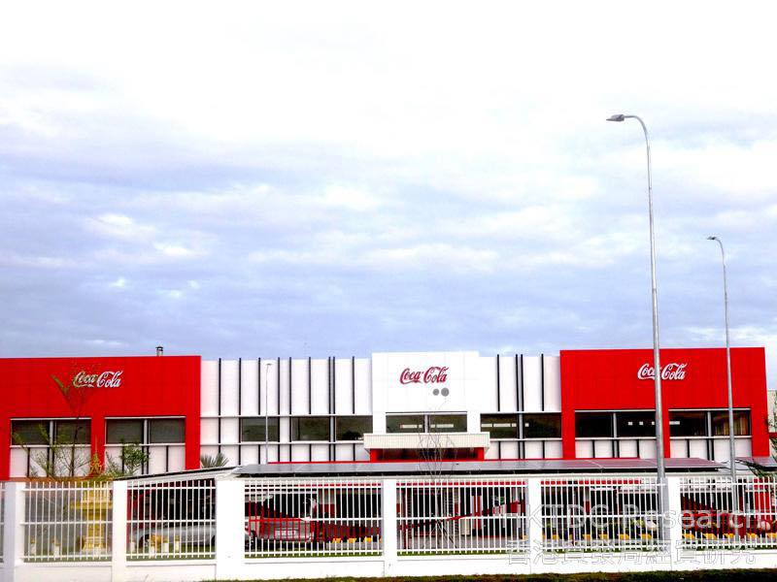
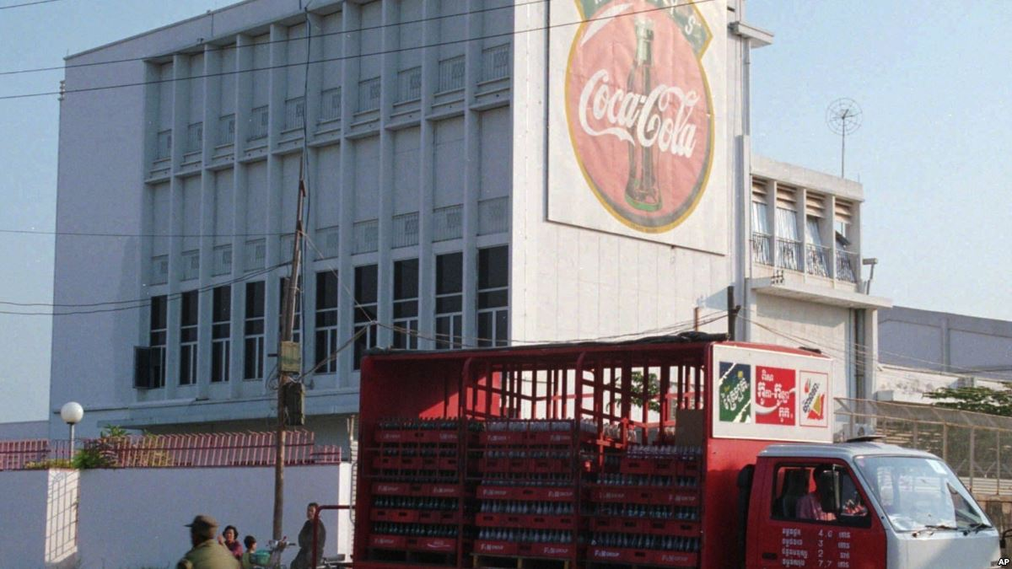
Case Study :
Cambodia beverage company LTd
Place : is the distribution channel to reach company’s target customer. For Cambodia, their goal is to reach every market and retailer all around Cambodia.
Many warehouse, store, super market, retailer is associated with CBC to make sure every customer has their access to used its product.

Slide 34
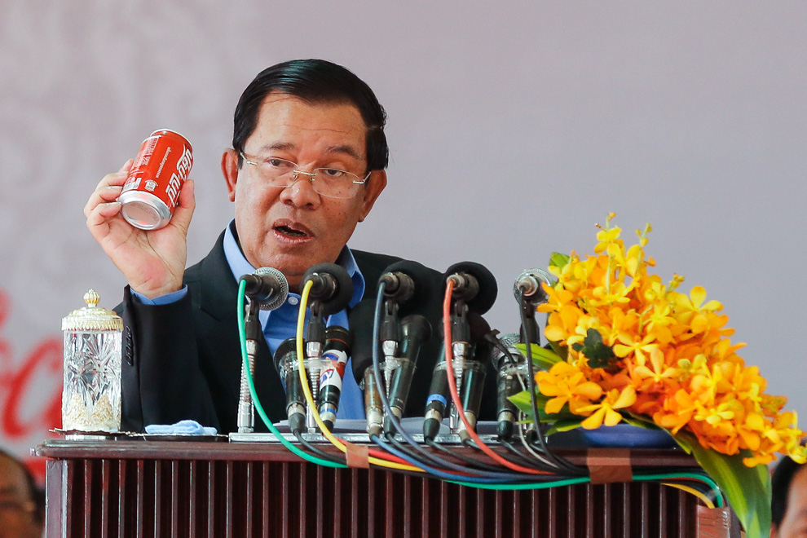
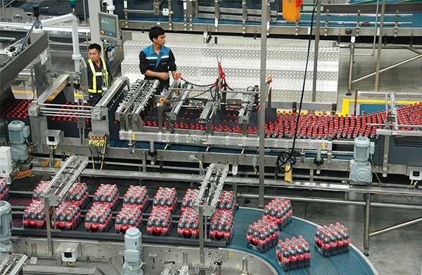
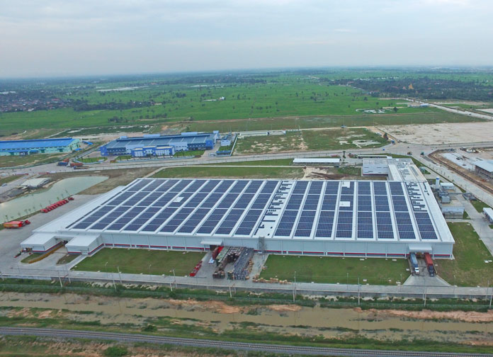
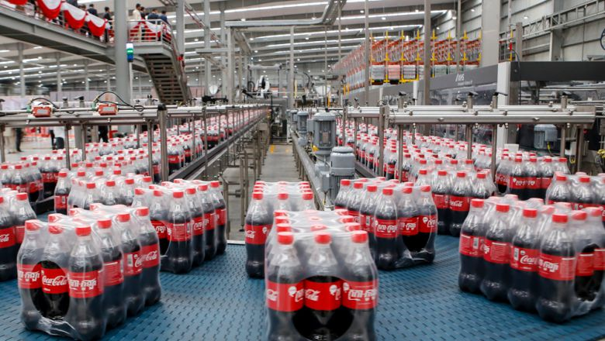
Case Study :
Cambodia beverage company LTd
Place :
When Coca Cola first come to Cambodia in 1993, there is only one distribution place as well as warehouse in Phnom Penh. As they growth rapidly, many branch had created.
In 2016, CBC had invested about 100 million dollar to construct a big production process in Phnom Penh Special Economic Zone for 3 main reasons.

Slide 35
Case Study :
Cambodia beverage company LTd
Promotion :
To compete intensively with its competitor, CBC had launch ‘Taste the feeling’ campaign in 2016 to promoted its brand deeply into the market that can reach to their potential customer.
CBC had imposed many different profession of transmission to encourage and influence customer to increase their demand.
+ Advertising: The company had used many diverse form to promoted their product through ads by TV, radio, school, big screen on highway…

Slide 36
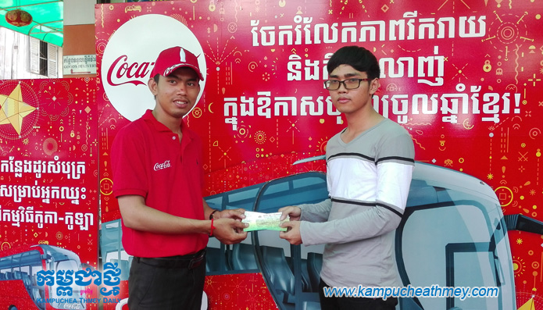
Case Study :
Cambodia beverage company LTd
+ Sale promotion: will be done mostly on holiday occasion such as Khmer New Year, by giving out discount, coupons …
+ Public relation: by doing concert, event or sponsorship on different programs. CBC had spend lot of money in 2003 to reach their information of the product to the new customer
+ Direct and digital market: CBC also try to emerge and approach the tactic of direct manner in the communication process: sending slogan by mobile on holiday occasion, giving out catalogs in the mall ….

Slide 37

Case Study :
Cambodia beverage company LTd

Slide 38
Reference
https://en.m.wikipedia.org/wiki/Promotional_mix
https://courses.lumenlearning.com/boundless-marketing/chapter/channel-intermediaries/
https://courses.lumenlearning.com/boundless-marketing/chapter/marketing-channels-in-the-supply-chain/
https://quickbooks.intuit.com/r/pricing-strategy/6-different-pricing-strategies-which-is-right-for-your-business/
https://www.linkedin.com/pulse/coca-cola-pricing-strategy-shashank-jindal
https://www.mbaskool.com/marketing-mix/products/16786-coca-cola.html
https://www.worldofcoca-cola.com/about-us/coca-cola-beverages-products/
Kotler, P. & Armstrong, G. (2016). The Principle of Marketing (16th edition global ver).

Slide 39
THE END
THANK YOU VERY MUCH for your attention
Feel free to ask any question!

