Slide 1

Motivations & Hurdles in choosing for higher education

Slide 2
About us
Group 3
TRAN Thi thuy trang
TABEI Nadir
TOMY Melvin
SOK Sotheara

Slide 3
Table of content
01
02
03
04
Issue Description
Topic Guide
Analysis
Recommendations

Slide 4
01
Issue Description
Brief description of the issue and research questions

Slide 5
What are the motivations and hurdles in choosing Audencia for higher education?
France
Nationalities
Food & Agriculture
MBA
Reputation
Program
IMM
Networking
International
Tuition fees
Age
DMF
Employability

Slide 6


Process
Not logical
1
Pilot test
Too broad
2
Final version
Focus and concrete

Slide 7
02
Topic Guide
Questionnaire explanation

Slide 8
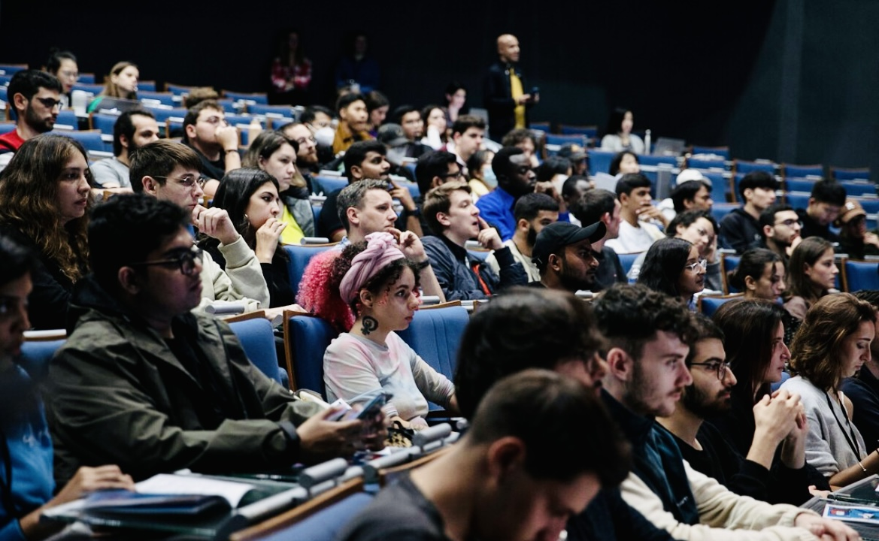



The subject of study
Preliminary information
Striking questionnaire
1
Motivation
2
Hurdle
Age
3
Nationality
Program
Recommendation

Slide 9
Questionnaires
Hurdle & Recommendation
What were the difficulties when you were searching for information about Audencia?
What are the biggest points that let you ever think you should choose another school over Audencia?
What would you have thought if the tuition fee was higher along with the ranking?
How did Audencia’s website influence you in choosing to study here? (application system, uploading of files, communication with the school)
Motivation
What were the main criteria for choosing a school?
How easy/difficult was it to find the program that corresponds to you in Audencia?
How did Audencia’s website and social media content influence you in choosing to study here?
How did Audencia's France/international presence help you in your choice?
Can you explain how can Audencia contribute to your professional and personal projects?
Besides your academic projects are there some other aspects of Audencia that made you choose Audencia?

Slide 10
03
Analysis
Capture the main characters of population questioned

Slide 11
Motivations
Ranking
National presence
International presence
Plurality of programs available
Quality of the website to find information

Slide 12
Hurdles
High price along with better ranking
Not much housing information
Lack of facilities content on the website

Slide 13
04
Recommendations
To maintain Audencia's position of being the best

Slide 14
The feasible recommendations
1
Provide More Assistance in Terms of Accommodations
2
More Information About the Classes’ Schedule on The Websites
3
All In One Place Information Especially for Student Life
4
Update The Information About Each Program Regularly

Slide 15
Food for thoughts recommendations
Put Available Resources to Good Use (I.E. Student Association Room)
Dedicated Smoking Areas
Expand The Available Space for Resting
More Food Choices at The Cafeteria
Provide Spacious Cafeteria
Try To Shorten the Length of The Classes Per Day
Caring About the Students' Well-Being
Cleanlier Facilities (I.E. Toilet)
Provide Faster Internet Access
A Gentle Reminder for The Students About All Procedures They Must Follow
One IC Buddy Per One Group of Students
Toughen The Selection Criteria (I.E. Conduct Interview to Assess Student’s Competences)

Slide 16
Thanks!
Do you have any questions?

