Slide 1


Promotion Mix
Group 4:
HOY Chankanika
YON Sorakyos
THON Chanmarianet
SOK Sotheara
Professor:
CHHEAV Narath
Subject:
TD Operational Marketing

Slide 2
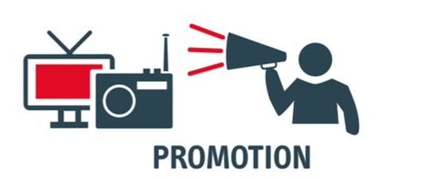
Content
Introduction
Promotion Mix tools
  Advertising
  Public Relation
  Personal Selling
  Sales Promotion
  Direct and Digital marketing
Conclusion
Reference

Slide 3
Introduction
Product
Price
Placement
Promotion
Definition:
↳ Not a single tool but a mix of several tools used for :
Engage customers
Persuasively communicate customer value
Build customer relationship.
Tools:
Advertising
Public Relation
Personal Selling
Sales Promotion
Direct & Digital marketing

Slide 4
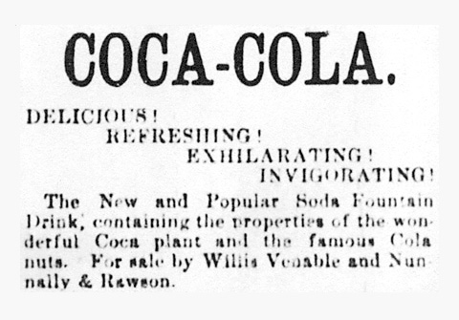
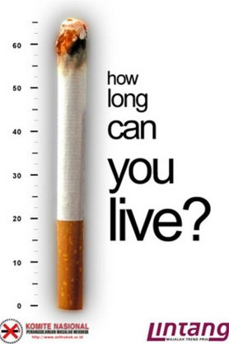
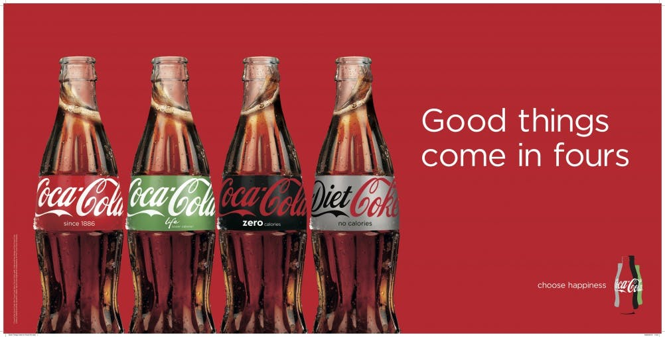
II. Promotion Mix tools
Advertising
“ any paid form of non-personal presentation or promotion of ideas, goods, or services by an identified sponsor ”
→ Advertising Objectives
Informative ads:
Announce, suggest New products.
Explain the benefit of the product
Communicate customer value
Build brand image

Slide 5
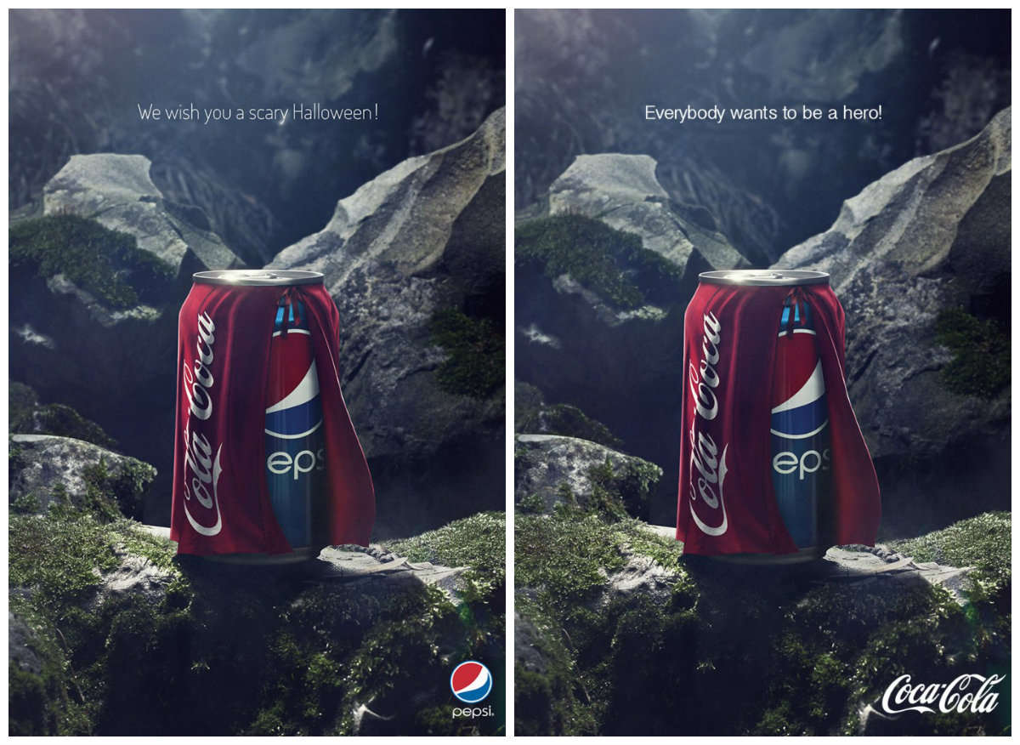
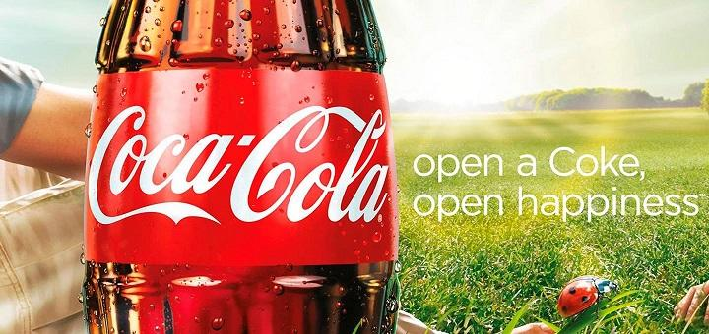
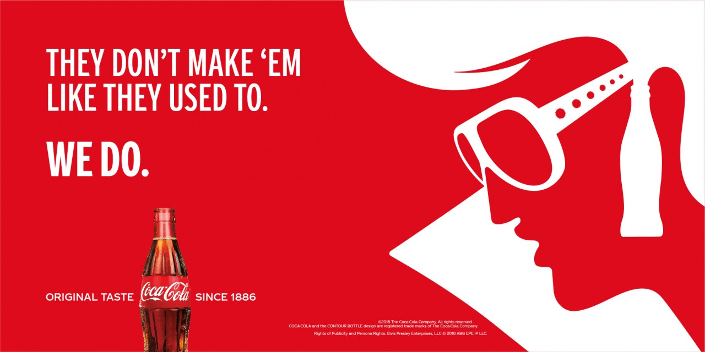
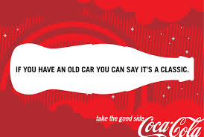
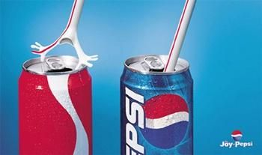
Persuasive ads:
Reminder ads:
Brand preference
Persuade customer
Change customer perception
Lead to comparative ads
Remind the needs of product
Remind customer where to buy
Keeping the brand in customer’s mind
→ Selecting advertising Media
Determining these to achieve the ads objectives:
Reach : % of people exposed
Frequency: repetition times of exposure
Impact: Qualitative value

Slide 6
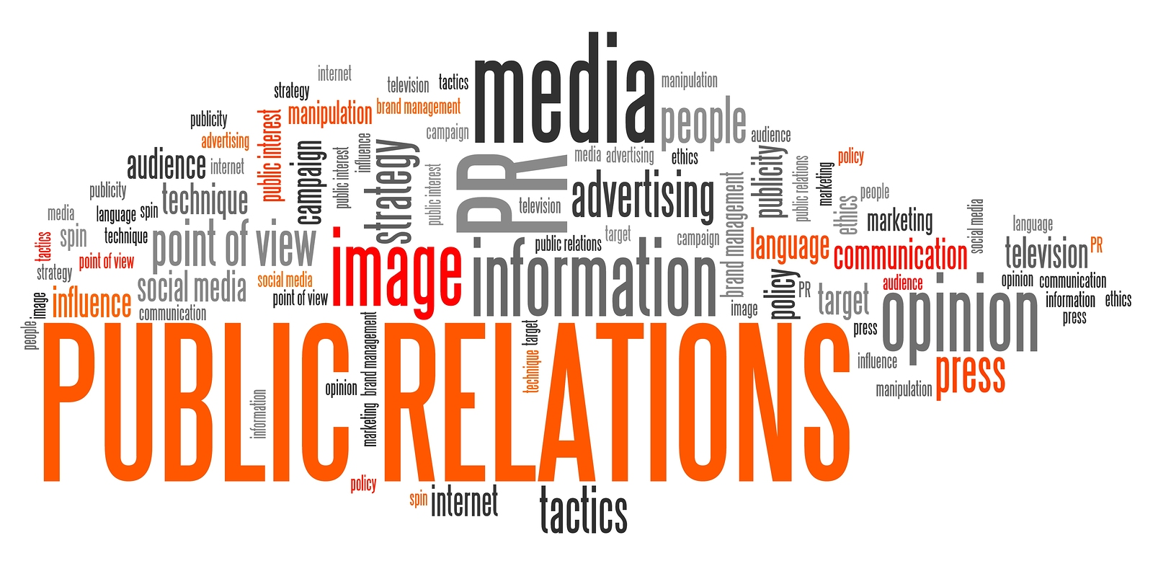
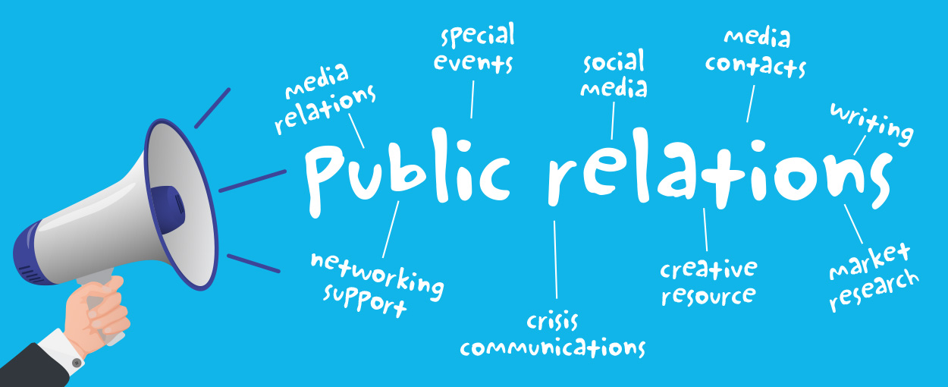
Public Relation
What is Public Relation? Is it effective for company?
Public Relation is is the form of marketing used to promote product, service, and the company itself through the internet ……

Slide 7
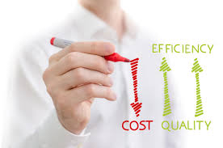
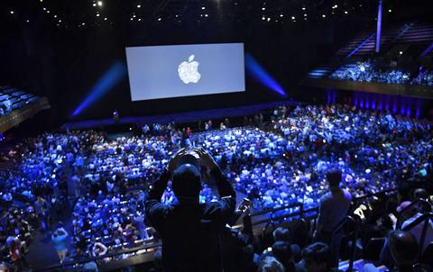
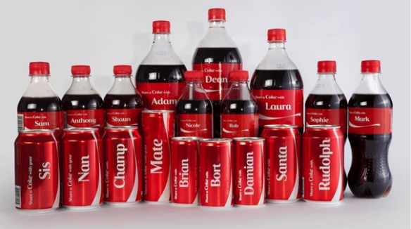
Public Relation
Public Relation department seem to spend small portion of the overall marketing budget…….
PR seems to be a marketing stepchild where the company can use its limited and dispersed use.

Slide 8
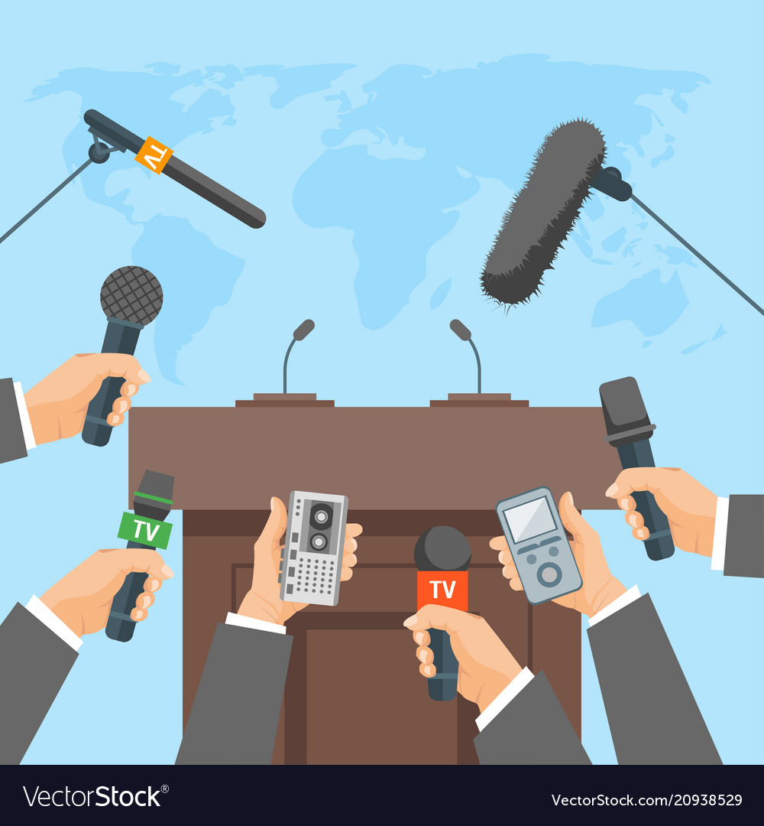


Public Relation
There are various type of public relation functions such as:
- Press relations or press agency
- Product publicity
- Public affairs

Slide 9
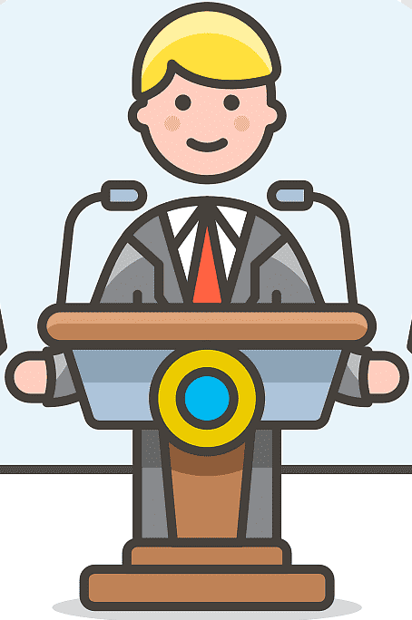


Public Relation
There are various type of public relation functions such as:
- Lobbying
- Investor relation
- Development

Slide 10
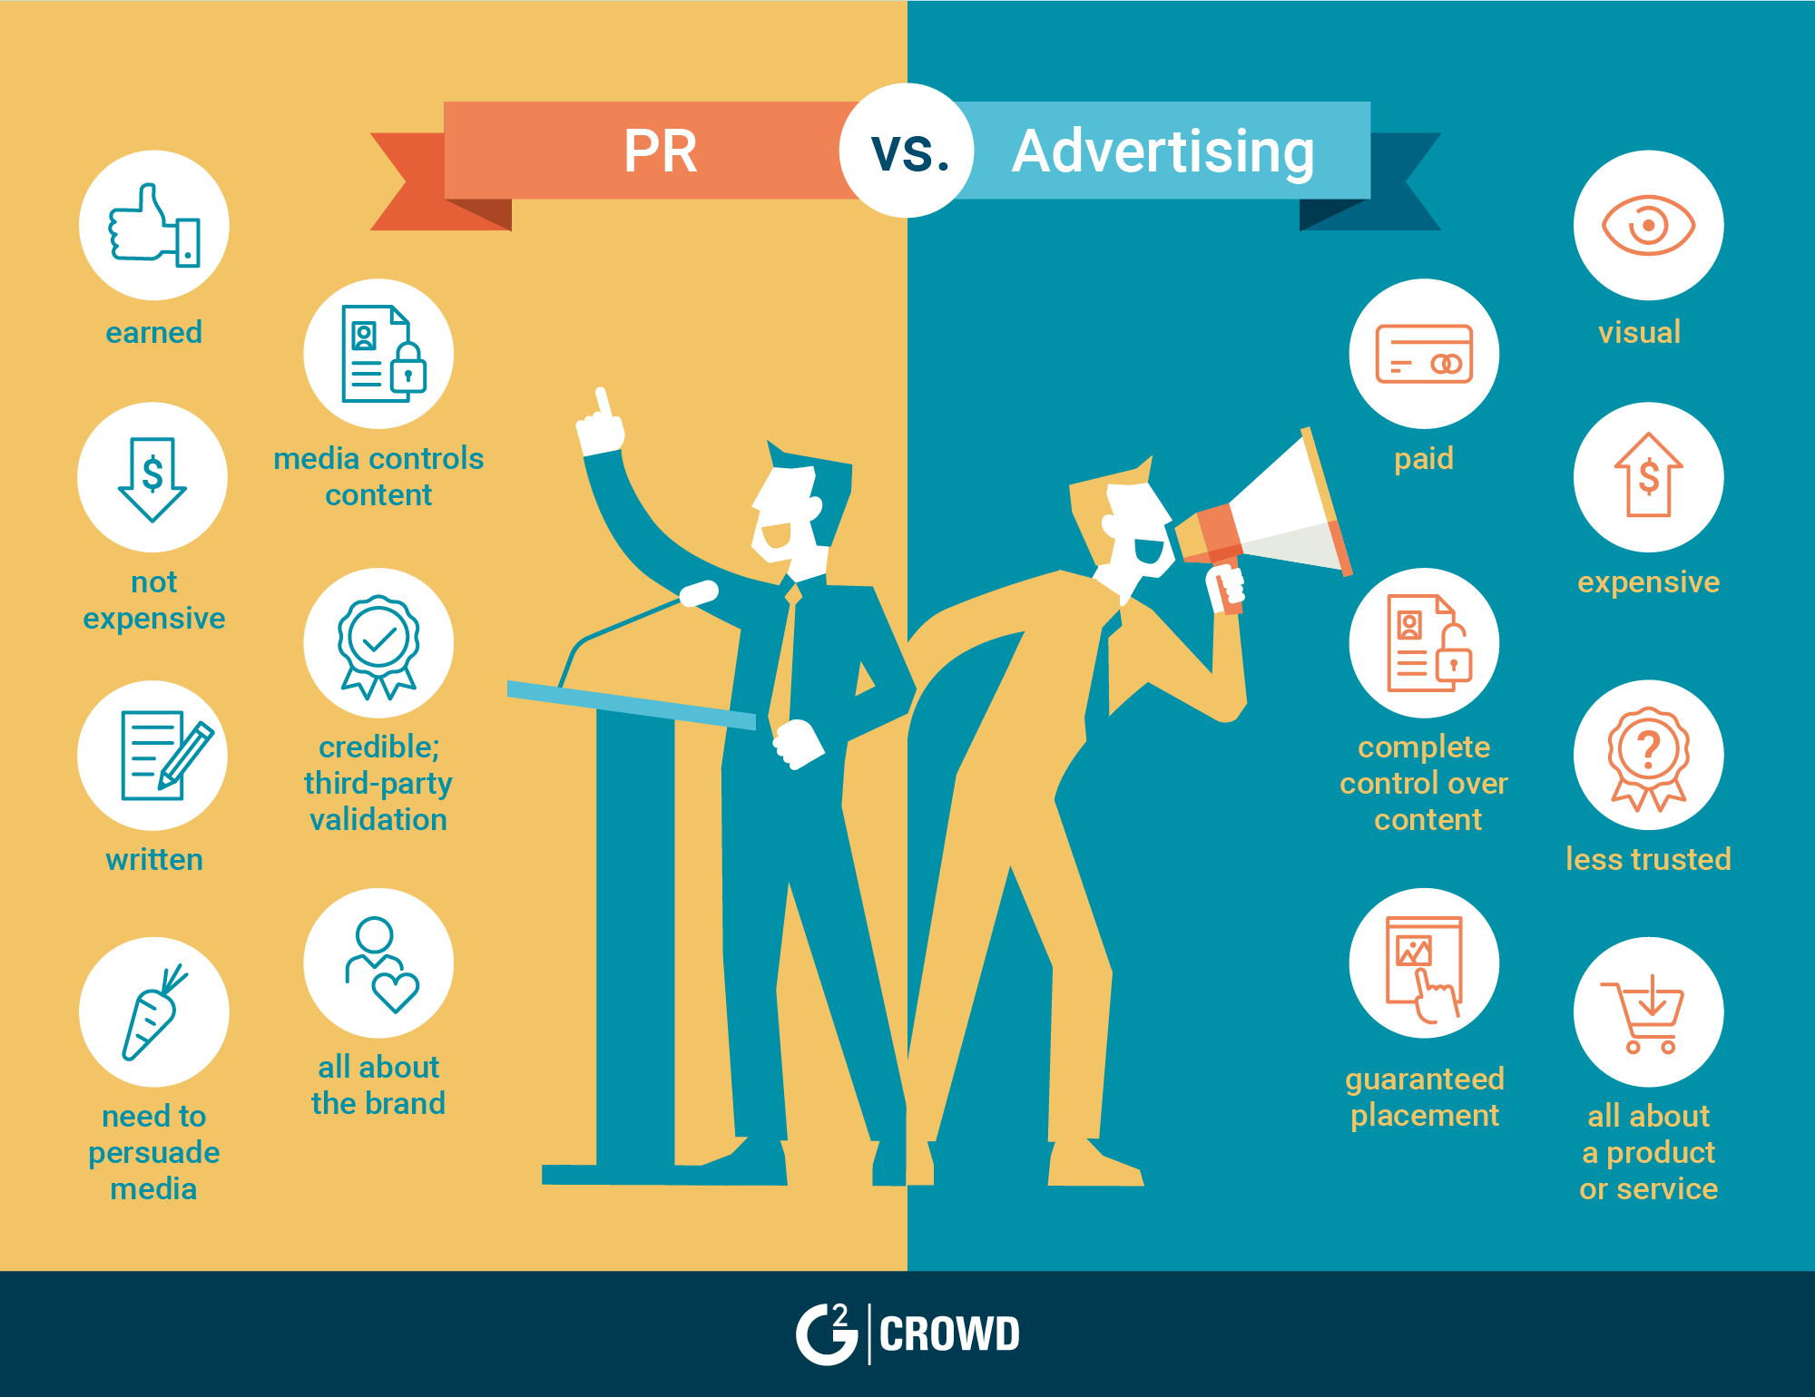
Public Relation Vs Advertising

Slide 11
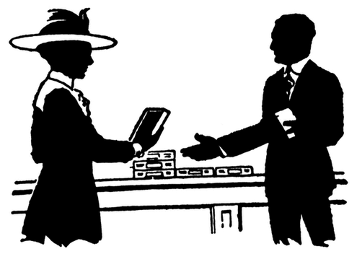
Personal Selling
What is Personal Selling?
The effective face to face promotional tool which is the interpersonal interaction between customers and a company representative.
The purposes of the personal selling are to engage customers, make sales, and build strong customer relationships.
What is company representative or salesperson?
An individual who represent a company to customer by performing one or more of the following activities: Prospecting, Communicating, Selling, Servicing, Information gathering, and Building customer relationship.

Slide 12
Personal selling
Personal selling process: 7 Steps
Prospecting
Identify qualified potential customer
Pre-approach
Gathering customer’s information
Approach
Presentation
Handling objection
Closing
Follow up
First meet customer
Tell the value story and show the solution for customers’ problem
FAB Method
Seek out, Clarify and Overcome customer objections
Ask the customer for an order
Ensure customer satisfaction and repeat business

Slide 13

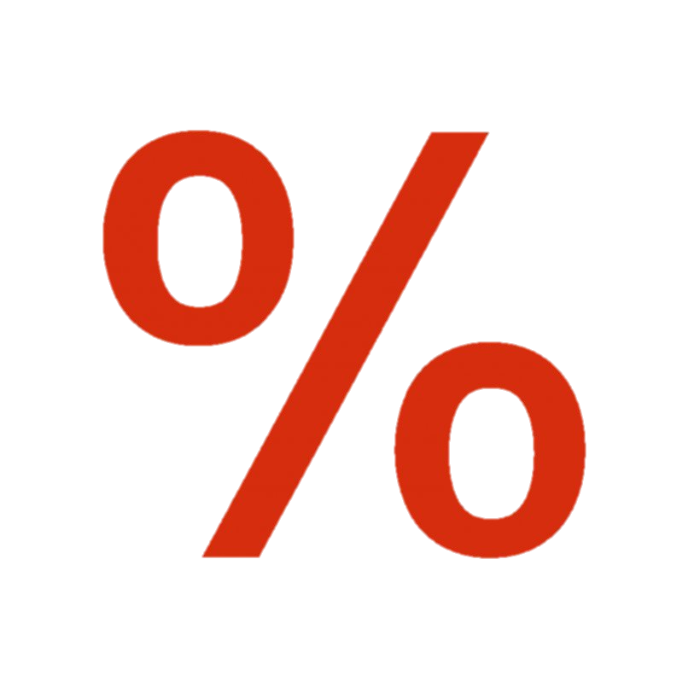

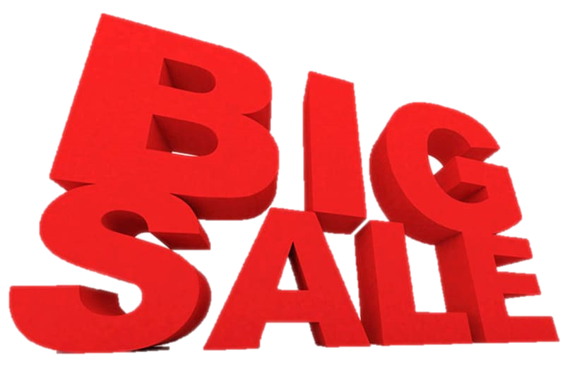
Sales Promotion
What is Sale Promotion?
The incentive given along with the advertising and personal selling. Sale promotion is the short-term incentive to encourage the purchase or sale of a product or service which offer customers the reason to buy NOW.
There are 3 main objectives which are
  Customer promotion: encourage Short-term buying and boost customer brand involvement
  Trade promotion: persuade customer to carry new items, more inventory, buy ahead and promote company’s products
  Business promotion: generate business leads, stimulate purchases, reward customers, and motivate salespeople

Slide 14
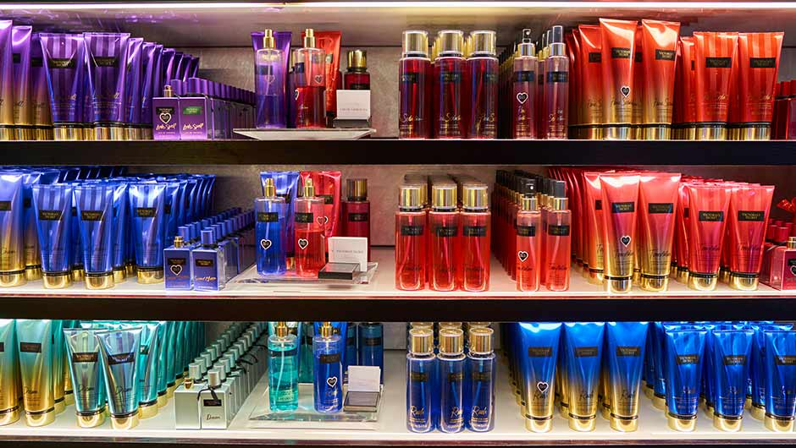

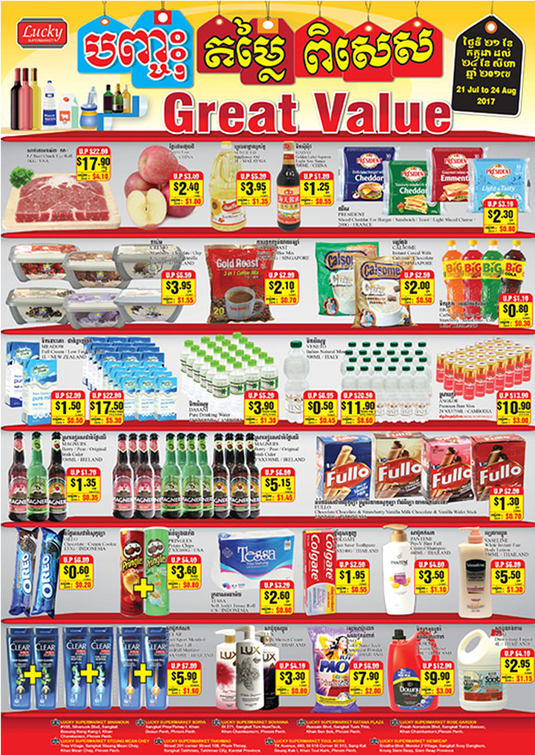

Sales Promotion
Sales promotion tools
In the sale promotion the tools are used by two different classification.
Consumer oriented promotions
Samples
Coupons
Rebates or
Cash Refunds
Price off or discount

Slide 15


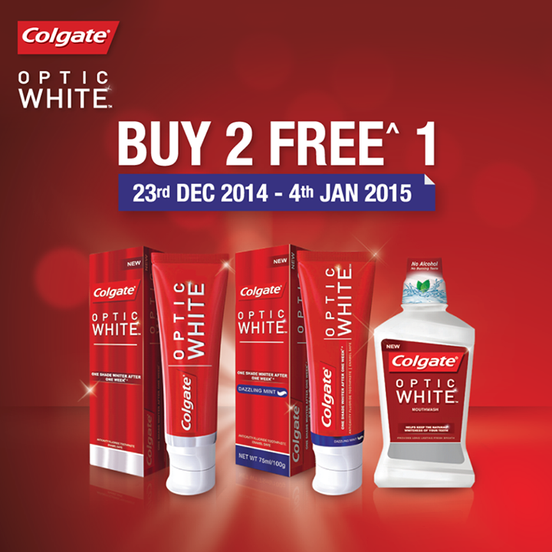
Sales Promotion
Sales promotion tools
In the sale promotion the tools are used by two different classification.
Consumer oriented promotions
Contests, sweepstakes, and games
Loyalty program
Premiums

Slide 16
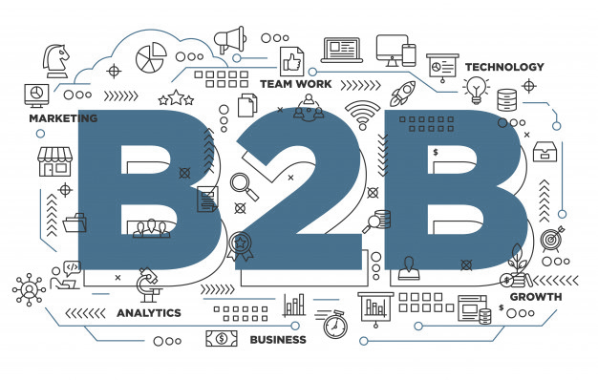
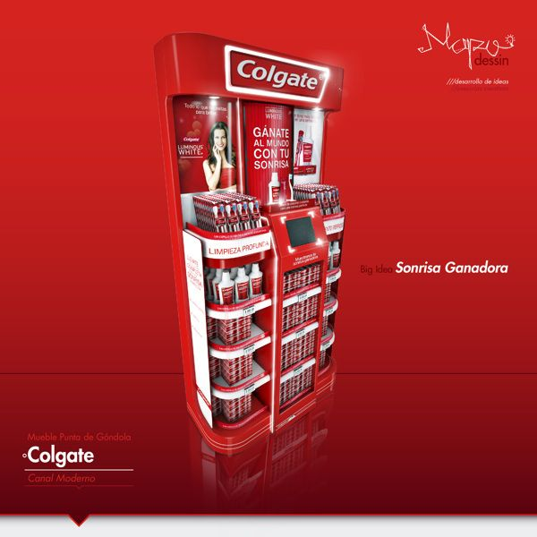
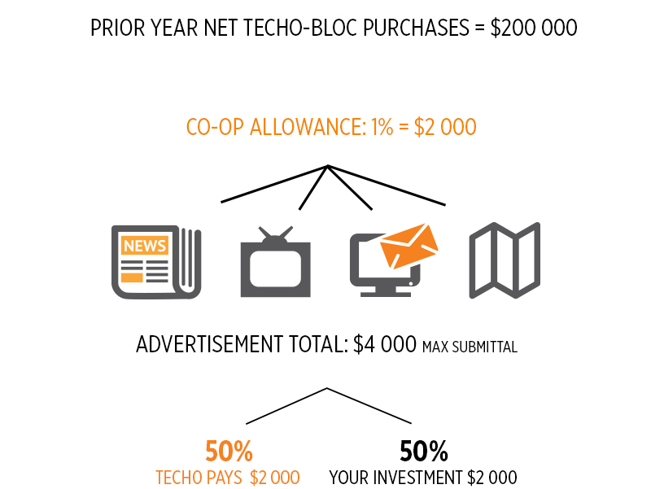
Sales Promotion
Sales promotion tools
In the sale promotion the tools are used by two different classification.
Trade oriented promotions
  Cooperative advertising allowance
  Market development allowance
  Display allowance
  Spiffs
  Volume rebate

Slide 17
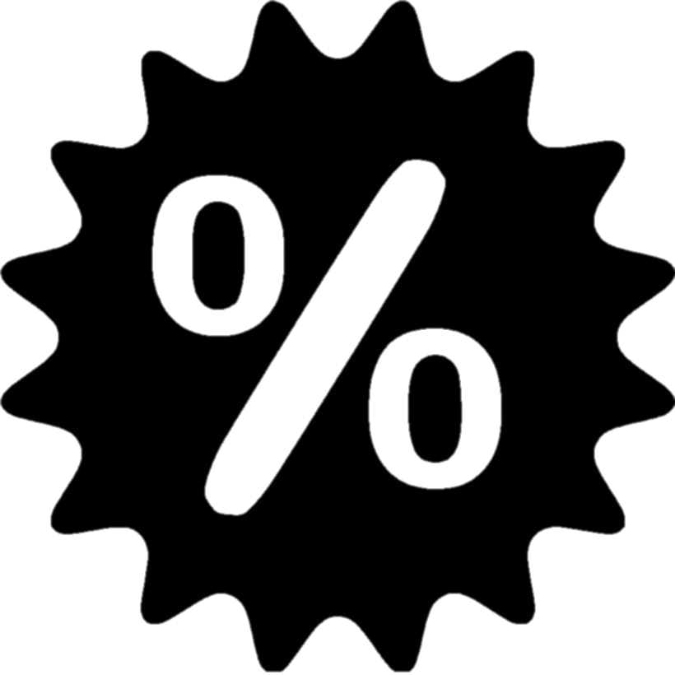


Sales Promotion
Sales promotion tools
In the sale promotion the tools are used by two different classification.
Trade oriented promotions
  Discounts (Volume or cash)
  Off-invoice incentive
  Inventory Financing
  Training

Slide 18
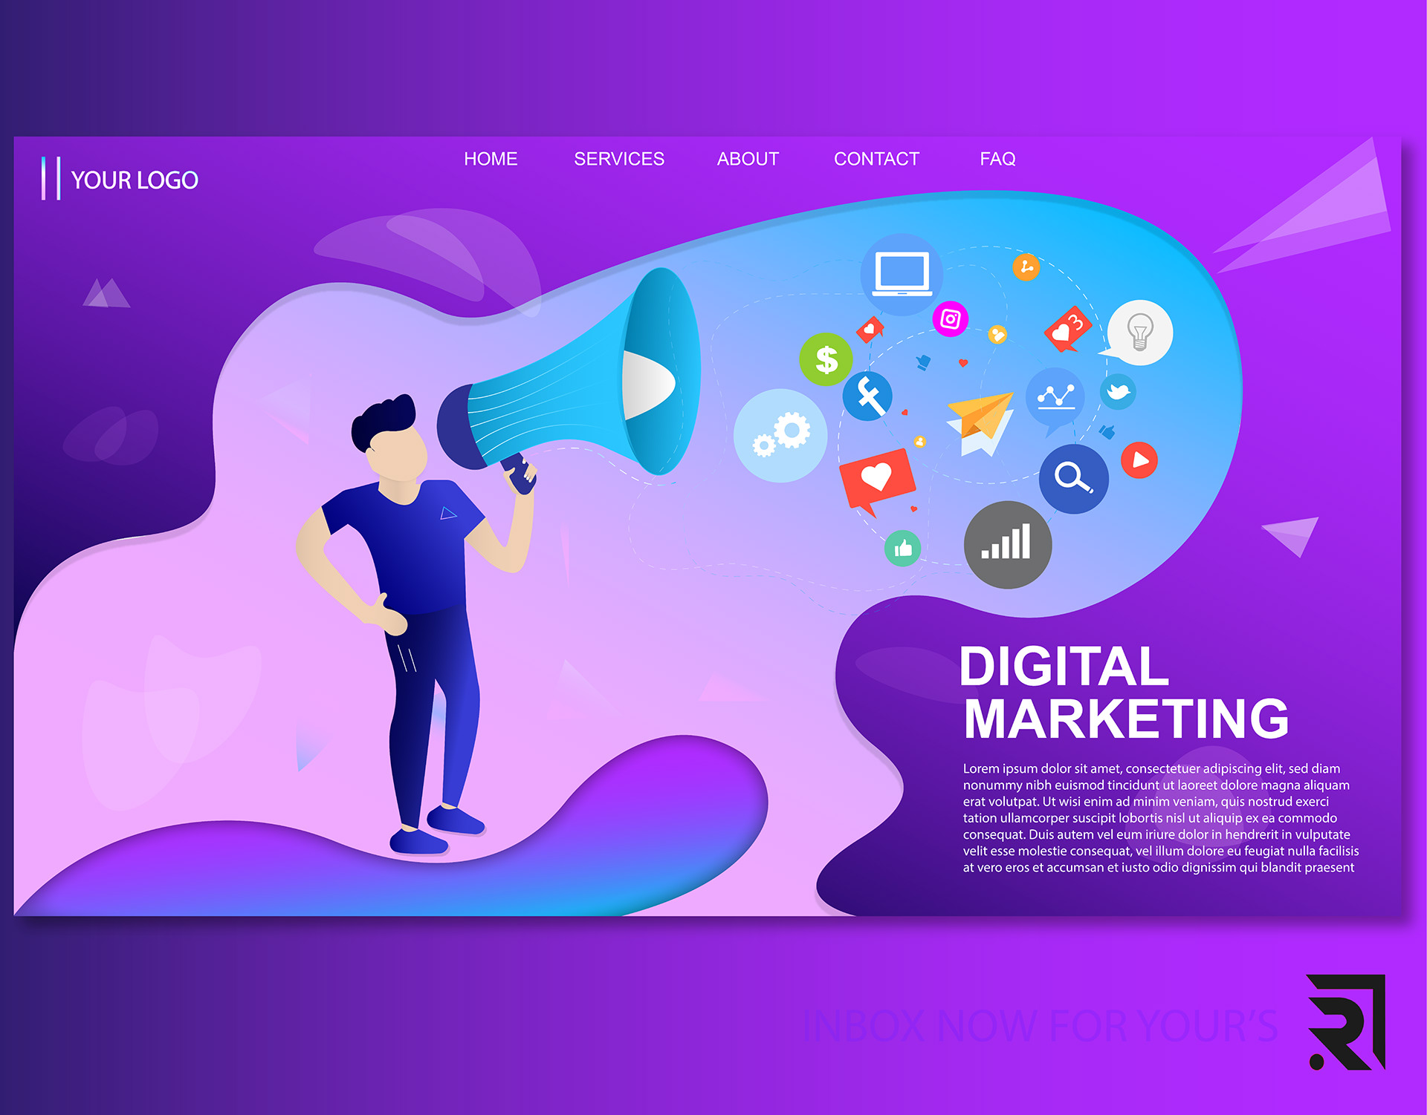
Direct
and
digital
marketing

Slide 19

Define Direct and Digital Marketing:
Engaging directly with targeted customers to obtain immediate response and build long lasting relationship.

Slide 20
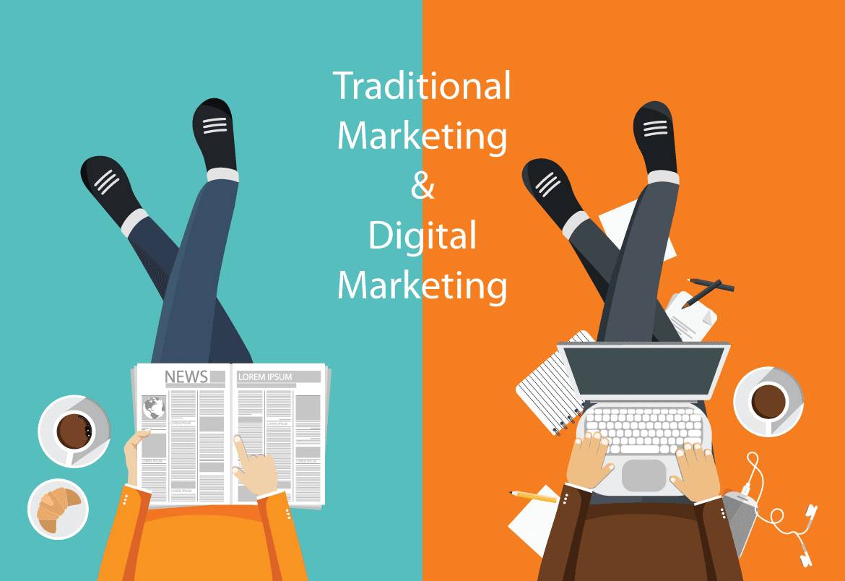
Forms of direct and digital marketing

Slide 21
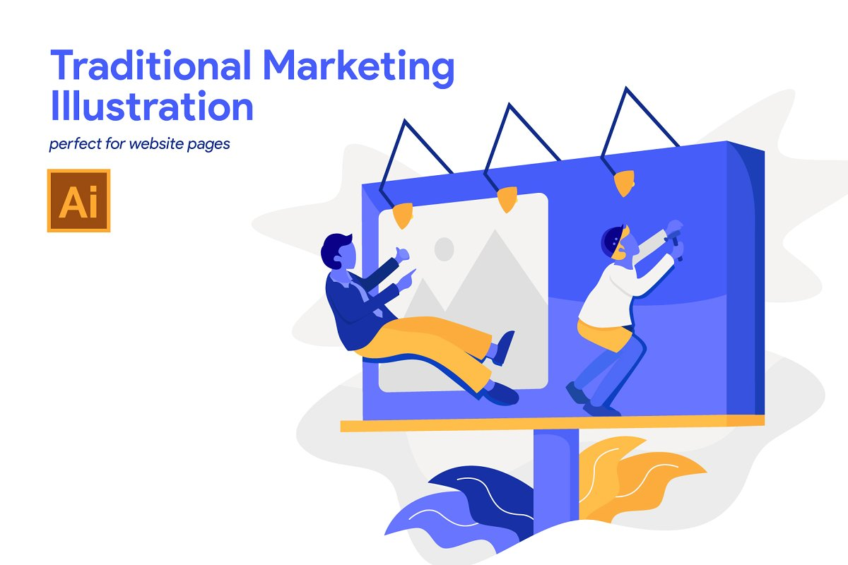

Slide 22

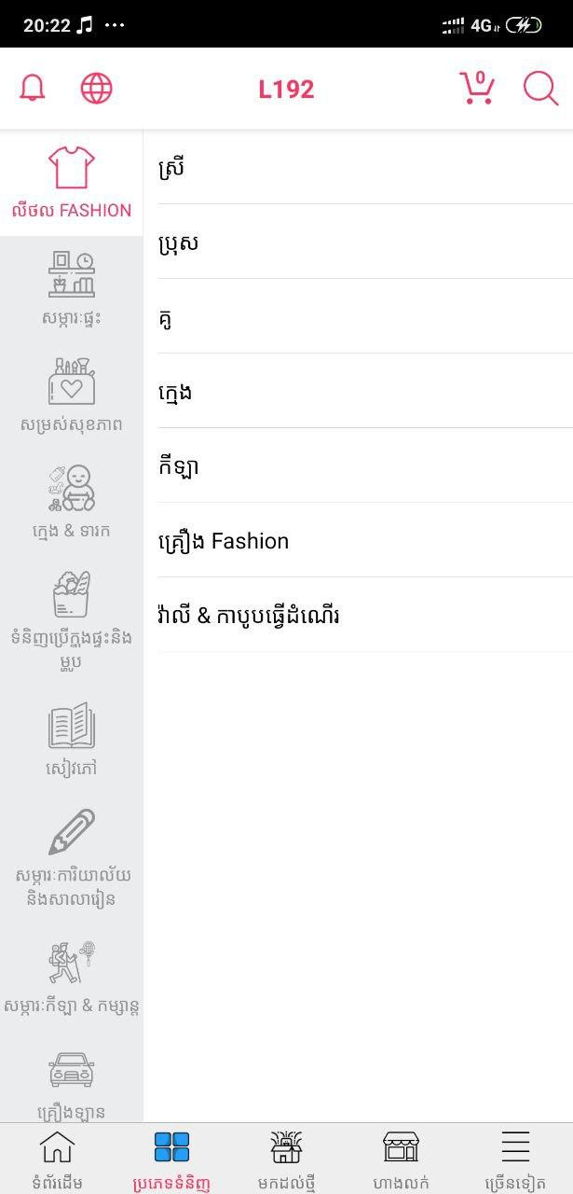
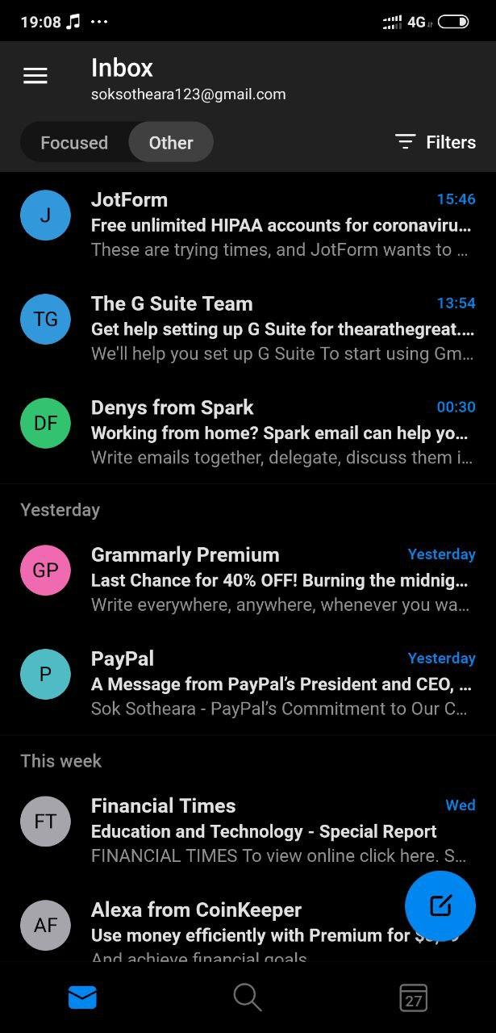
Face-to-face selling
Catalog
Direct Mail Marketing

Slide 23
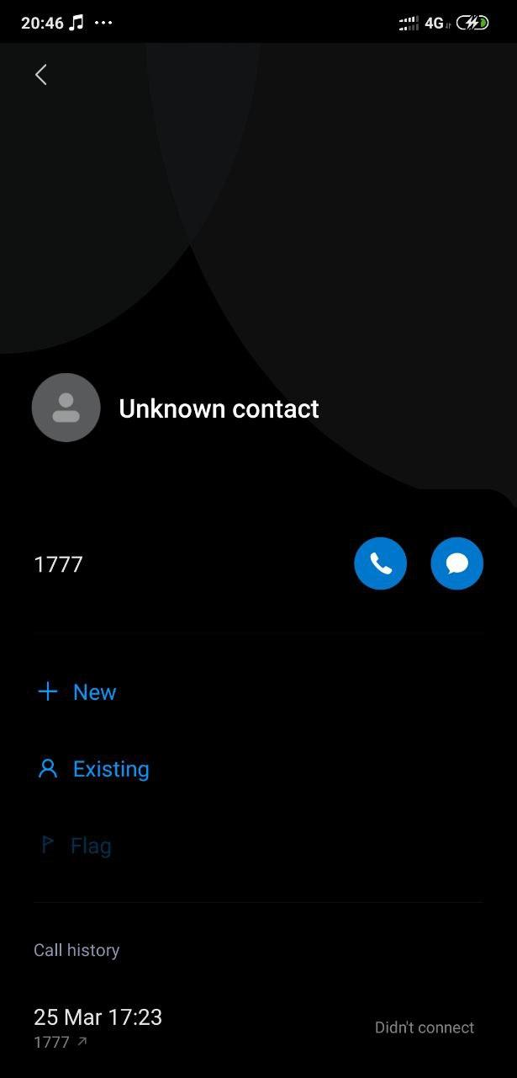
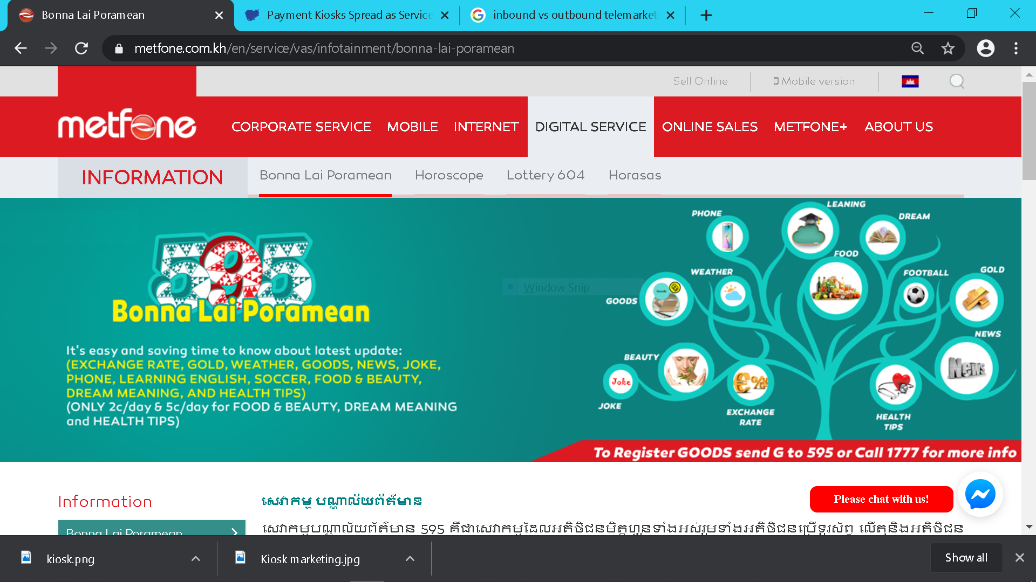
Outbound Telemarketing
Inbound Telemarketing

Slide 24

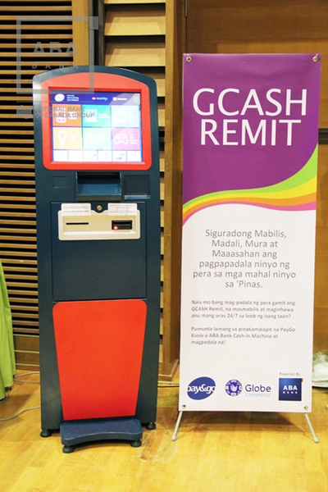
Direct-response TV marketing
Kiosk marketing

Slide 25

- Online marketing
- social media marketing
- Mobile marketing
Digital Marketing

Slide 26
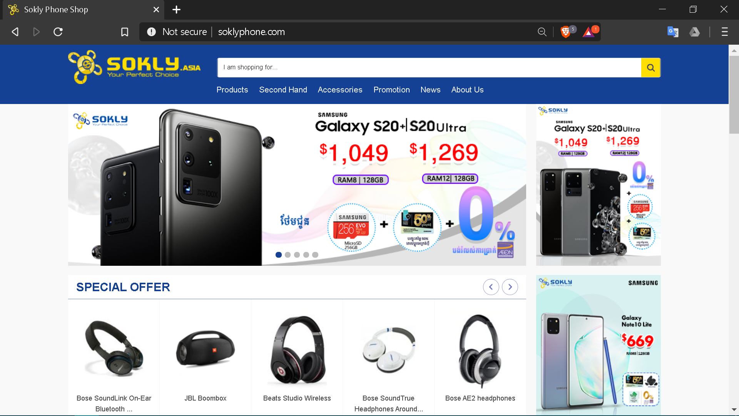
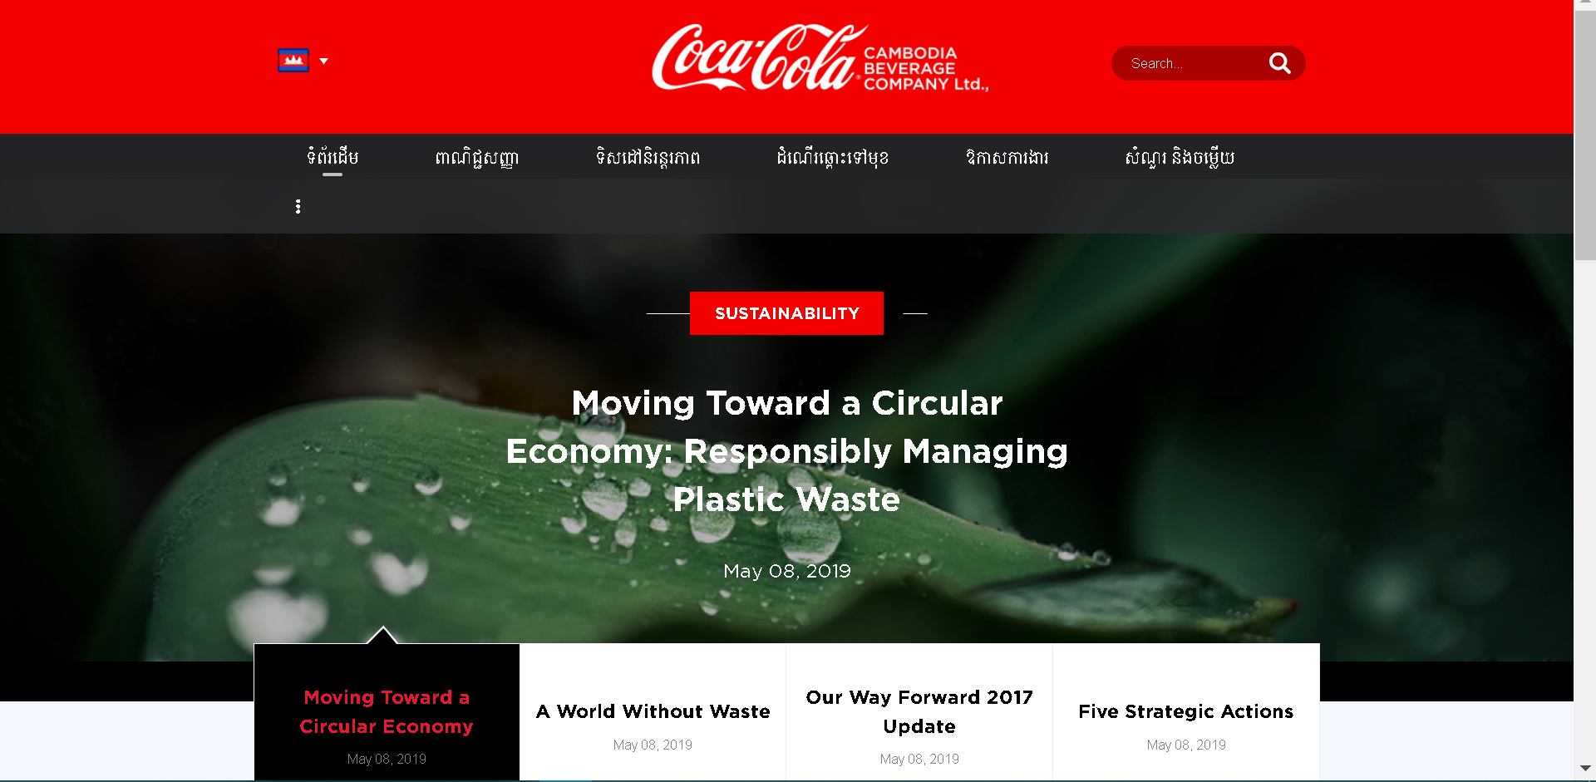
Online marketing
Company’s Website
Branded Community Website

Slide 27
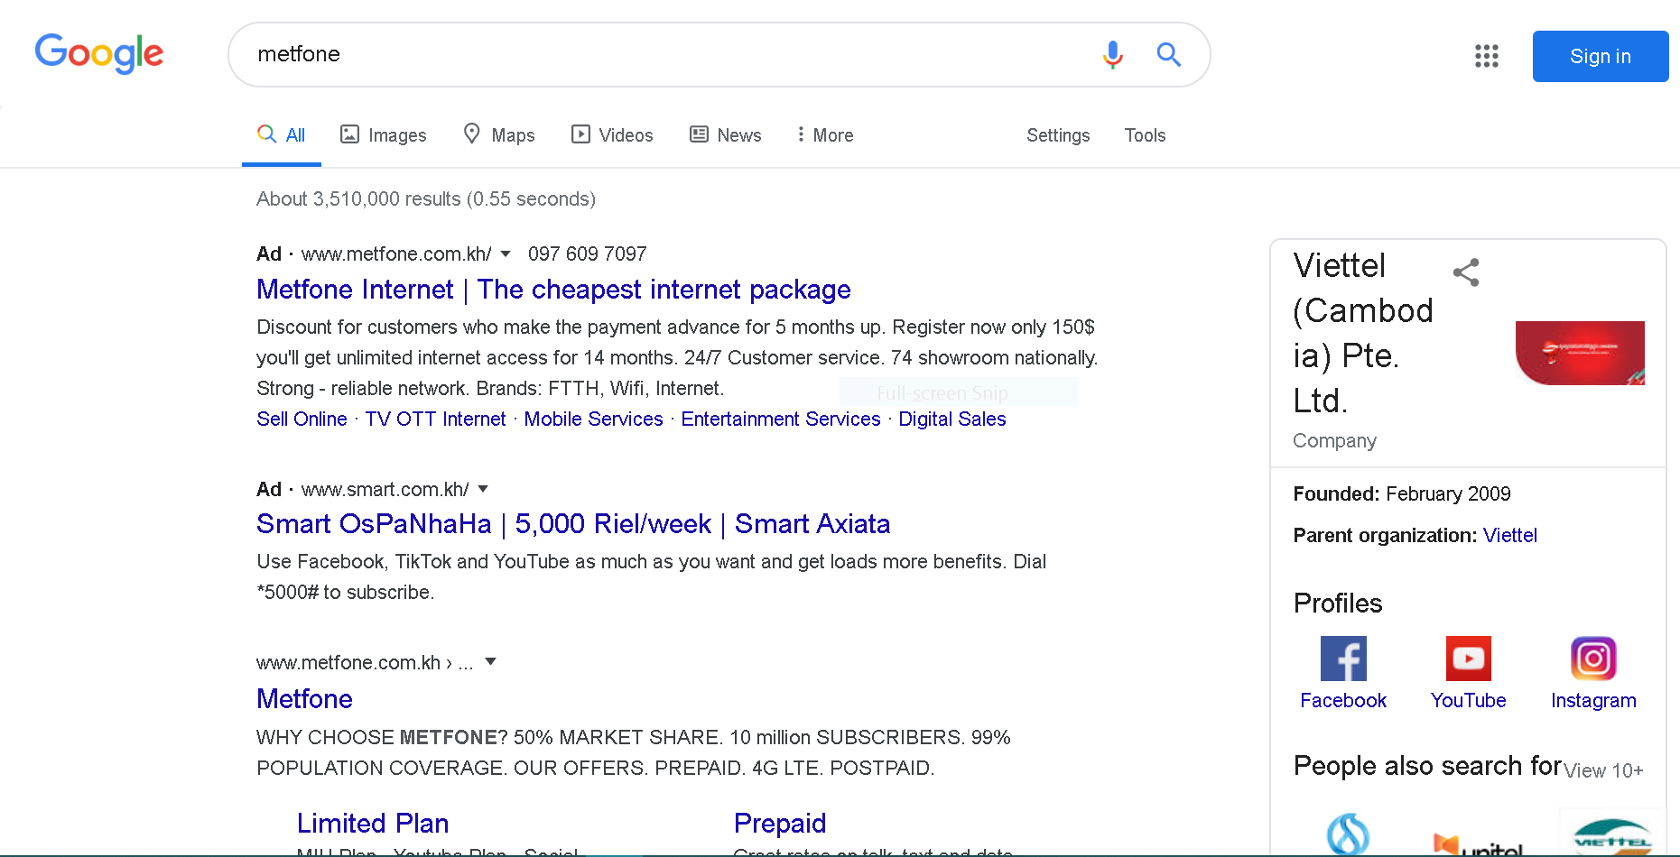
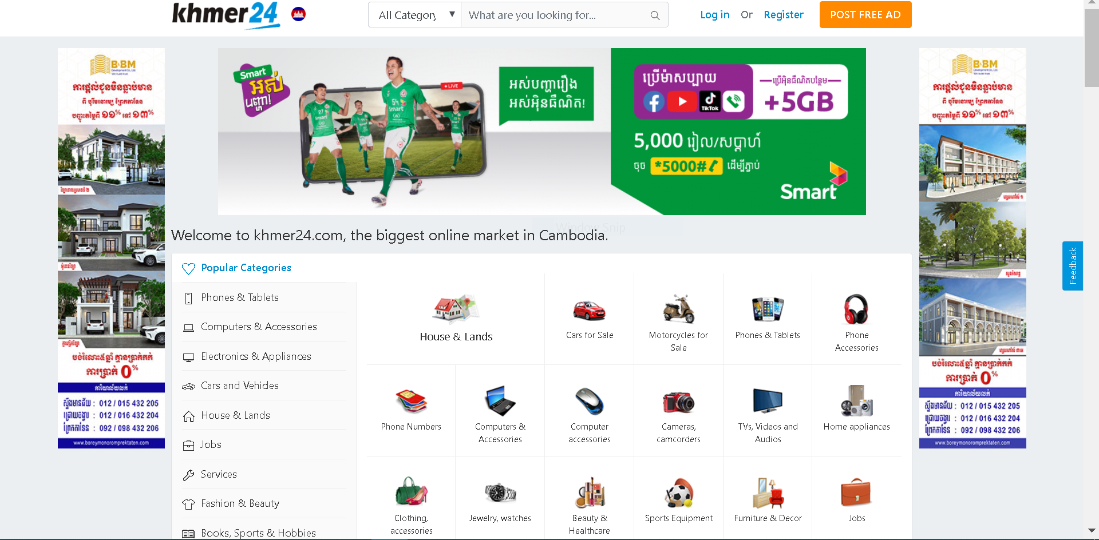
Search Related Ads
Online Display Ads

Slide 28

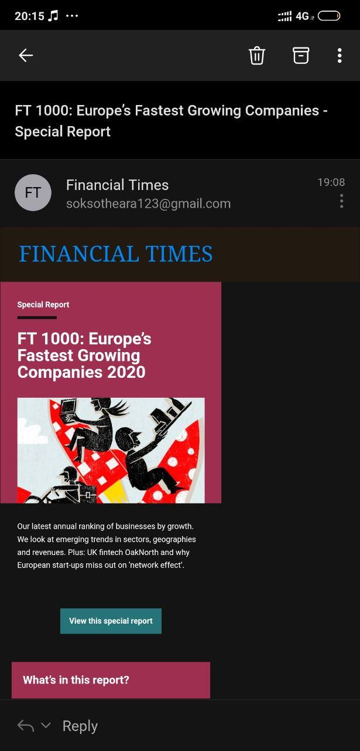
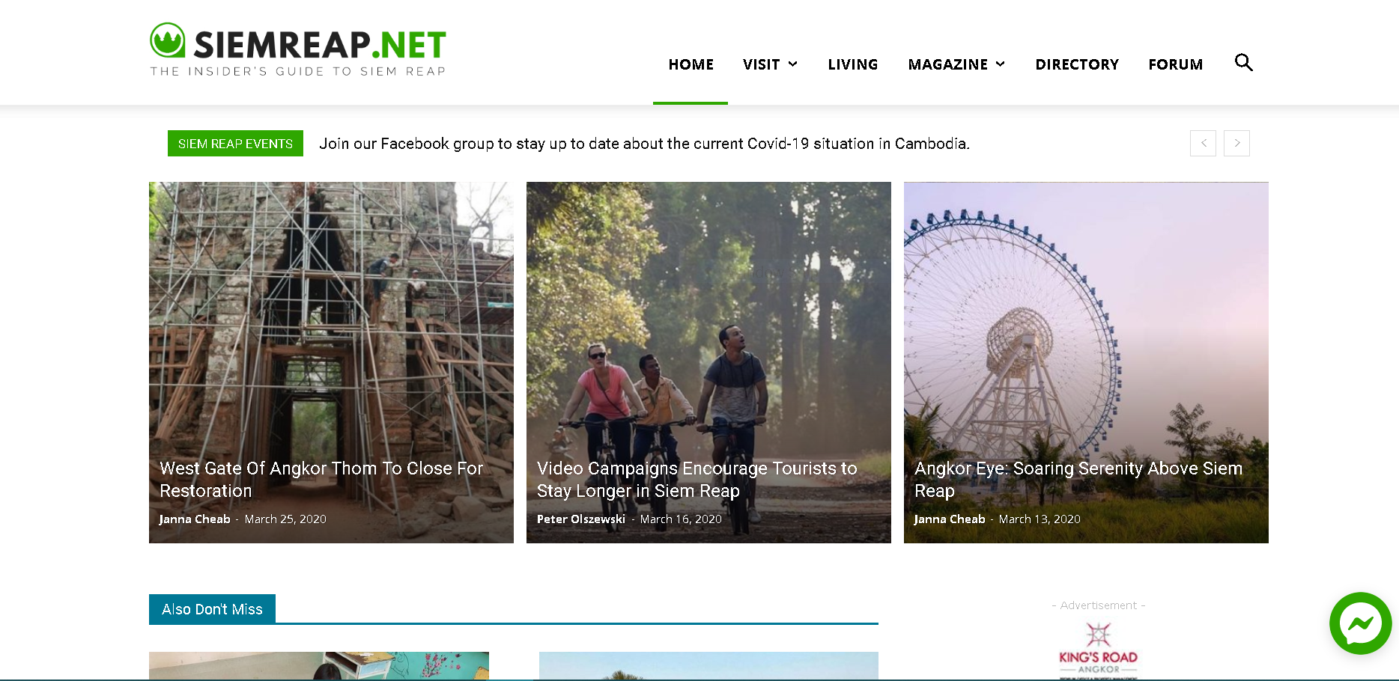
Viral Marketing
Email Marketing
Blog

Slide 29
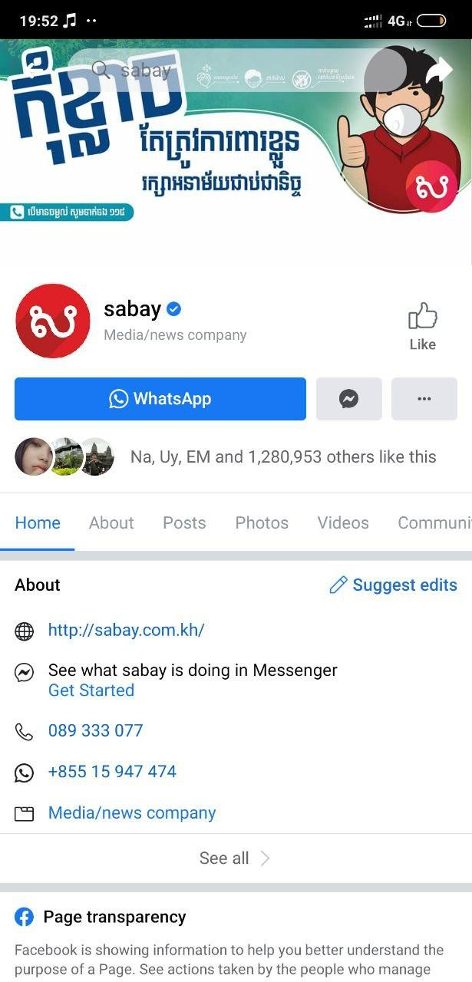


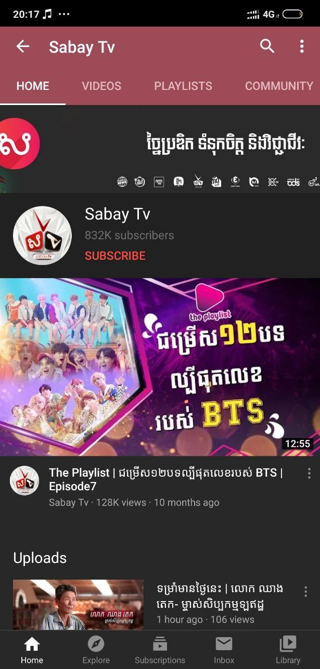
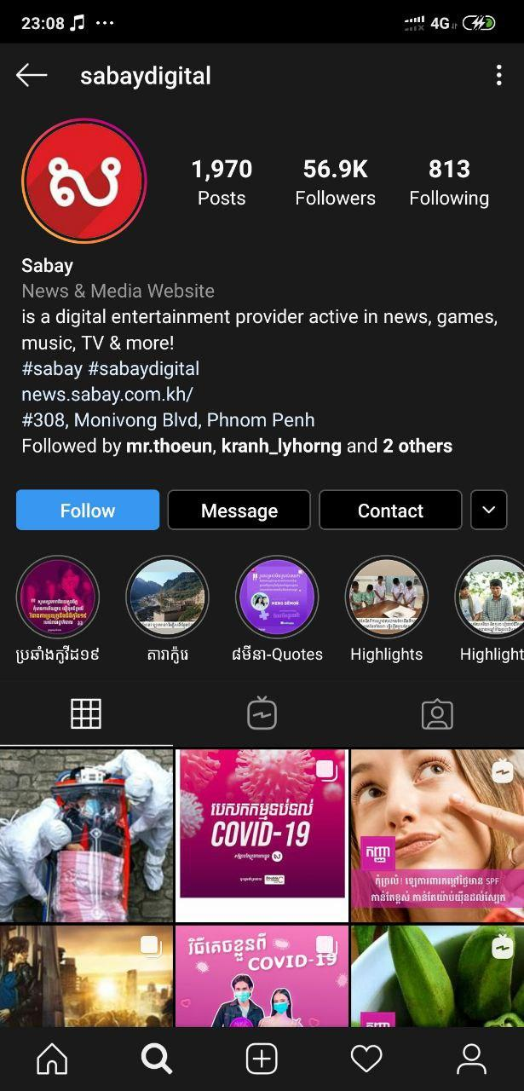
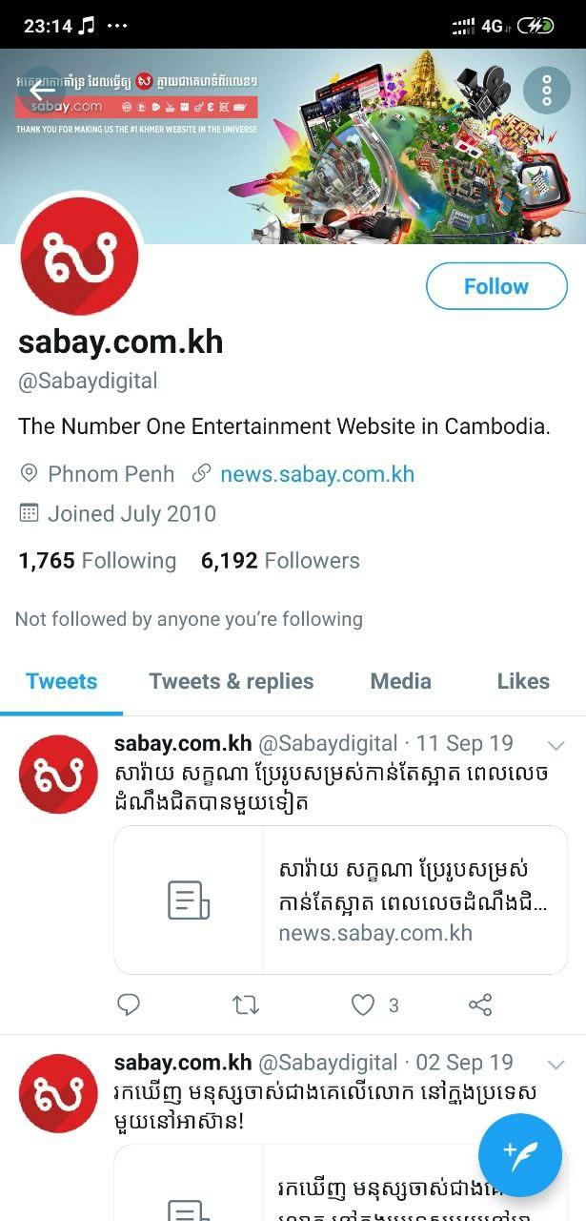
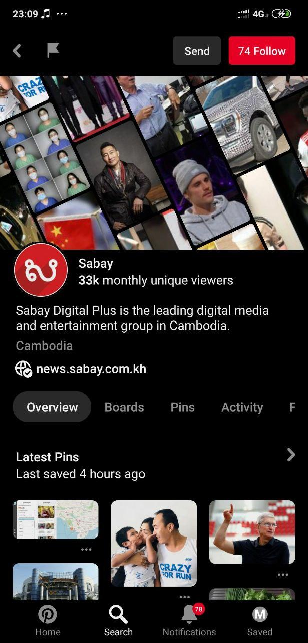
Social media marketing

Slide 30
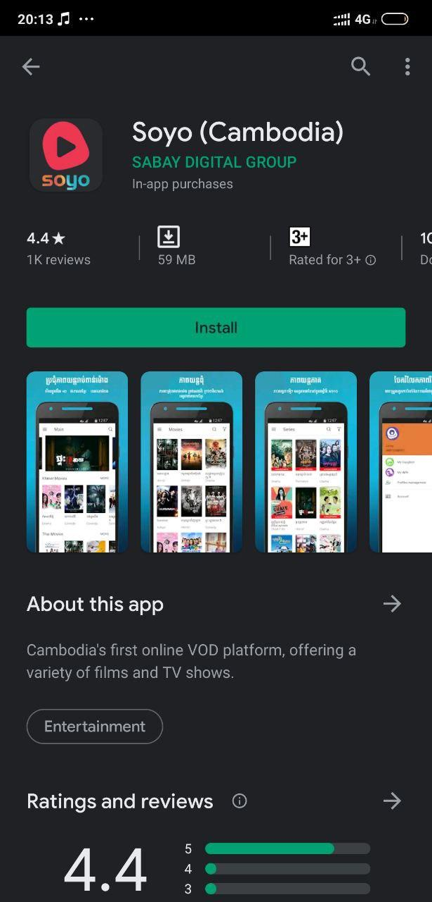
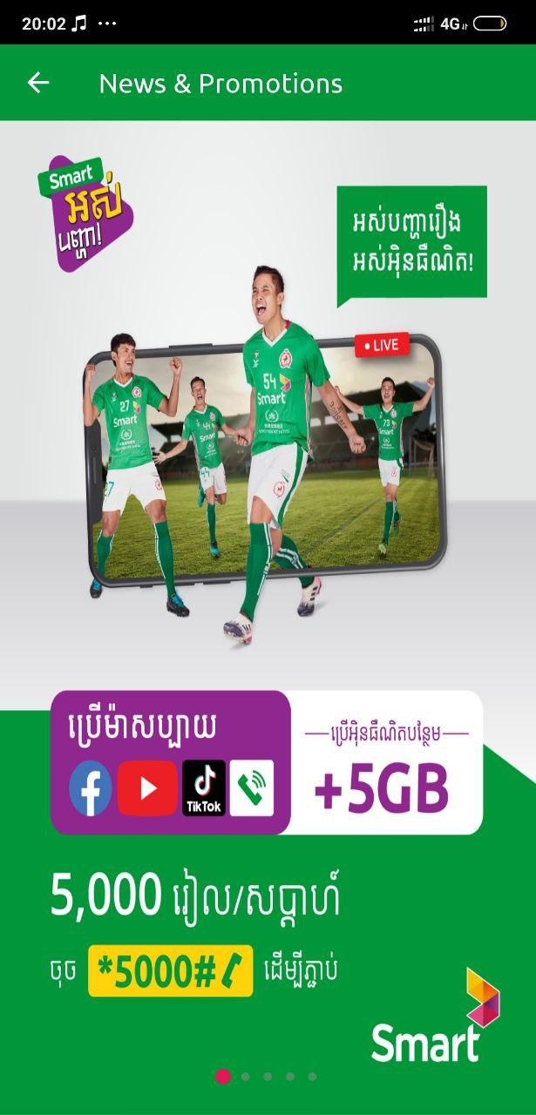
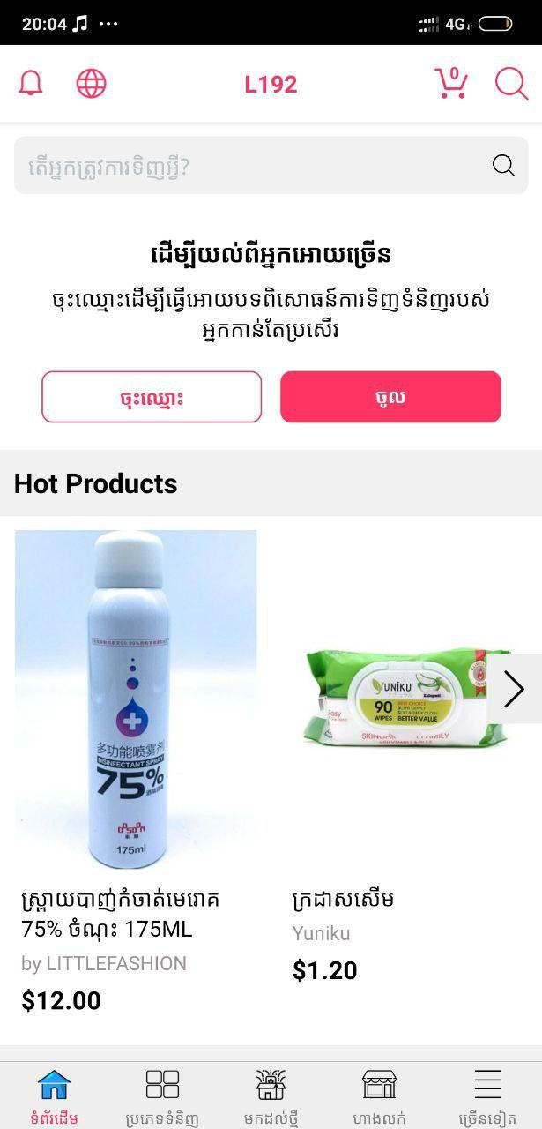
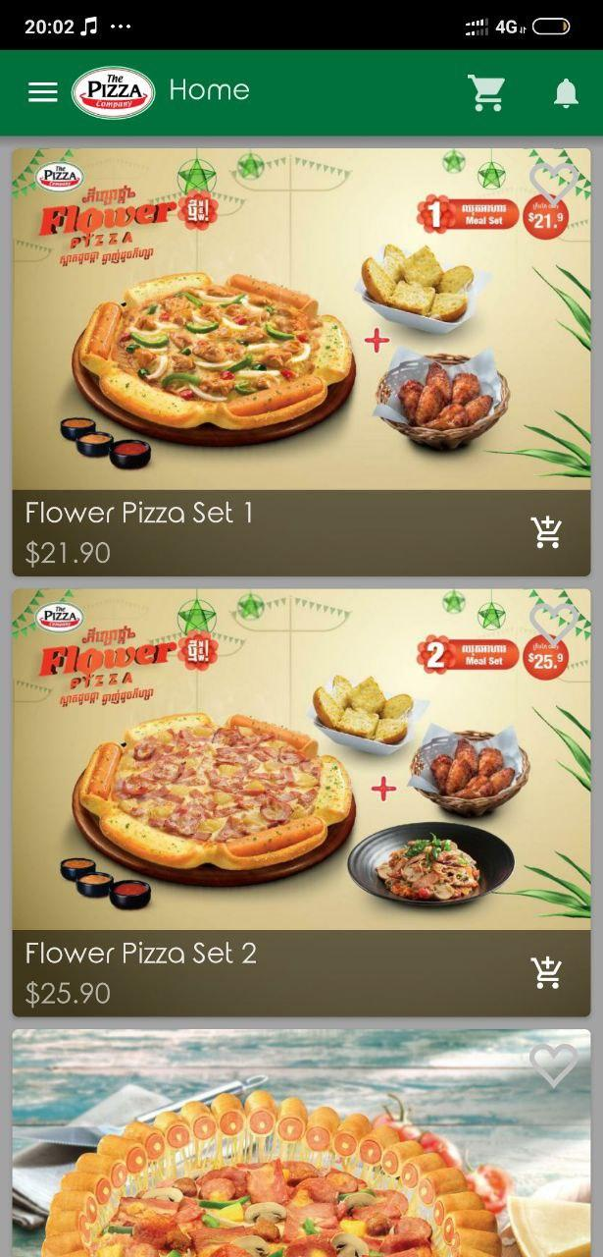

Application
Mobile marketing
Direct SMS

Slide 31


Slide 32
CONCLUSION

Slide 33
Reference
Philip T. Kotler and Gary Armstrong. Principles of Marketing 16th Edition. Pearson Higher Education, 2015.
“Promotional Mix.” Wikipedia, Wikimedia Foundation, 19 Mar. 2020, en.wikipedia.org/wiki/Promotional_mix.

Slide 34


