Slide 1
Topic: Low Digital Literacy
Participant: Sotheara SOK
Supervisor: Yaqi Chu (Aggie)

Slide 2
WHAT TO TALK ABOUT?
Problem statement
Proposed solution & how we deliver it
How it works
Expected impact
Resources needed
Project vision

Slide 3
Problem statement
Most of our students have Low Digital Literacy because they don’t realize the potential benefit of minimal educational technologies.

Slide 4
Proposed solution
EdTecKH is a digital platform where student can learn about minimal technologies to boost their productivity and creativity.

Slide 5
How we deliver it
YOUTUBE CHANNEL
WEBSITE

Slide 6
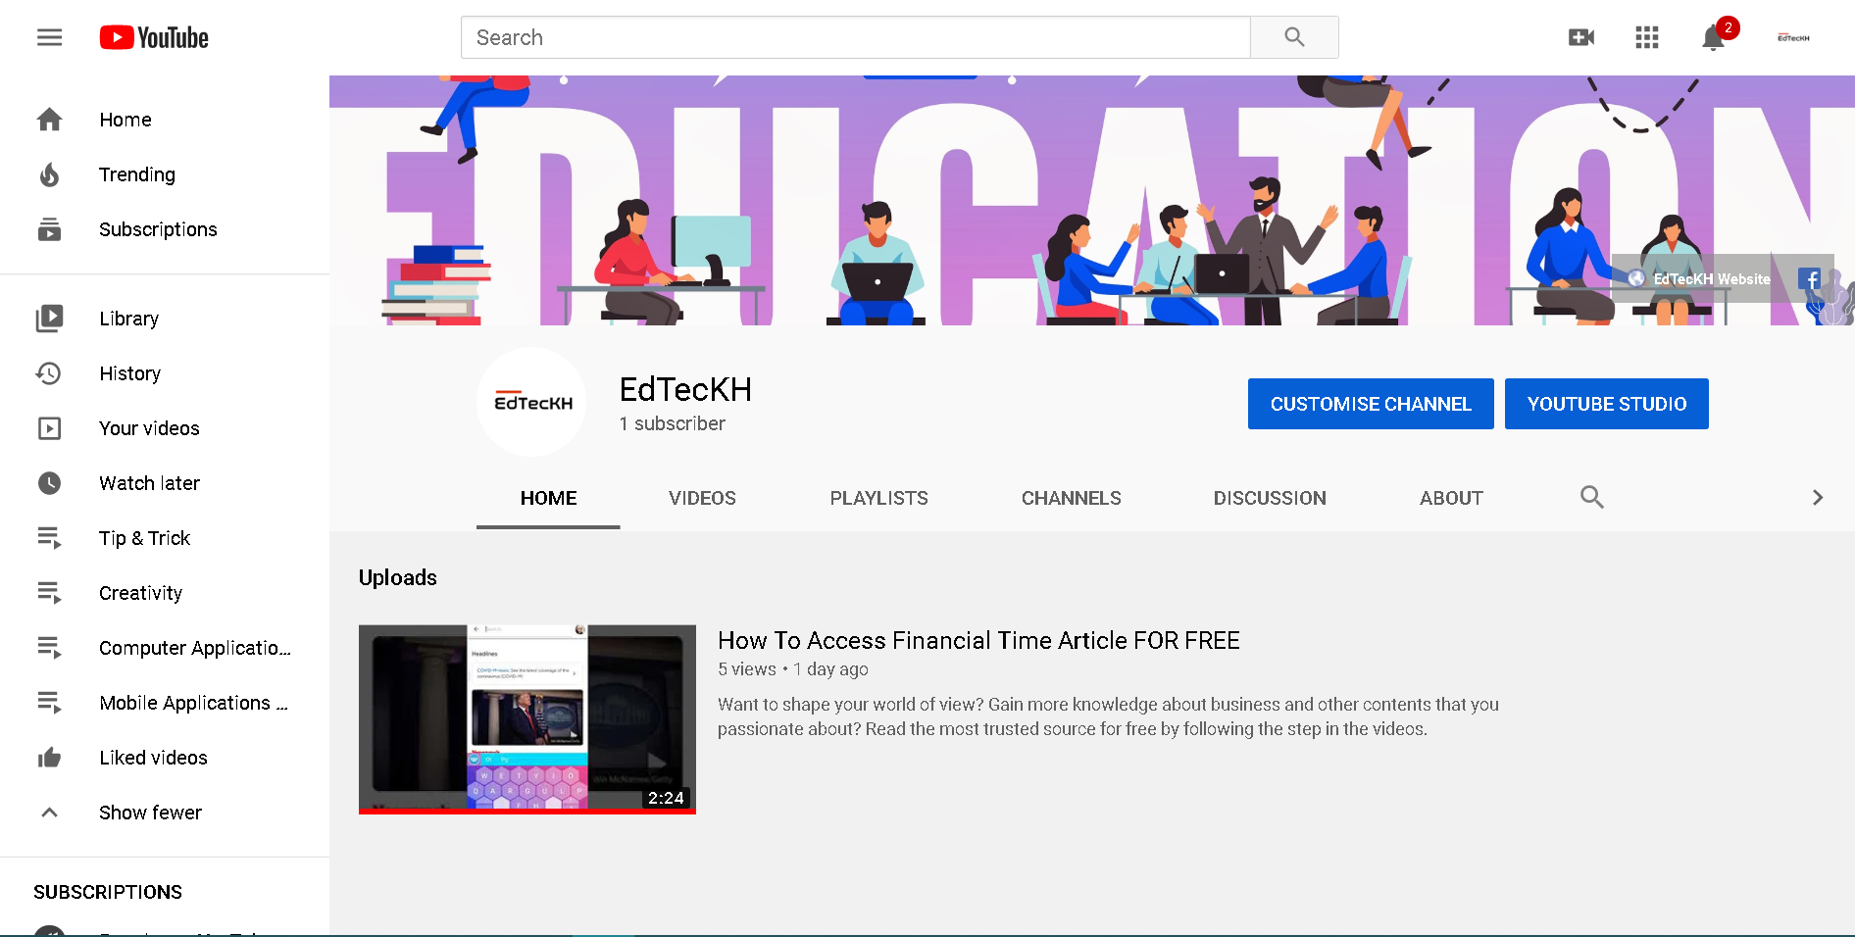
YouTube Channel

Slide 7
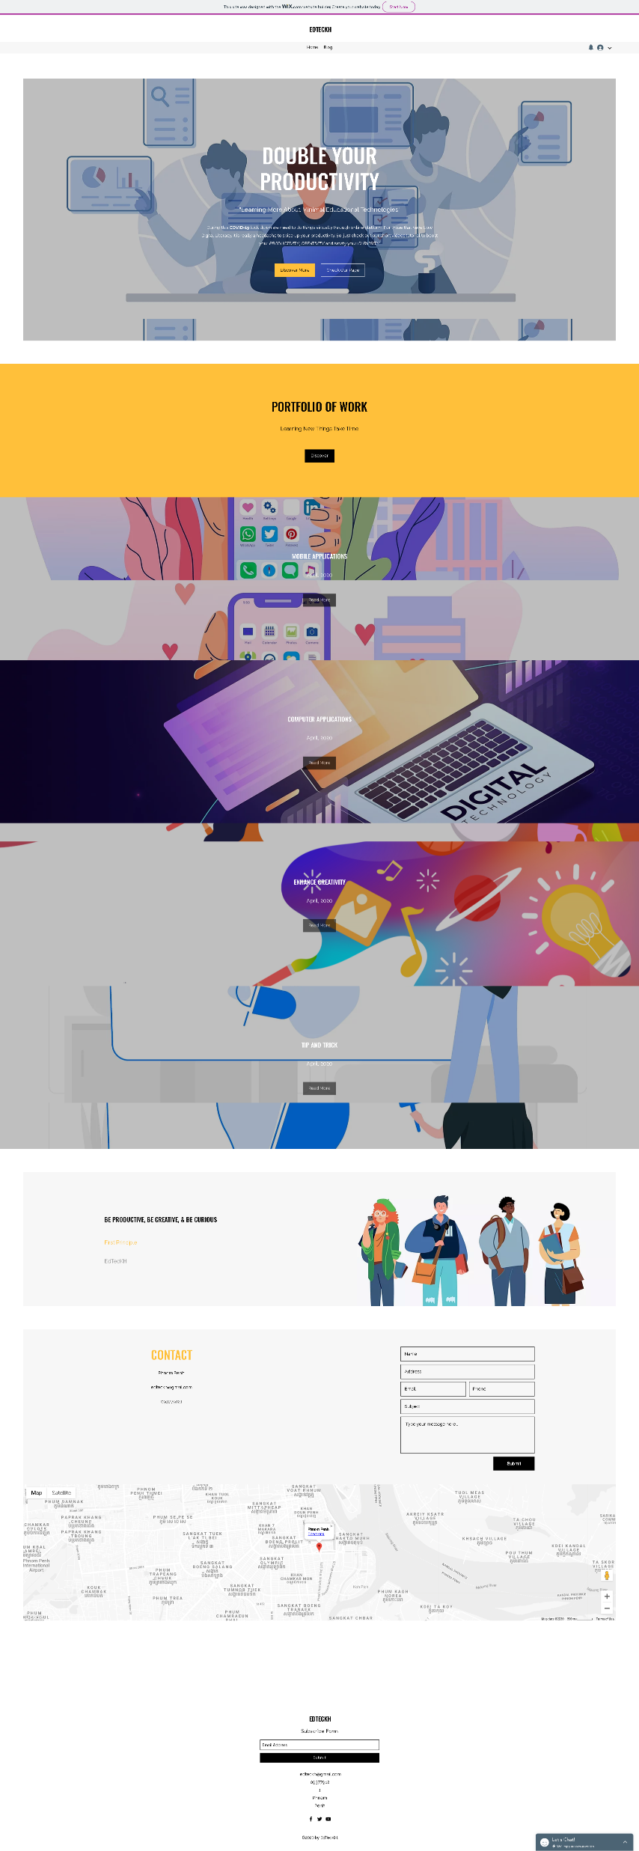
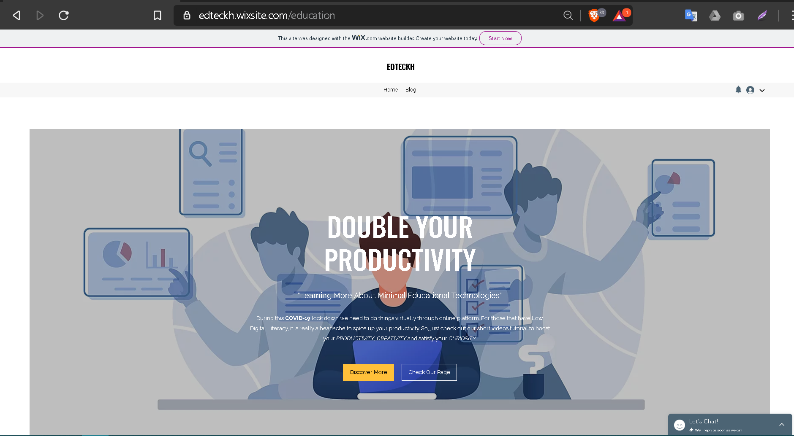

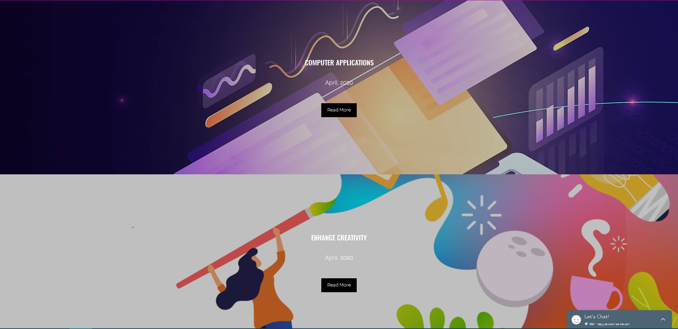
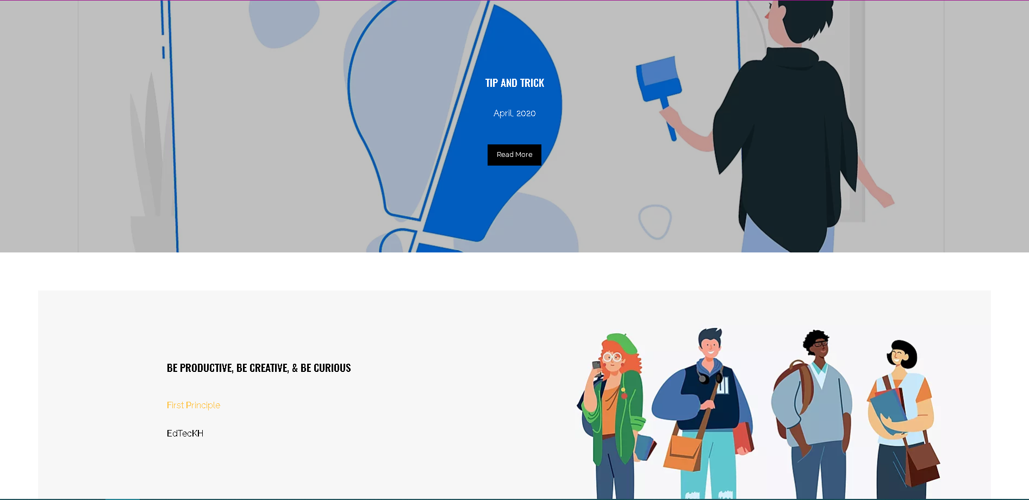
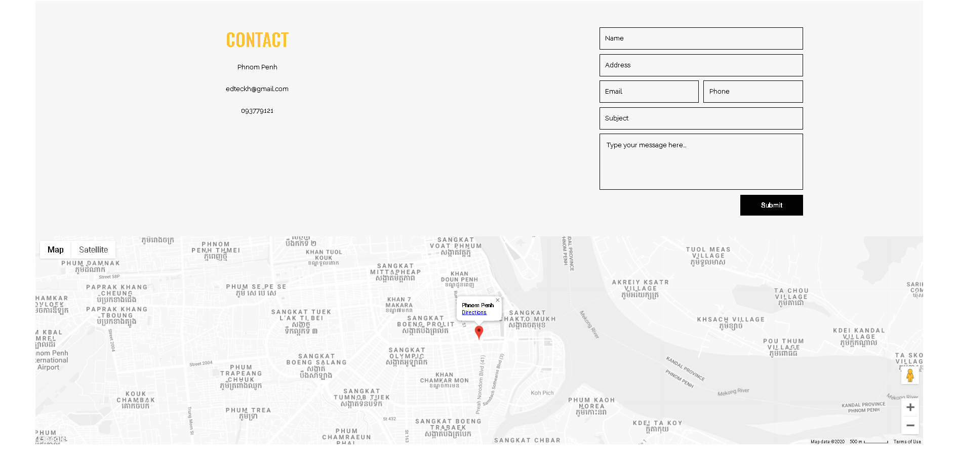
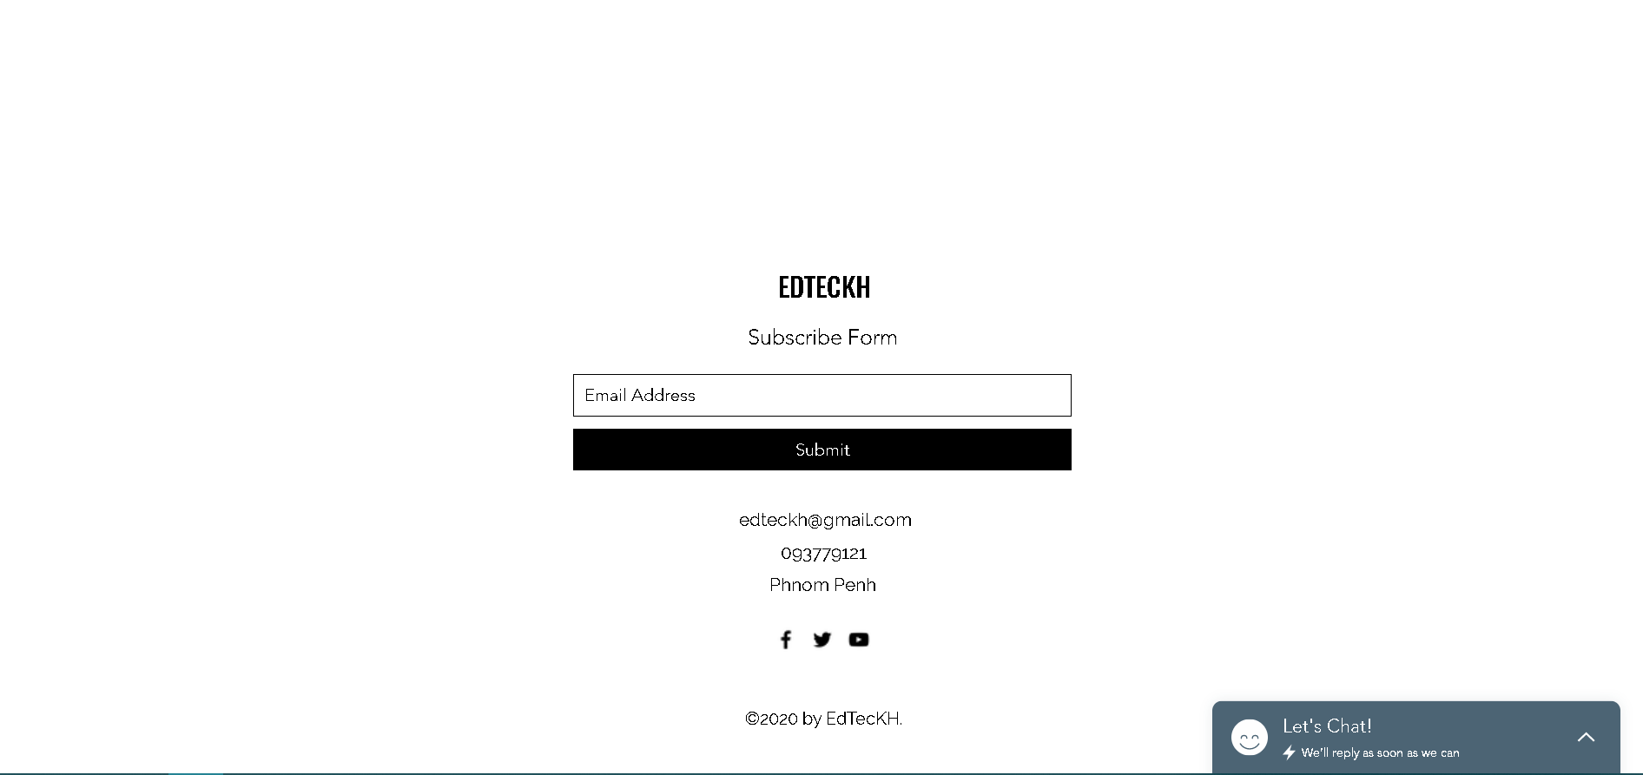
Website

Slide 8
How it works
KEY CONTENTS ON YOUTUBE CHANNEL
KEY FEATURES ON WEBSITE

Slide 9




Key contents on YouTube Channel
Mobile Application (Native Apps)
  Entertainment
  Educational
  Music
  Productivity
Tip and Trick
Enhance Creativity
Computer Application (Utility Software)
  Productivity (i.e. Microsoft Office)

Slide 10
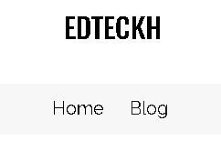
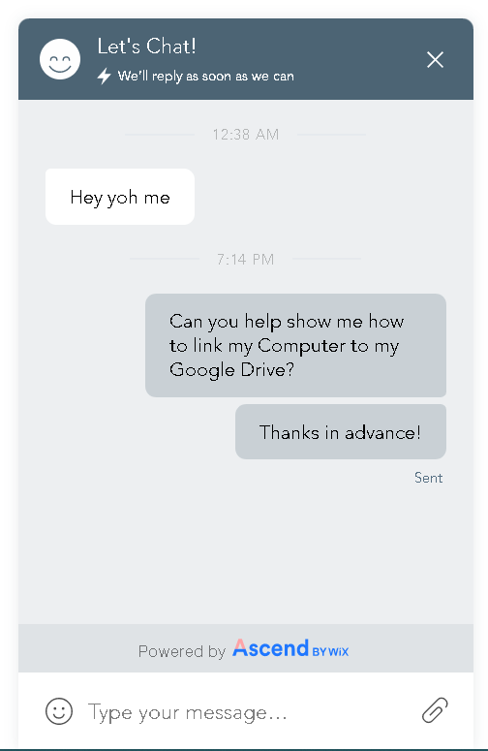
Key features on Website
Blog Post
Digital Catalog
  Easy to browse on all smart devices
  Eye catching
  Direct link to YouTube
Instant Message

Slide 11
Expected impact
THE IMMEDIATE IMPACT
POSITIVE IMPACT
SMALL LIFE CHANGES

Slide 12
End of April, 2020
  We expected that around 100 students will directly impact and 250 others will benefit indirectly (by sharing knowledge from one another).
Small life changes
  Student will be more open minded to new technologies
  Enjoy exploring more and learn about new tech
  Autonomous life (using virtual assistant)
End of September, 2020
  We expected to have active engaging student around 500 and those who benefit indirectly about more than 1200.
Positive Impact
  Increase productivity
  Paper less academic life (by using cloud storage)
  Higher creativity

Slide 13
Resources needed
CONTENT CREATOR
WEB DESIGNER
DIGITAL MARKETING SPECIALIST

Slide 14
CONTENT CREATOR
I wish I could get some help from gifted content creator that could supervise me on how I can create and maintain attractive appealing content to targeted audience. Especially, if he or she has been maintaining his or her own YouTube channel, that would super related and helpful.

Slide 15
WEB DESIGNER
This is really a crucial need for me because I have no skill yet to this kind of field but I would love to learn from he or she in order to establish an amazing and unique website that make our audience want to come and browse our website again and again

Slide 16
DIGITAL MARKETING SPECIALIST
I would like to have a delightful mentor to teach me about how to establish an astonishing Digital Marketing Strategies to attract our 3rd generation Cambodian people to come and look at the service that we provide on official website and YouTube Channel.

Slide 17
Project vision

Slide 18
We expected to accumulate more people from different kind of fields that passionate about technologies and are willing to help and share about what they already know to others that have been struggling about things that seem simple to others but highly complexity for them.
We hope that our effort would contribute at least a little bit to other’s everyday life both social life and academic life.
Even though our average students have no match to other students in develop countries when comparing about digital literacy but things have changed a lot now, so we believe that more and more students and non-students in our country will catch up with them sooner or later. Thanks to more access to the internet and implementation of more and more digital to high school students, especially those who live in province.

