Slide 1
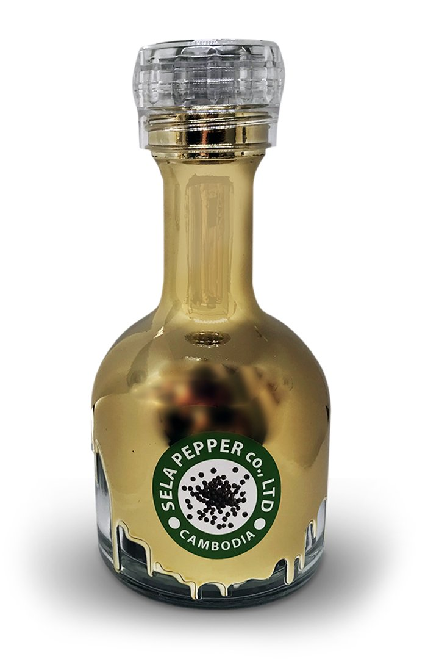
Sela pepper
Professor: CHHEAV Narath
Group 4: HOY Chankaknika
THON Chanmarianeth
SOK Sotheara
YON Sorakyos

Slide 2
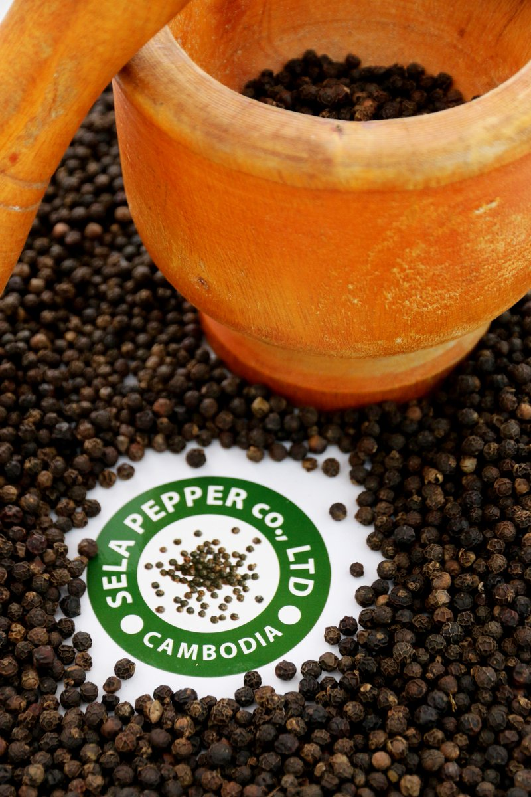
Table of content
Sela Pepper Co.LTD
Placement strategy
Domestic market
International market
Suggestion & Conclusion

Slide 3
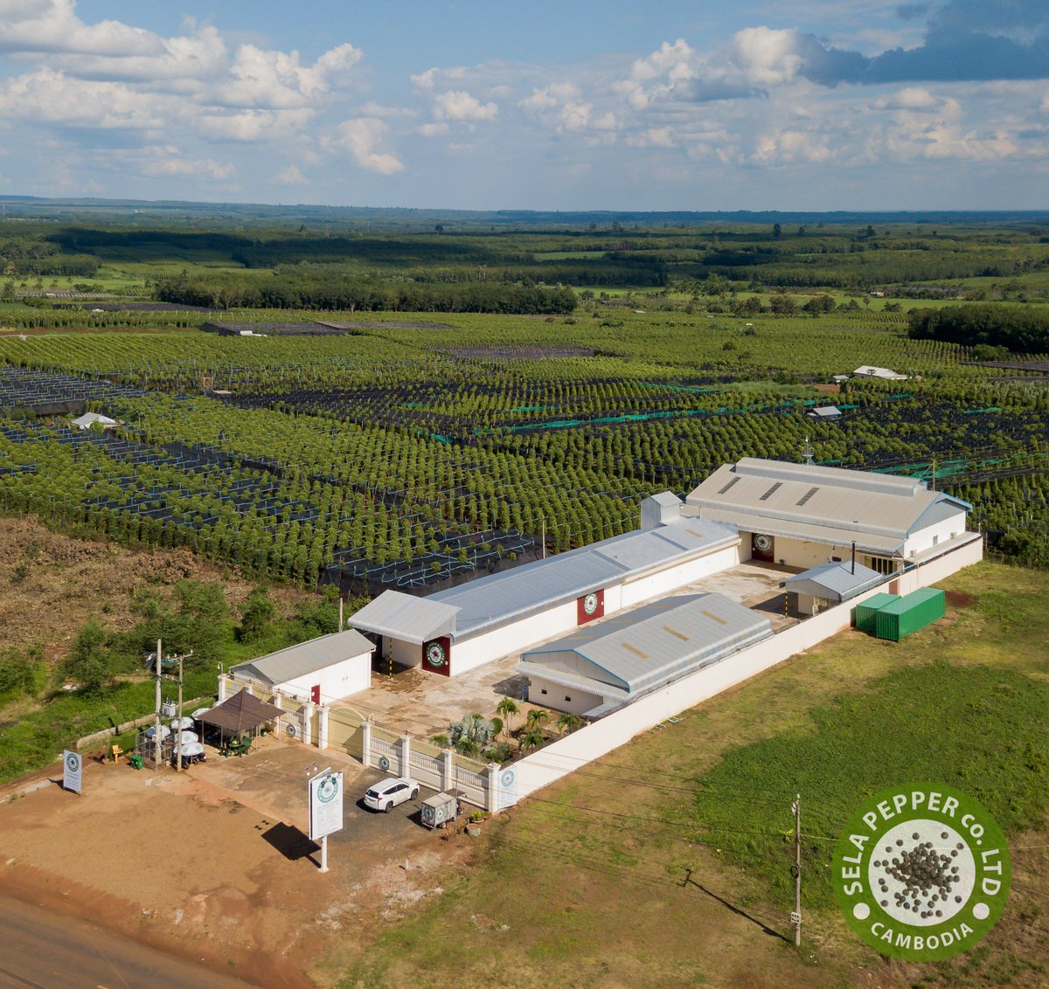
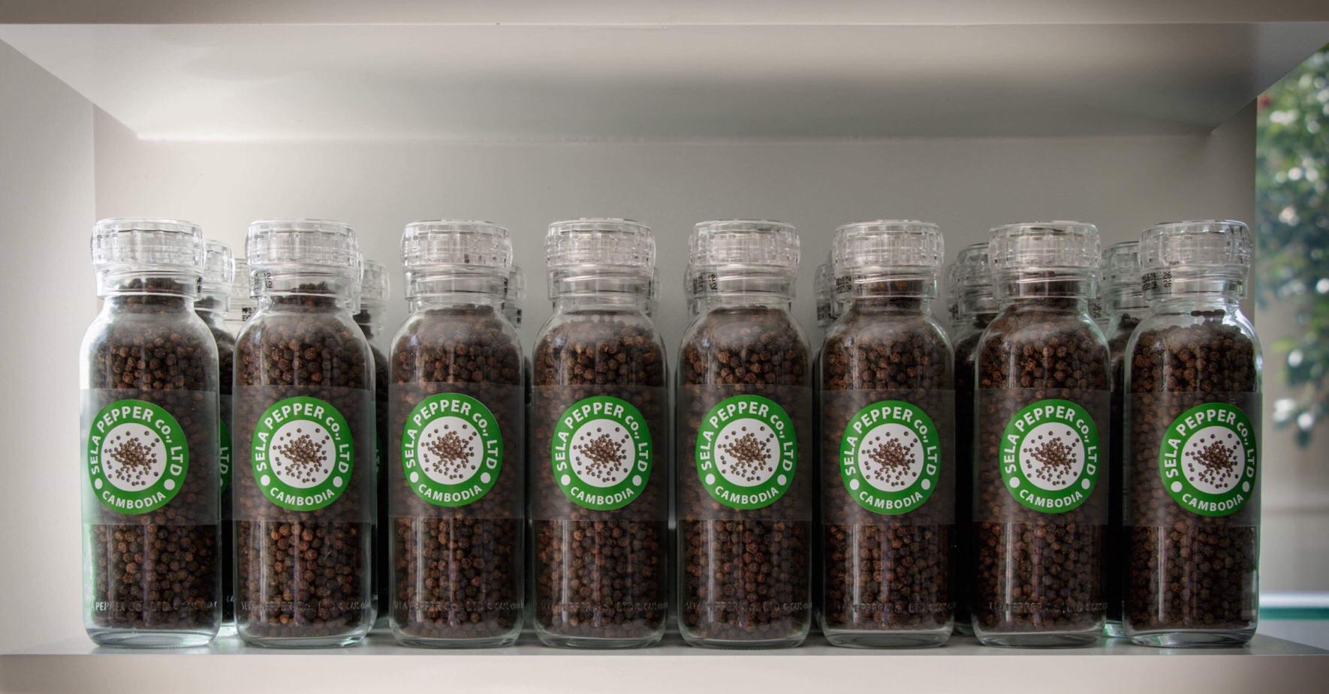
Sela pepper
It is one of the first pepper processing center, founded in 2015, based in Memot district, Tbong Khmum Province, Cambodia.
More than a distribution, Sela CO. LTD also have their own farming field. After harvesting, those pepper will be directing goes into the production system.

Slide 4
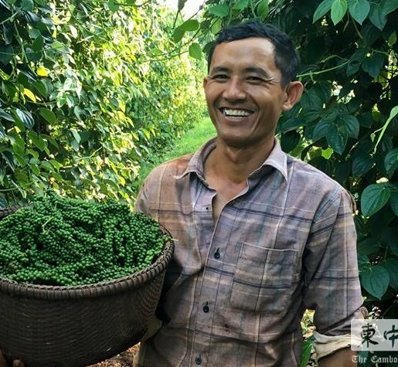
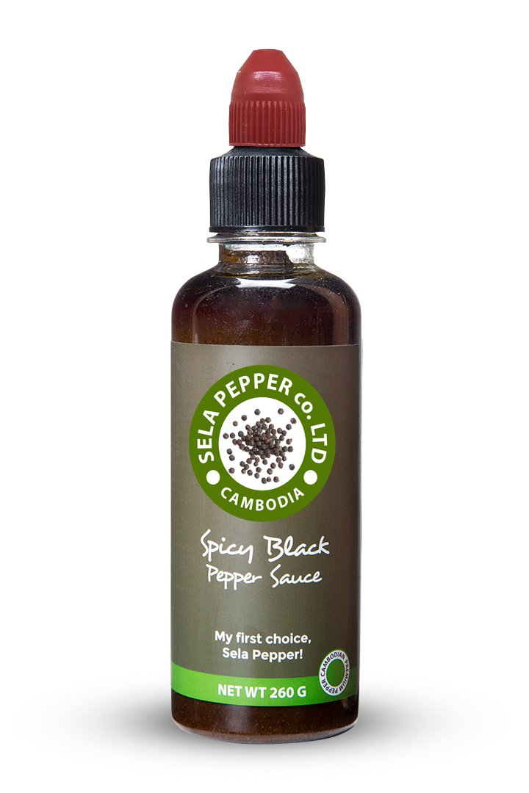
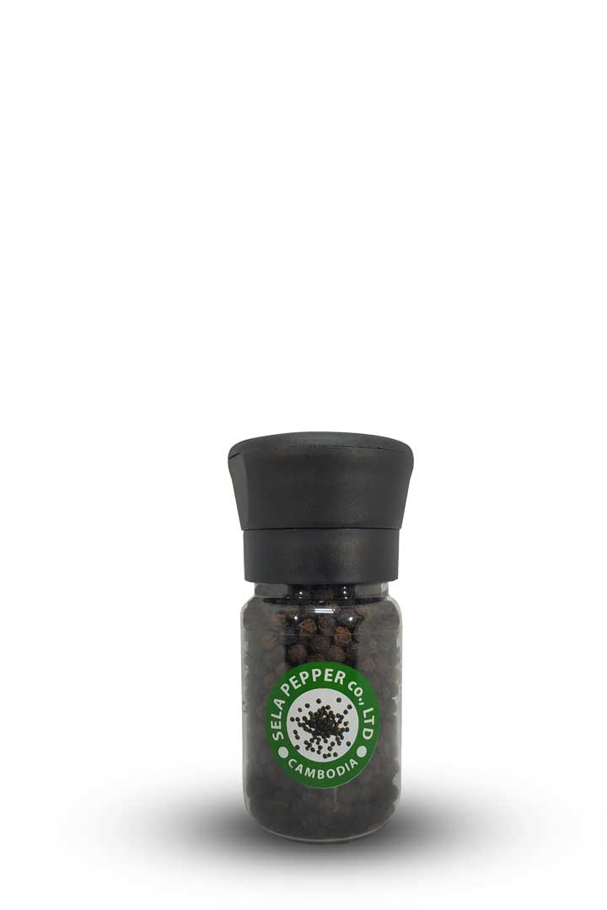
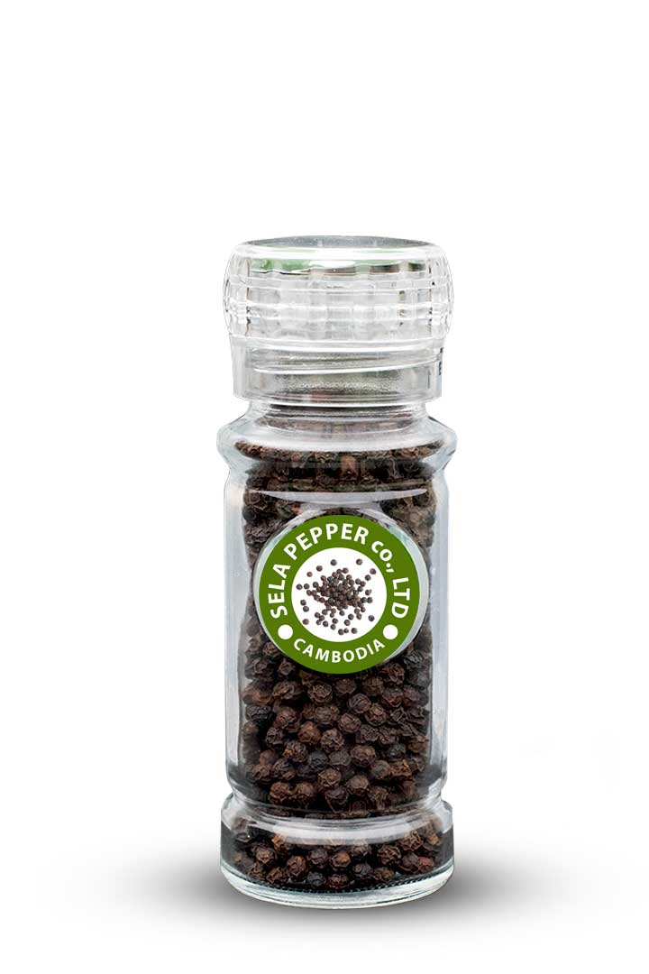
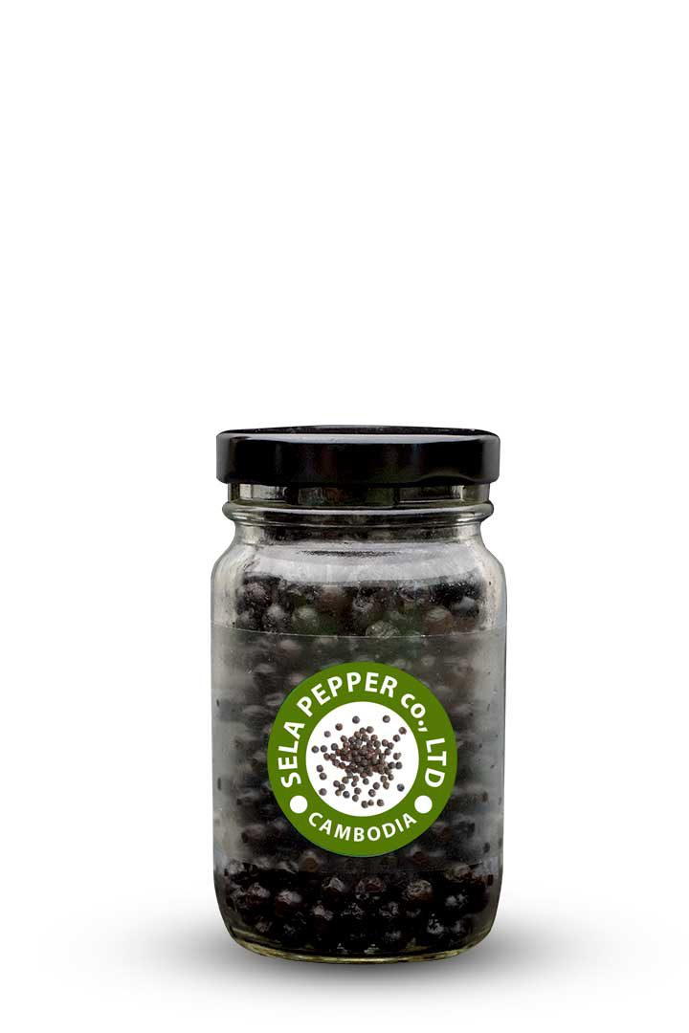



Sela pepper
The mission of Sela Co. LTD is to introduce to the market the best quality pepper in food standard, not only to local community but worldwide.
Sela have updated it product to five categories:
Notes:
© Copyright Showeet.com – Free PowerPoint Templates

Slide 5
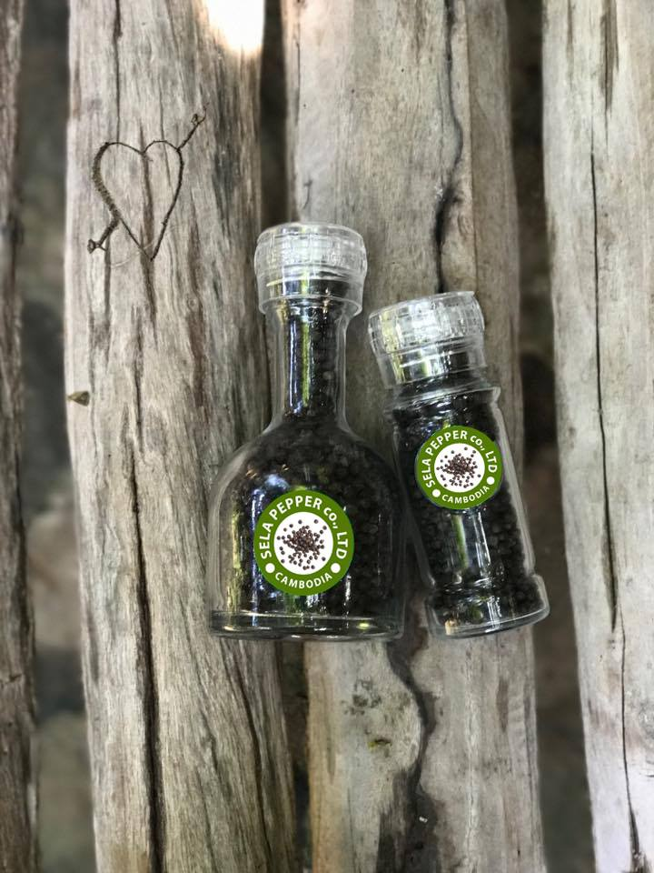
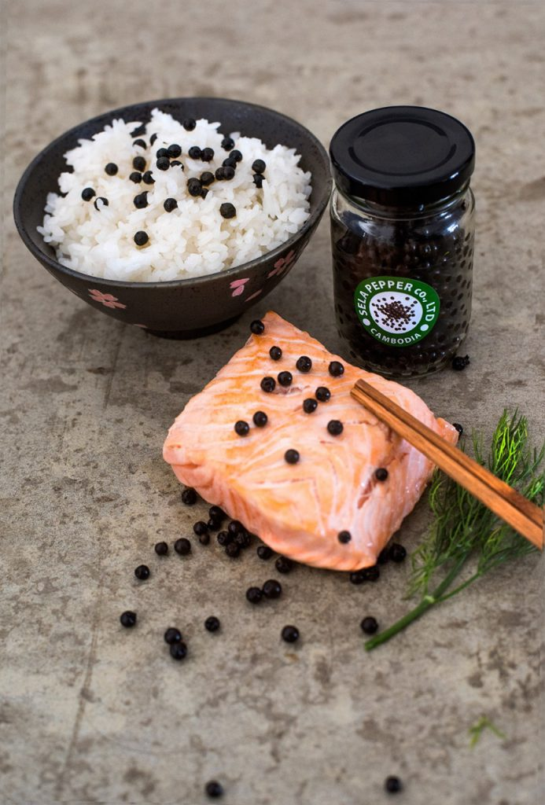
Placement strategy
Placement strategy is the method that the a company uses in order to make the products reach company’s potential customers in different degree and channels.
Notes:
© Copyright Showeet.com – Free PowerPoint Templates

Slide 6
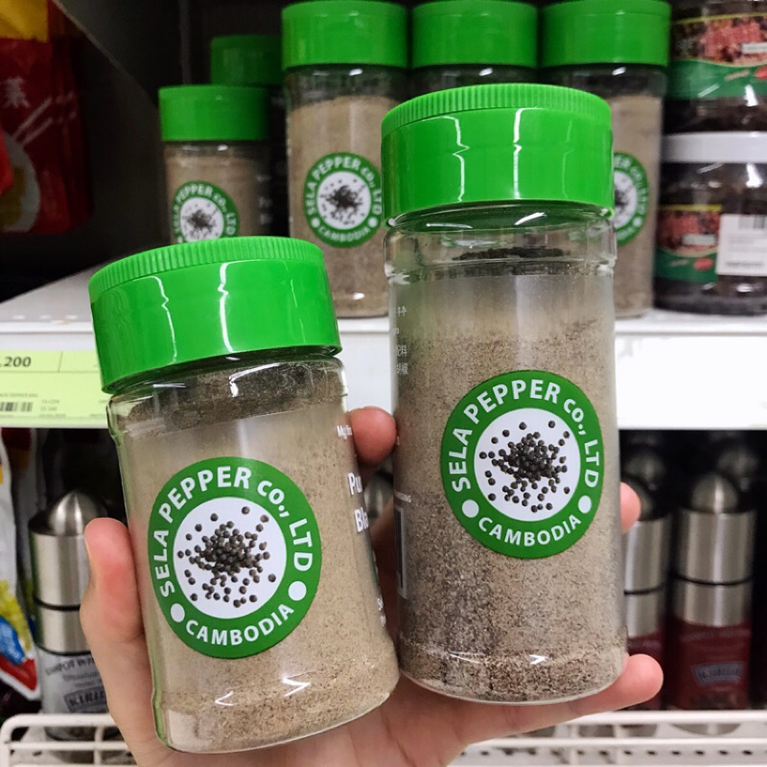
Sela Pepper’s
Placement Strategy
Distribution degree- Intensive distribution
Sela Pepper Co.,LTD. is using the intensive placement which the company want the product to be accessible in many outlets as possible.

Slide 7
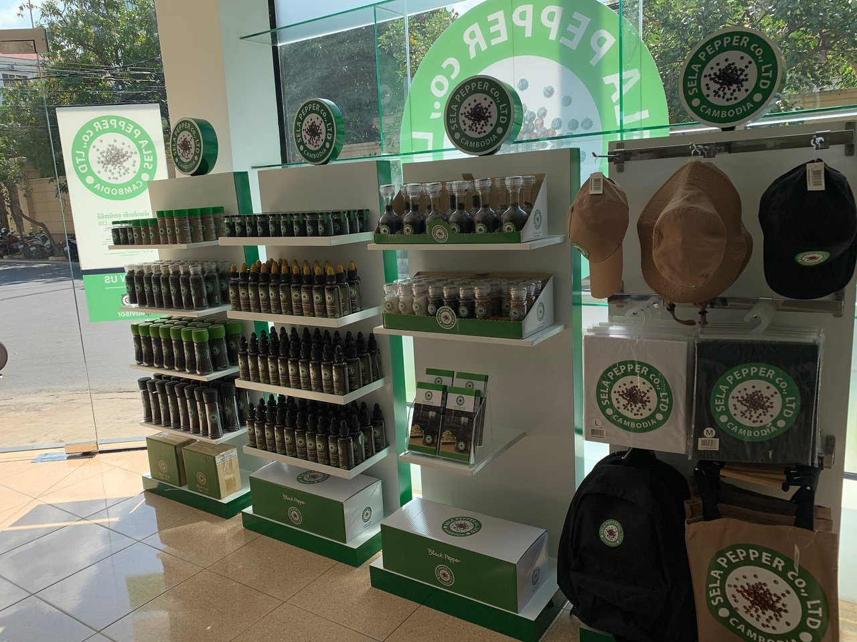
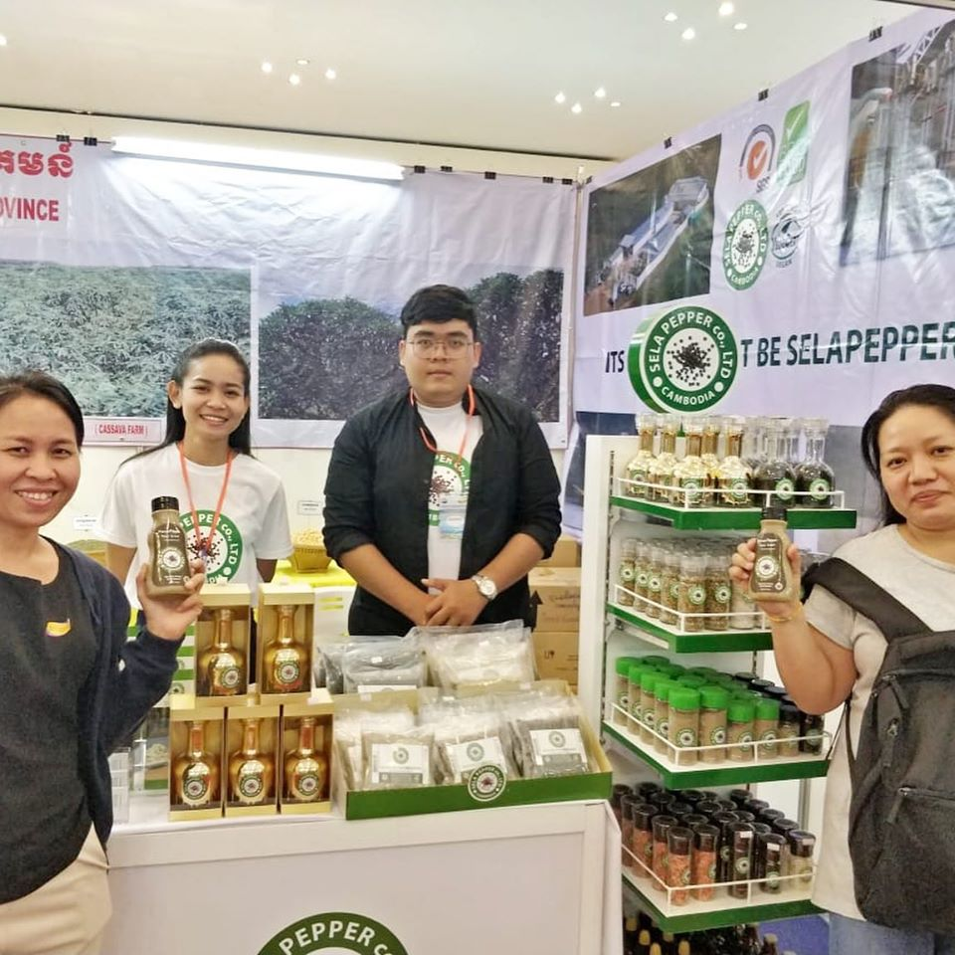
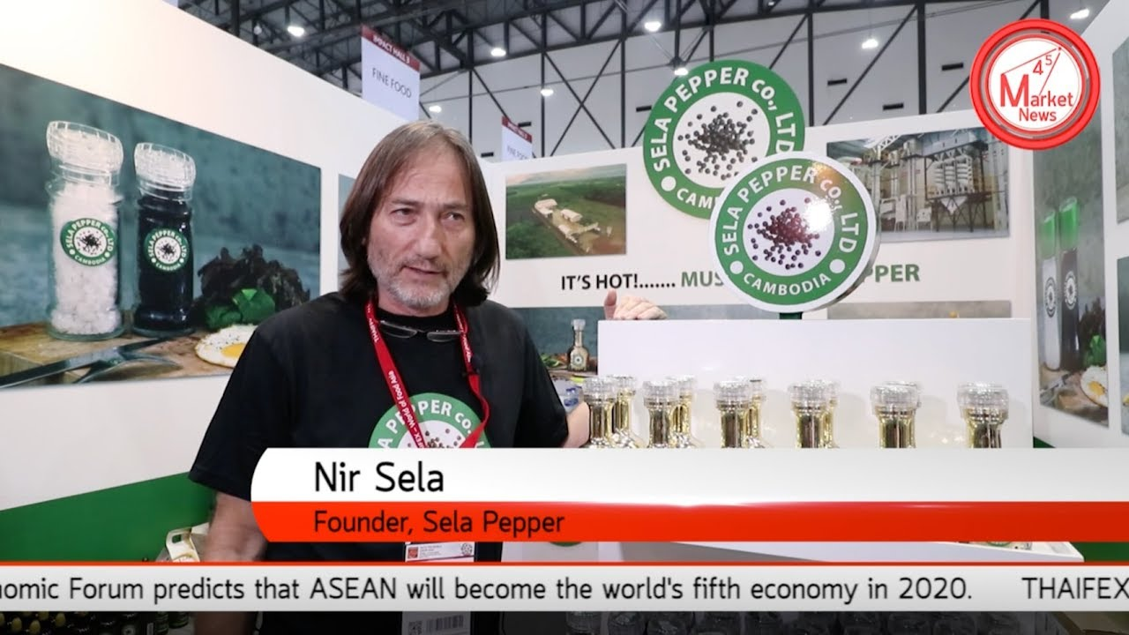
Sela pepper’s
Placement Strategy
Channel distribution- Dual Distribution
With the purpose of intensive placement, this company distributes products to the consumers both directly and indirectly through Intermediaries.
Direct Distribution Channels
Own store
Trade Fair/ Exhibition

Slide 8
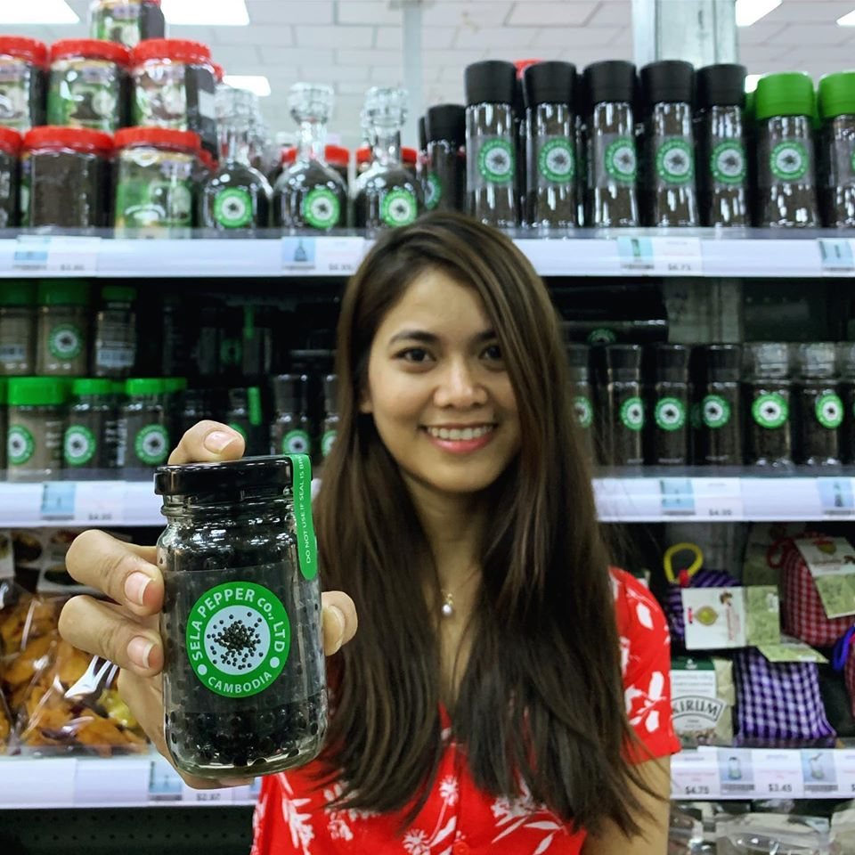
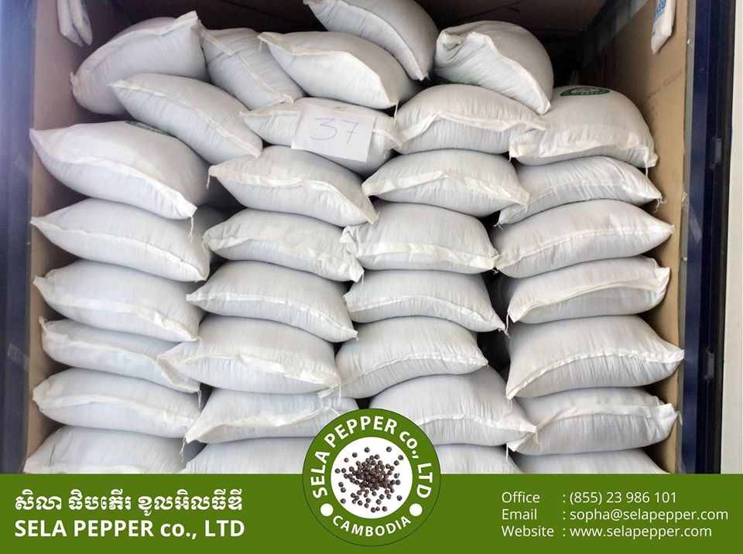
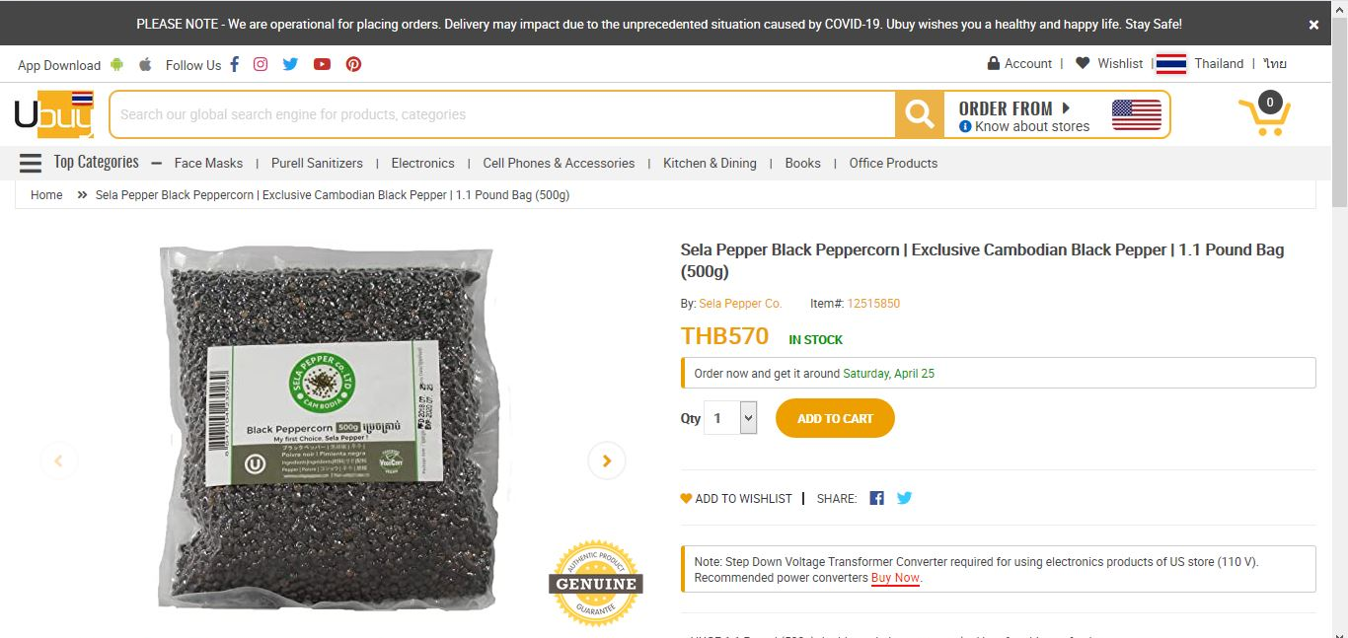
Sela pepper’s
Placement Strategy
Channel distribution- Dual Distribution
With the purpose of intensive placement, this company distributes products to the consumers both directly and indirectly through Intermediaries.
Indirect Distribution Channels
Wholesalers
Retailers
Online retailers

Slide 9
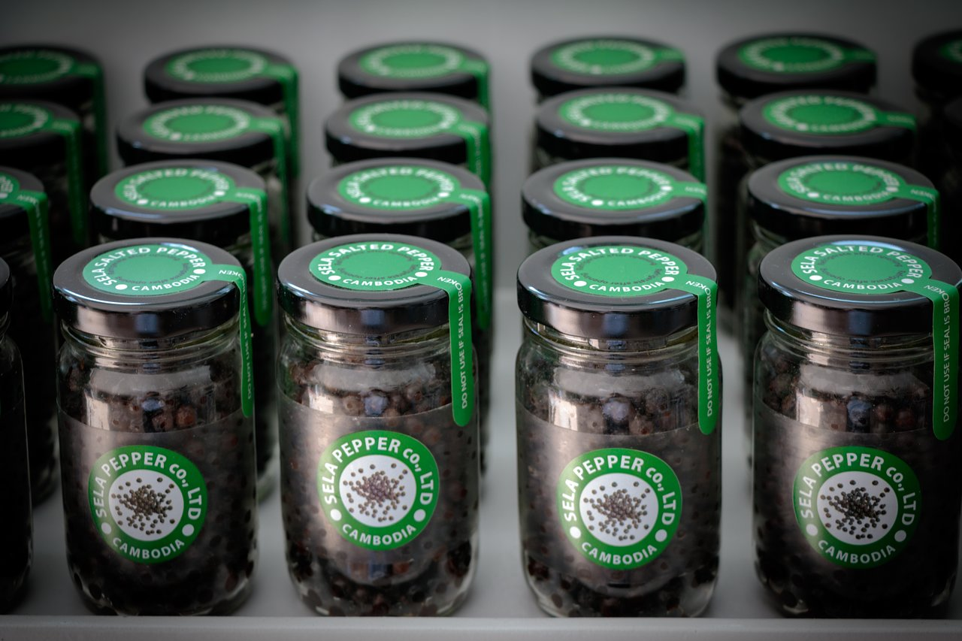
Domestic
Market

Slide 10
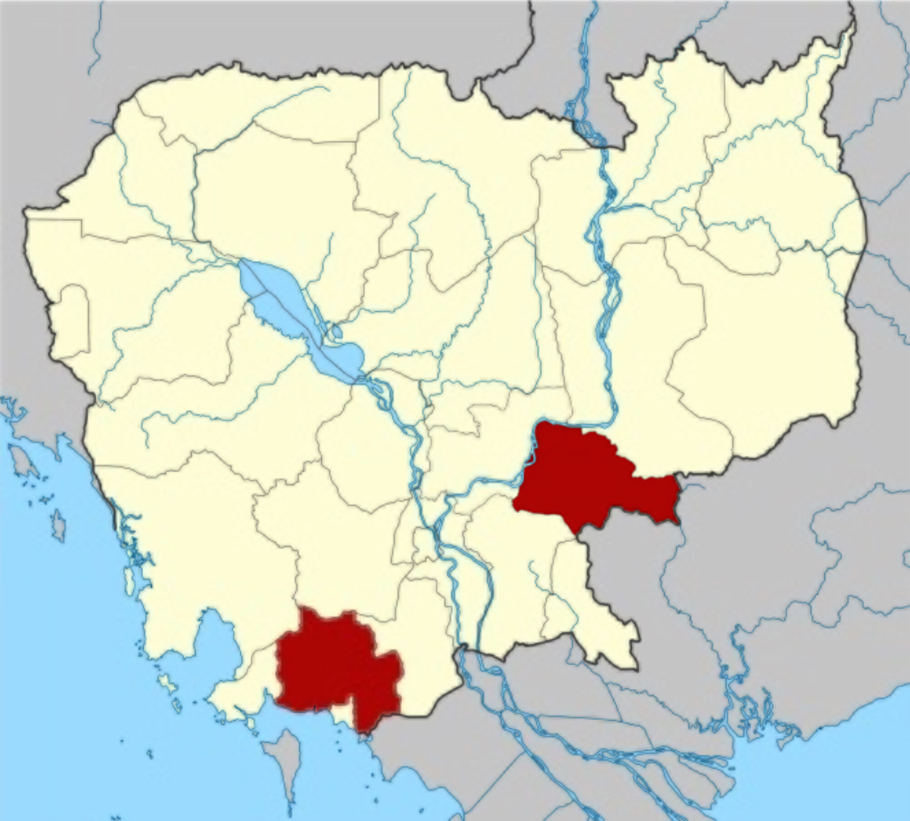

Price Changes-
Tbong Khmum
2009
2015
2017
2018
2020
Tbong Khmum
$2/kg
$9/kg
$3.75 - $5/kg
$2.75/kg
$5/kg (Local) &
$7.5/kg (Sela)
Value Chain-
Kampot (GI)
Past (Low)
Present (High)
Low price & lose authenticity
Limited cultivation technique
Lack of understanding on quality requirement
High exportation cost
Industrial-scale processing facility
( 1.5 ton per hour)
Link smallholders with retail customer overseas
Farmers benefit fair & stable market
Kampot (GI)
Black pepper $15/ Kg
Red pepper $25/ Kg
White pepper $28/ Kg

Slide 11
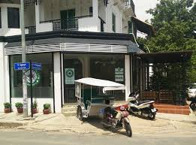
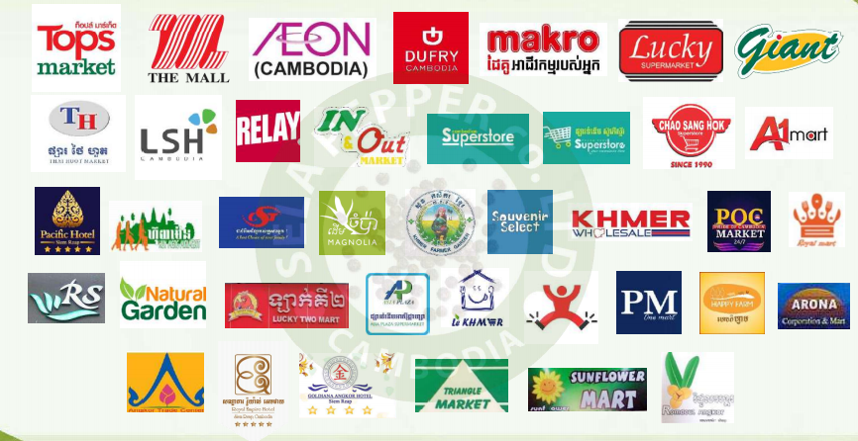
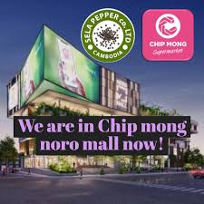
Distribution Channel & Partners-
Channel Objectives:
Cambodian authentic gift for tourists
Allow customers to get detail information regarding the brand & the industry
Total Partners: 54
Phnom Penh 31
Siem Reap 21
Sihanouk Ville 2)

Slide 12
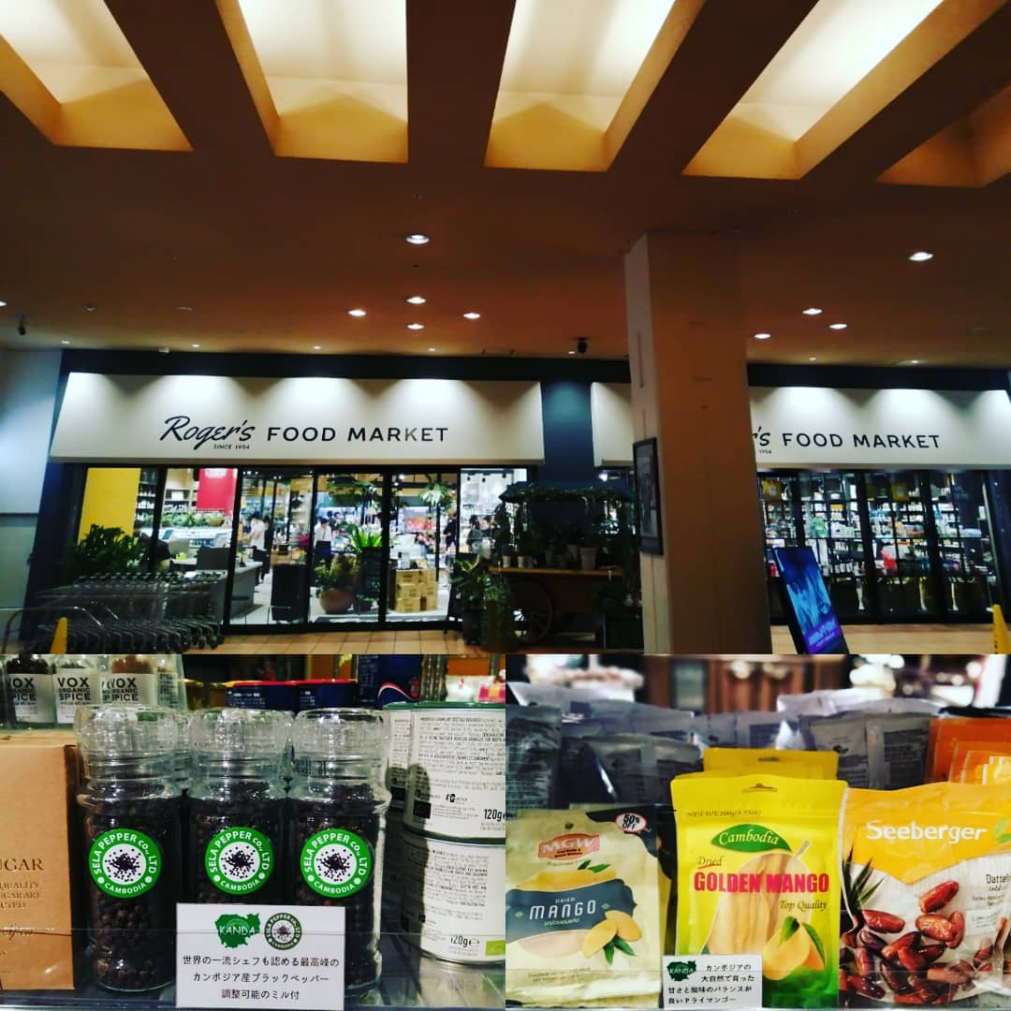
International market
Sela Pepper reached international market in the U.S., Germany, EU, Japan, India, Taiwan, New Zealand, and Thailand.
Notes:
© Copyright Showeet.com – Free PowerPoint Templates

Slide 13
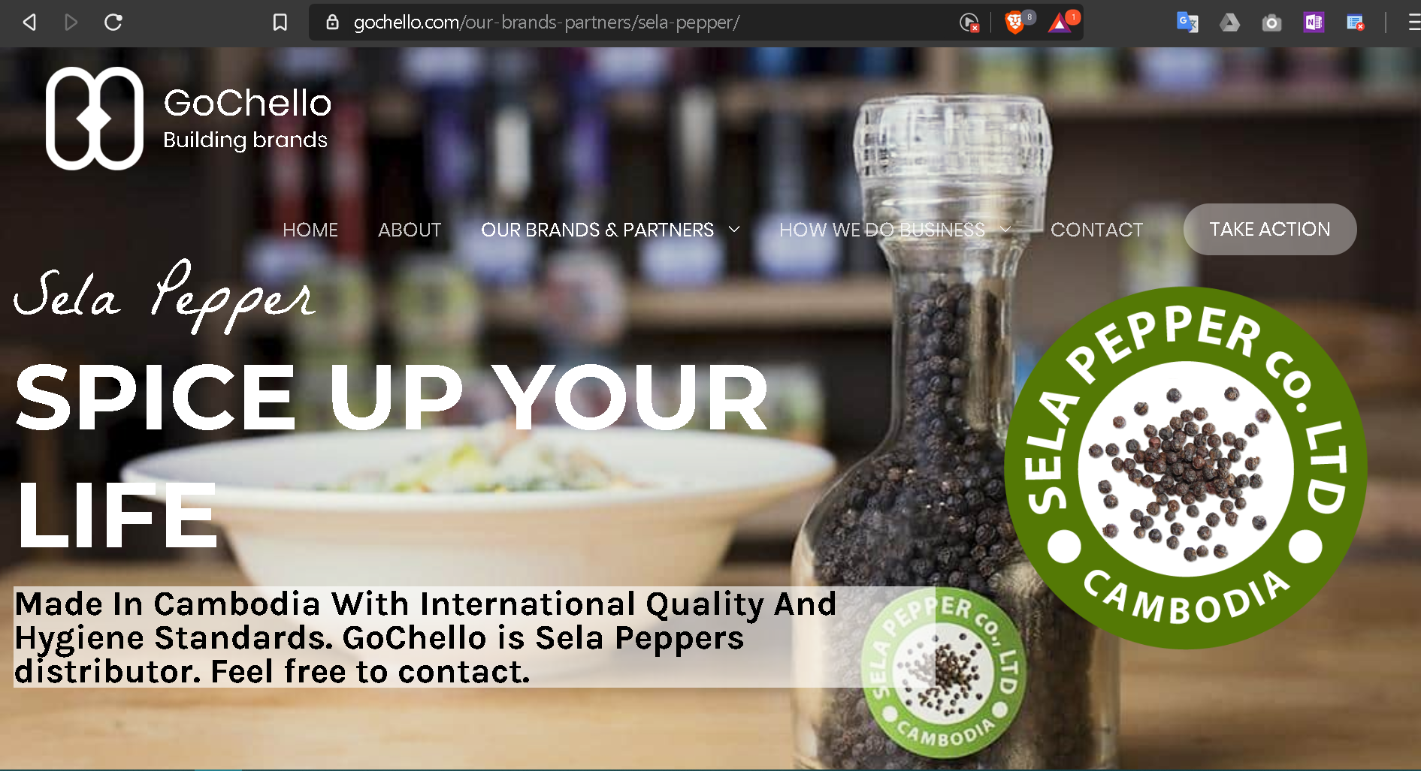
Wholesaler

Slide 14
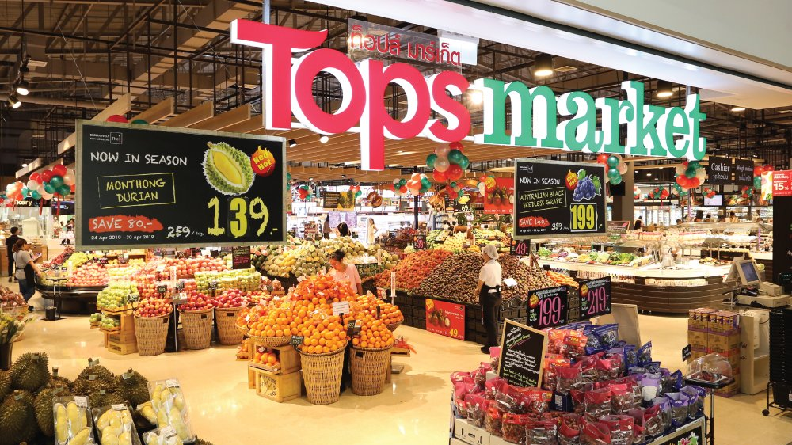
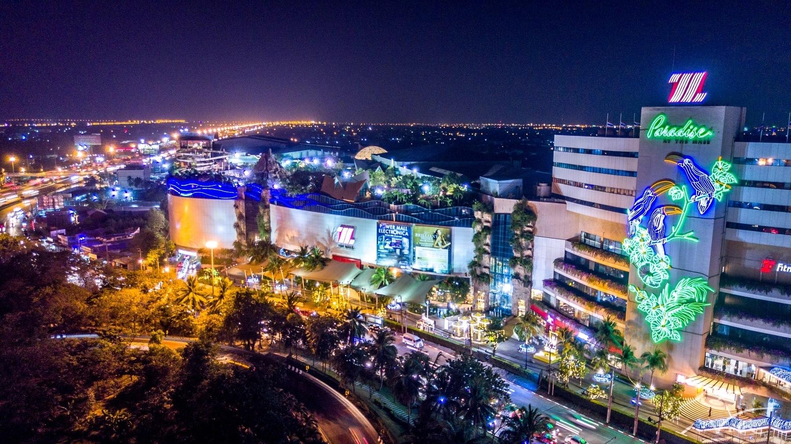
Retailers
Super Market
Department store

Slide 15
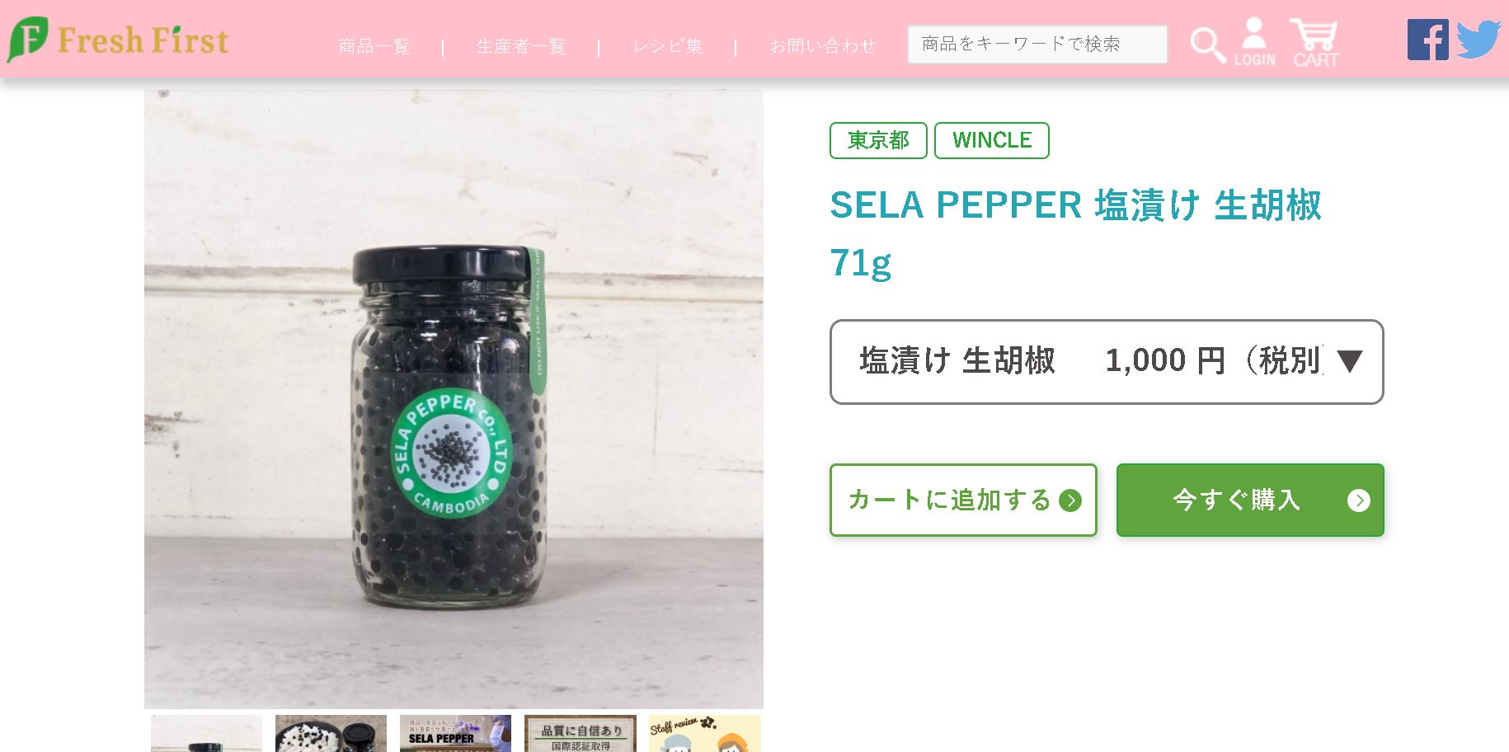
Retailers
Convenience store

Slide 16
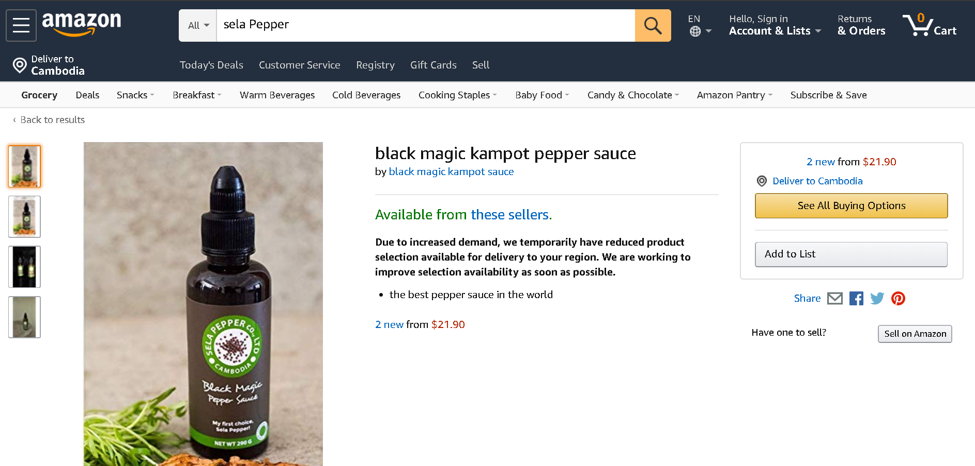
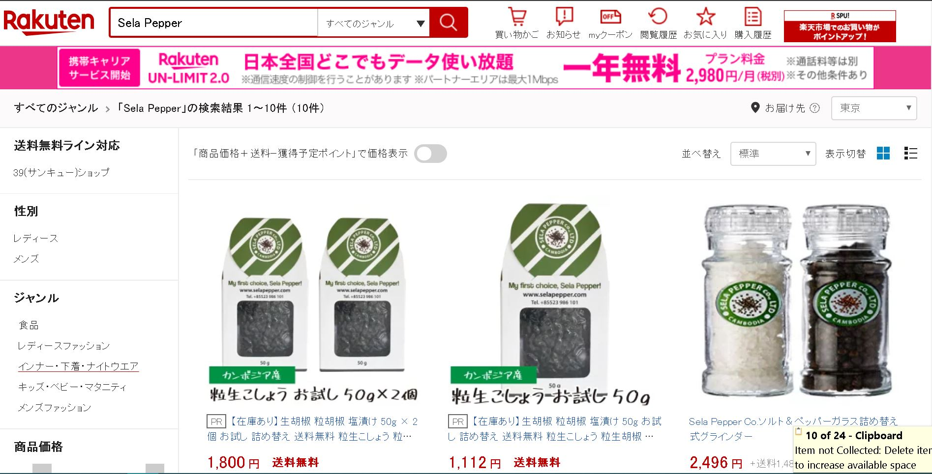
Online retailers

Slide 17
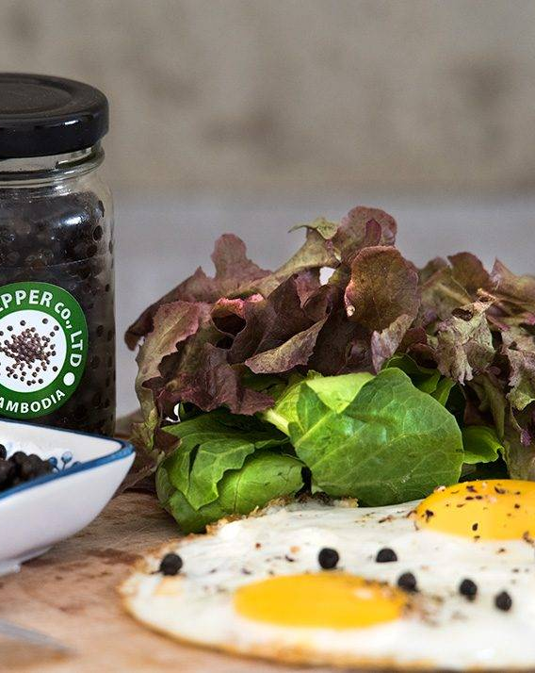
Suggestion
Notes:
© Copyright Showeet.com – Free PowerPoint Templates

Slide 18

Thank you for your attention!

