Slide 1


Internship Defense In
Learning and Development
Sotheara SOK

Slide 2
Table of Contents
Company Profile
Internship Activities
Duties and Mission
Competences Required and Deployed
Problems Faced
Outputs
Improvement Suggestions
Further Studies and Professional Project

Slide 3
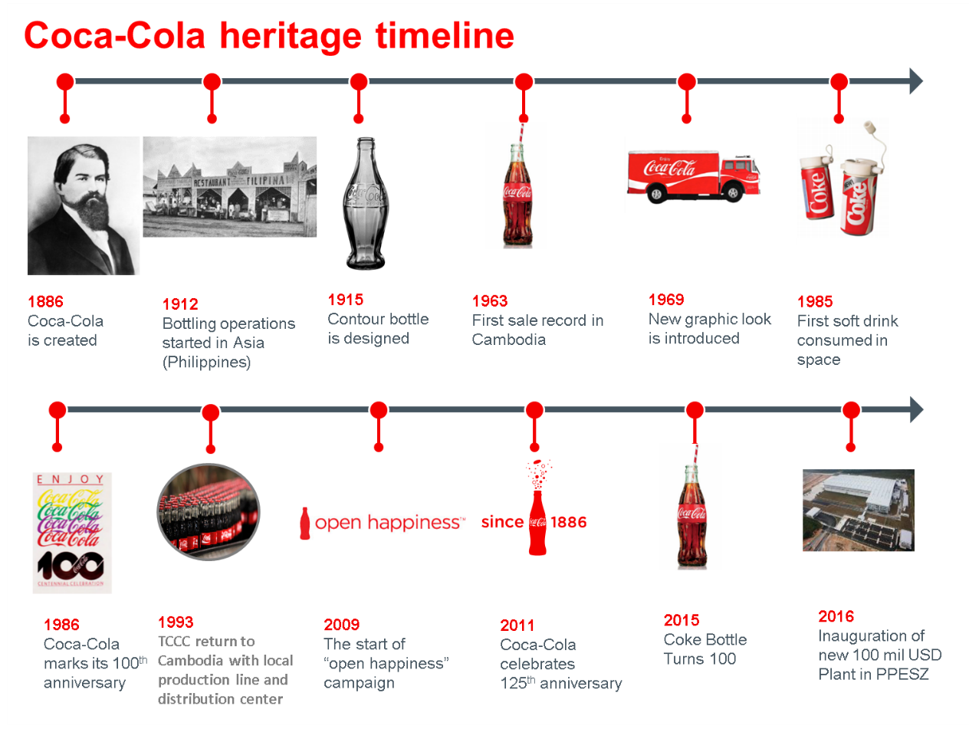

History in Cambodia
Founded in 1886
First sale in Cambodia in 1963
Return to Cambodia in 1993
Build new plants worth $100M in PPSEZ

Slide 4
CBC’s Main Location
Divided into four regions: North, West, East, and South
Head office in Russey Keo, Phnom Penh

Slide 5
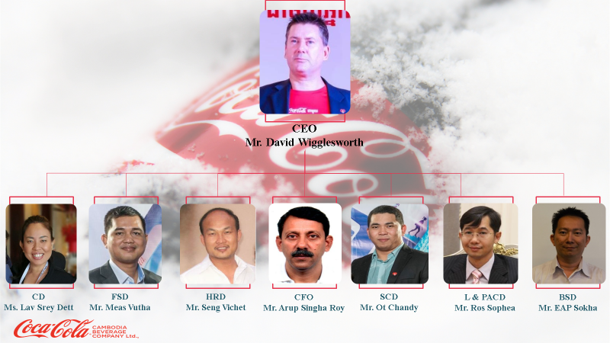
CBC’s Hierarchy
Current CEO Mr. David Wigglesworth
Has seven key important people represent seven departments

Slide 6
Table of Contents
Company Profile
Internship Activities
Duties and Mission
Competences Required and Deployed
Problems Faced
Outputs
Improvement Suggestions
Further Studies and Professional Project

Slide 7
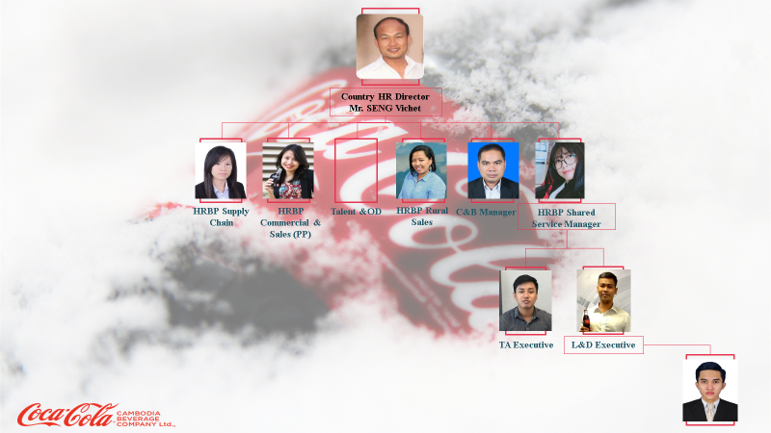
HR Department Hierarchy
I work under the sub-function of HR department, namely Learning and Development and under the supervision of Mr. Vannak LOEM
Above him is Mrs. Socheata SY which taking in control the HRBP Shared Service Manager
Mr. Vichet Seng is the Country Human Resources Director

Slide 8
In-House Training
External Training
Duties and Mission
Core Training

Slide 9
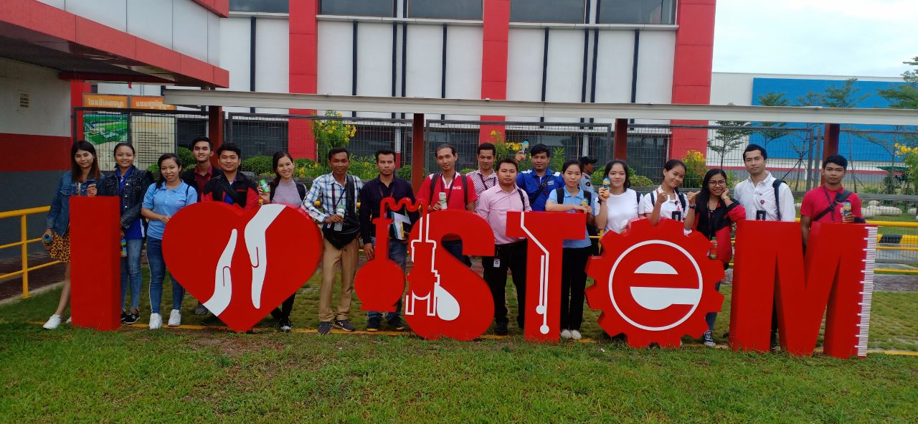
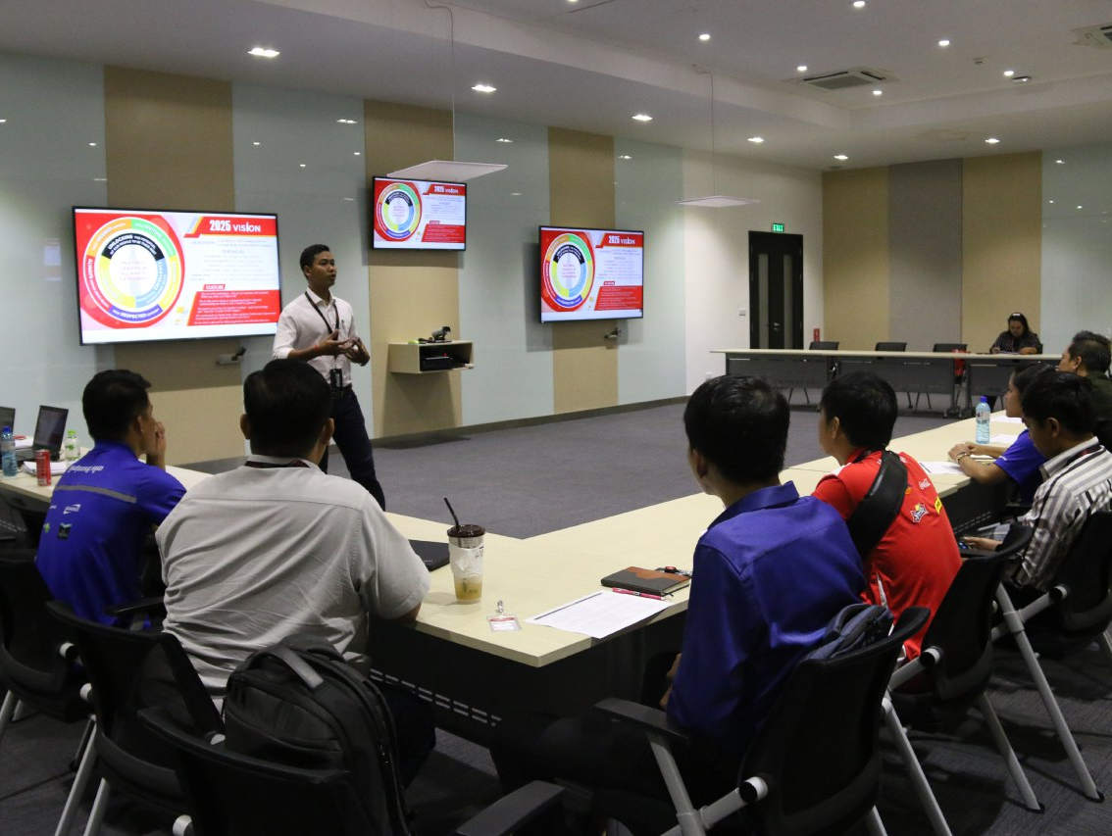
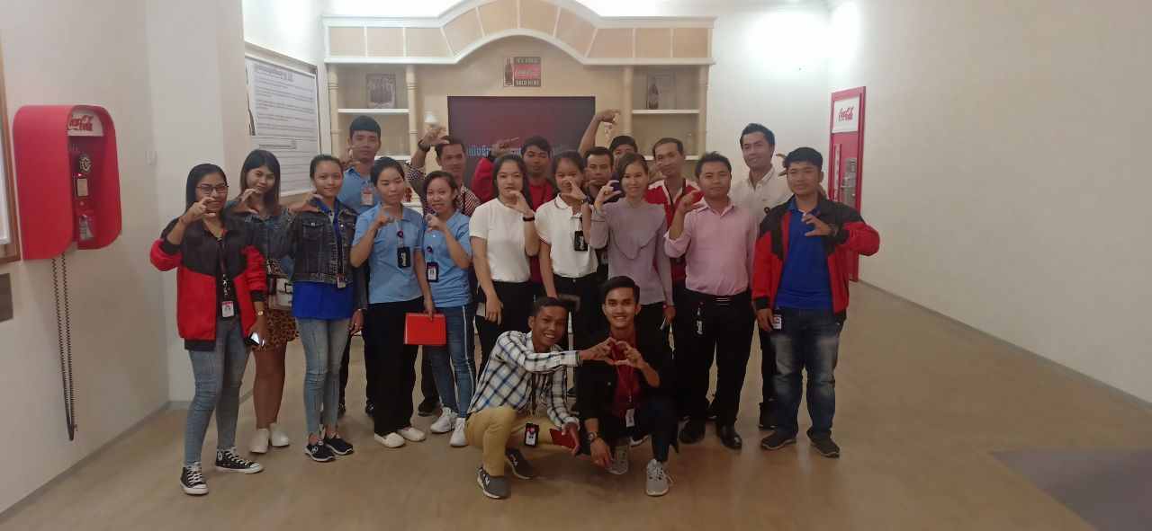

Core Training:
Induction Training
Before: call follow up, prepare paper works, and book the room
During: facilitate, arrange snacks, and survey participators
After: record the survey data, distribute survey results, and organize hard copy documents

Slide 10
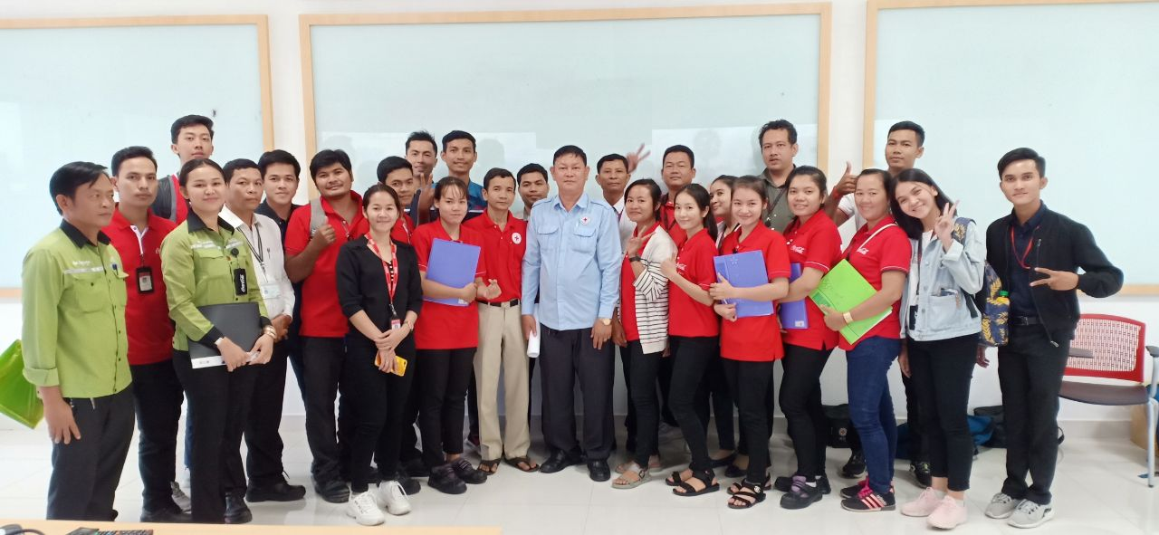
In-House Training:
First Aid Training & Contract Training
Record the attendance
Assist presenters
Sit down and learn

Slide 11
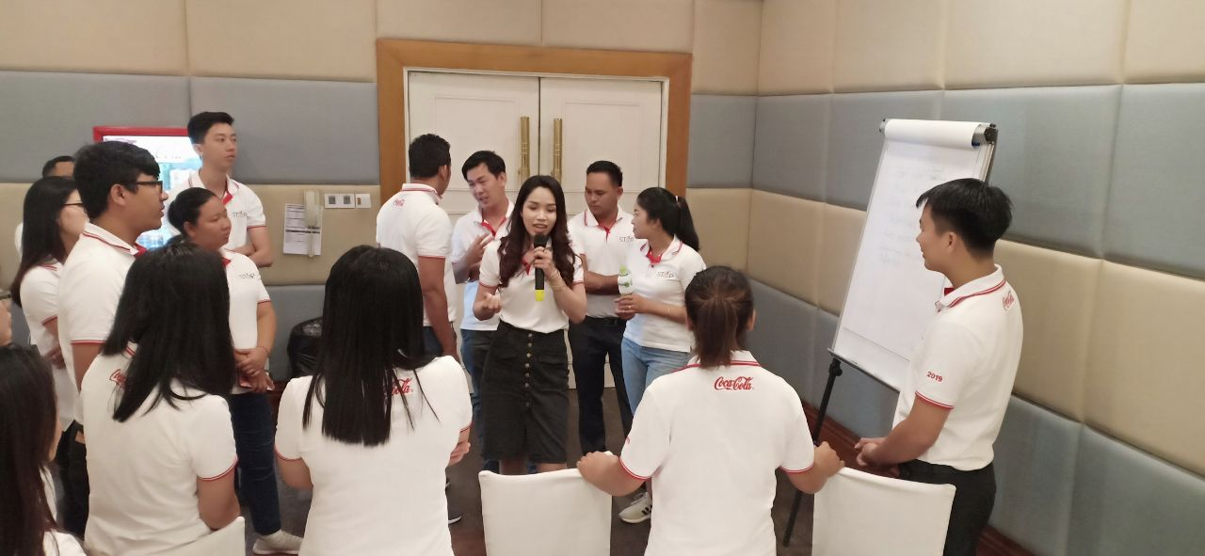
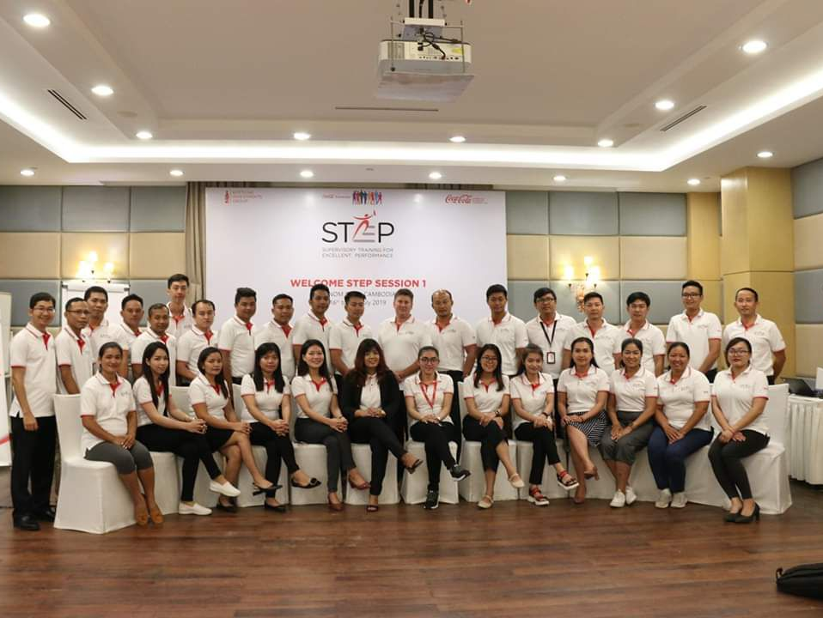
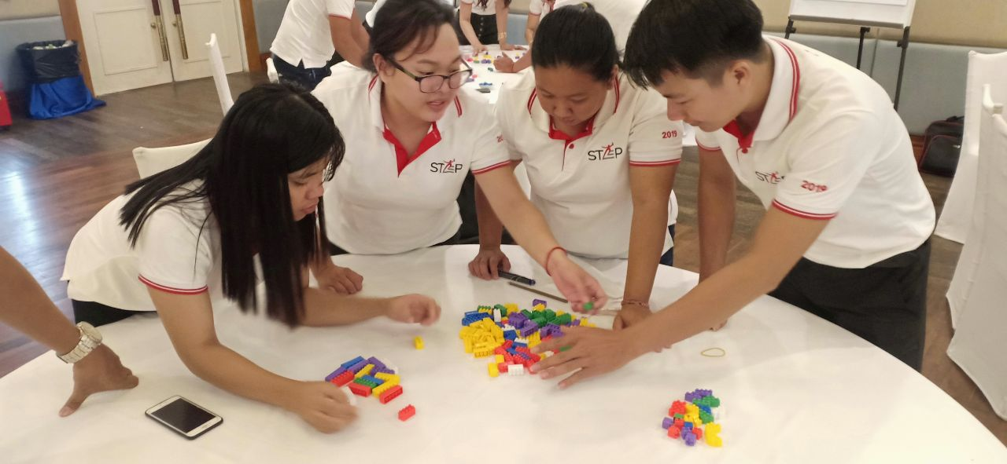
External Training:
STEP Program
Delivery
Do checklist
Buy stationary

Slide 12
English Language
Computer Science
Competences Required
Interpersonal Skills

Slide 13
Limitation to the Group Meeting
Allotment of Trivial Work
Problems Faced
Long Distance Travel

Slide 14
Table of Contents
Company Profile
Internship Activities
Duties and Mission
Competences Required and Deployed
Problems Faced
Outputs
Improvement Suggestions
Further Studies and Professional Project

Slide 15
Creative Working Environment
Attention to Trainees
Improvement Suggestions
Encourage Education

Slide 16
Further Studies and Professional Project

