Slide 1


Professor: CHHEAV Narath
Pricing Strategy
GROUP IV
THON Chanmarianet
YON Sorakyos
SOK Sotheara
HOY Chankaknika

Slide 2
TABLE OF CONTENTS
- About OPPO
- OPPO’s market Share
( Global & Cambodia)
- OPPO’s Pricing Strategy
- Suggestion

Slide 3
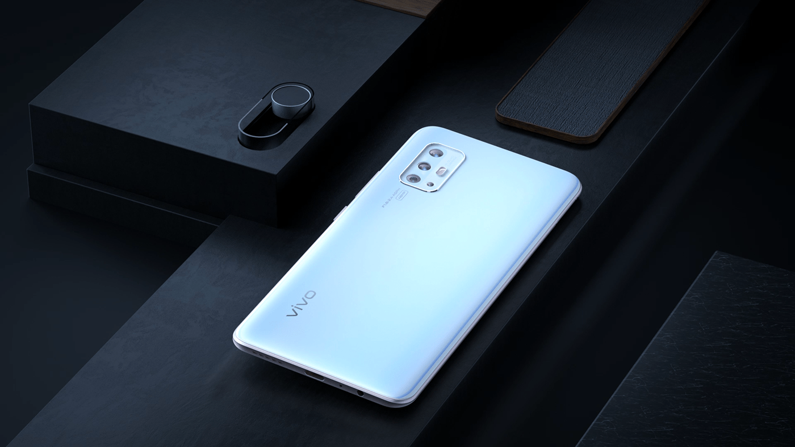
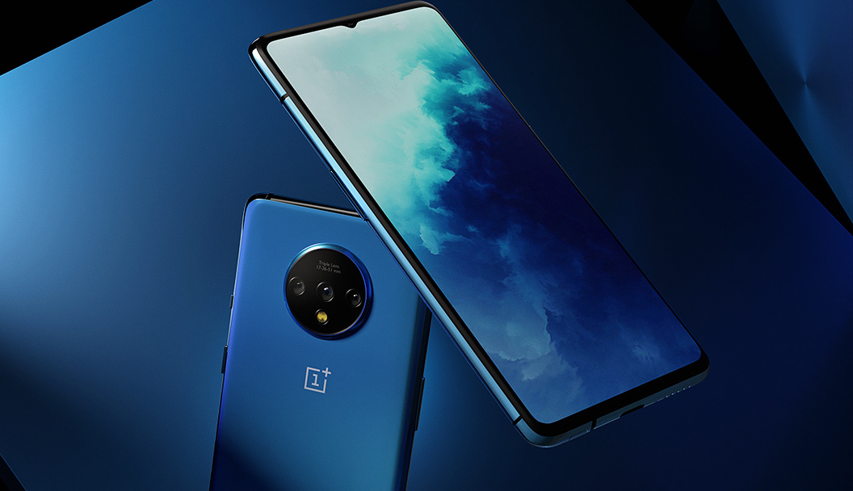


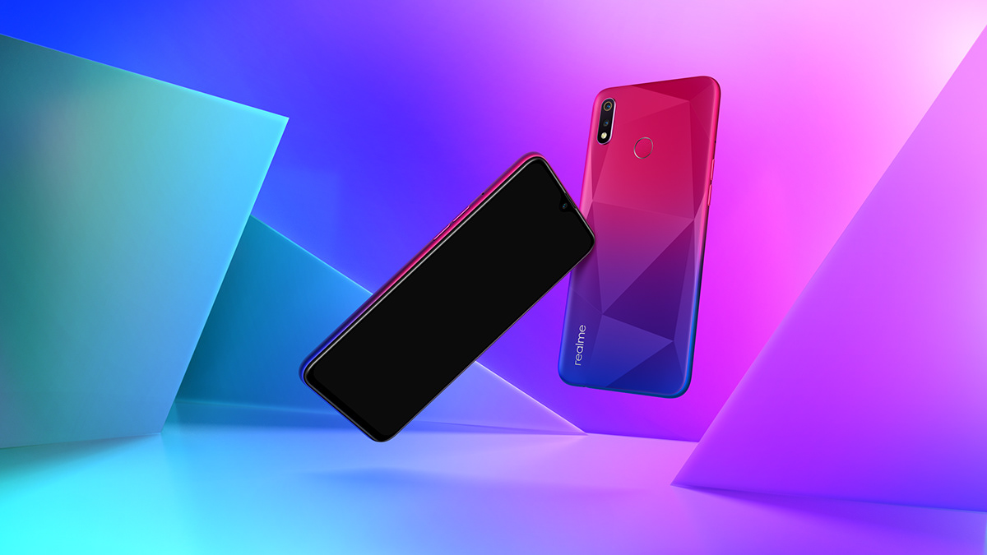

Slide 4
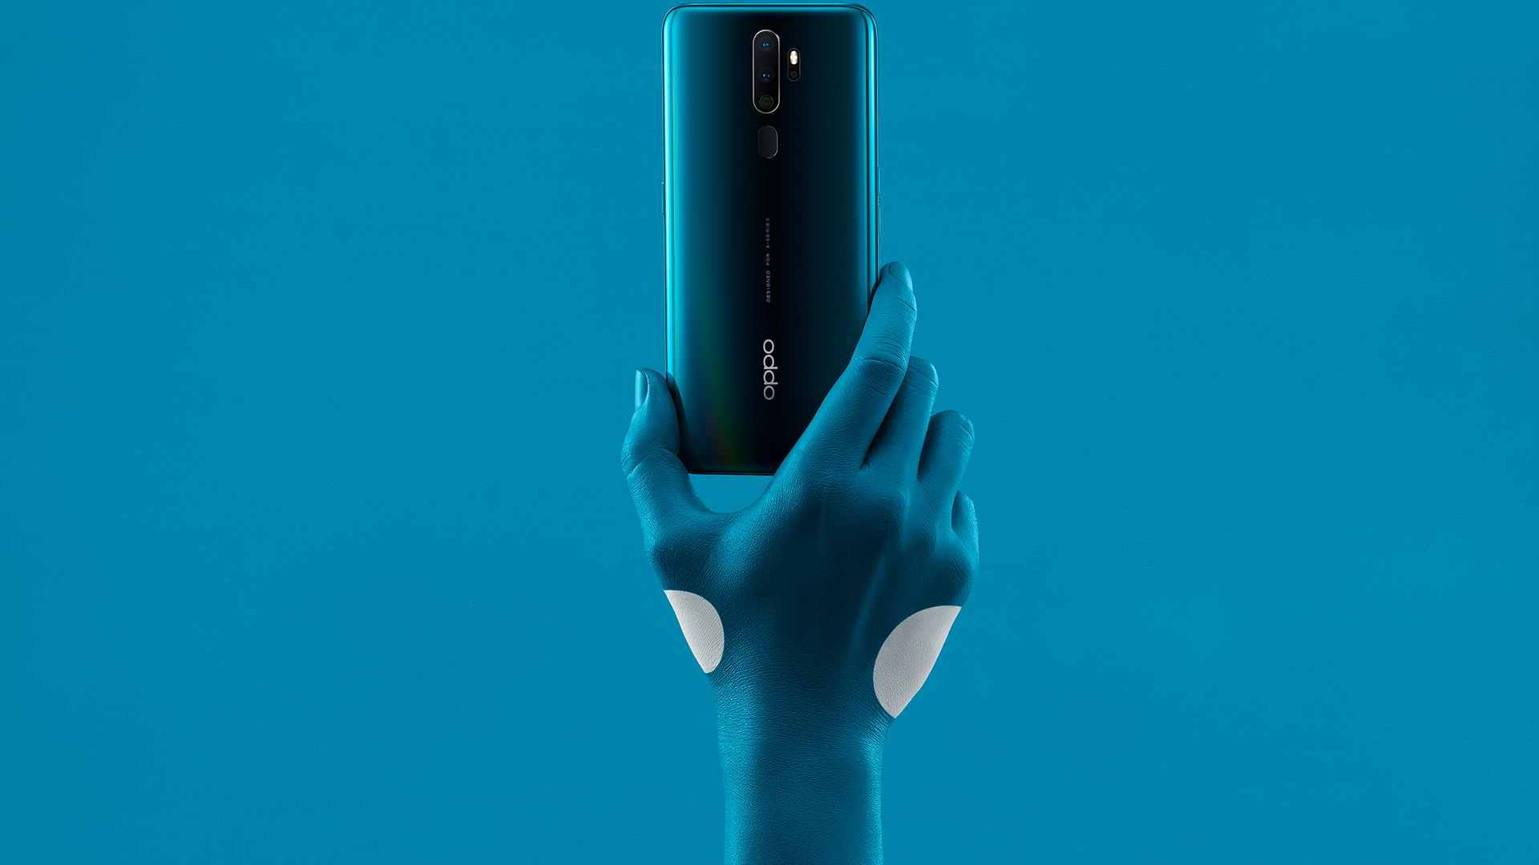
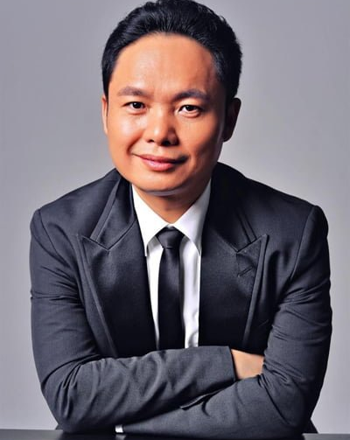
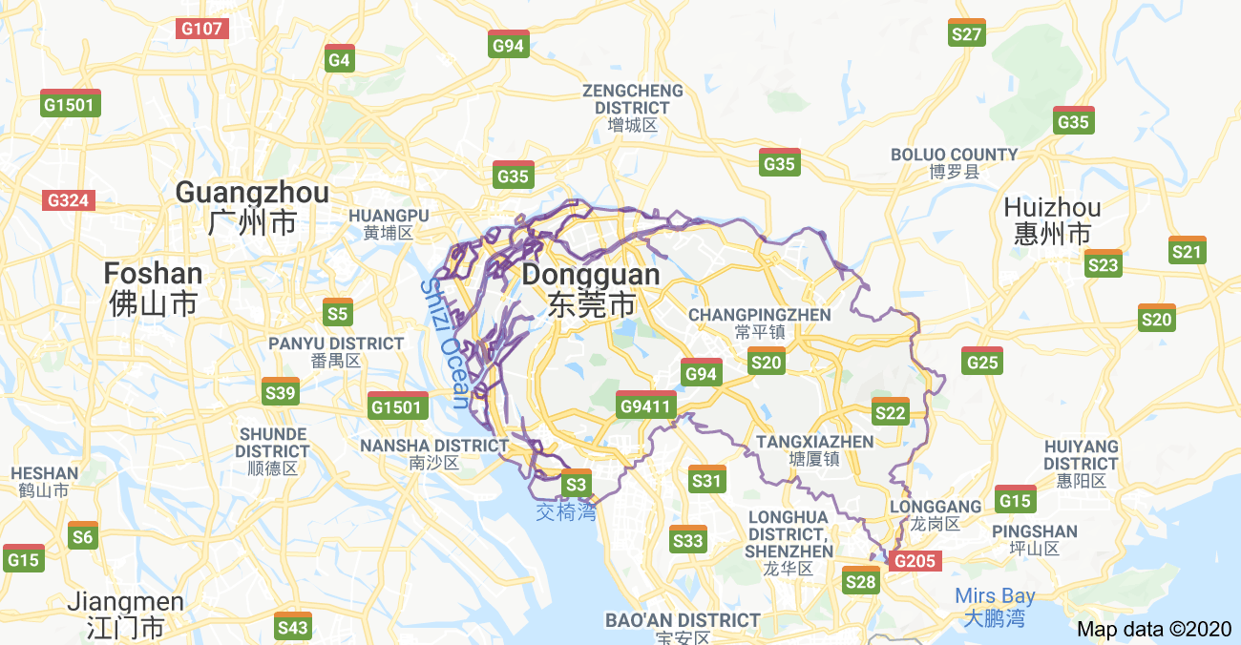
Founded in 2001 and launched in 2004
Headquarter in Guangdong, China
Tony Chen
Dongguan

Slide 5
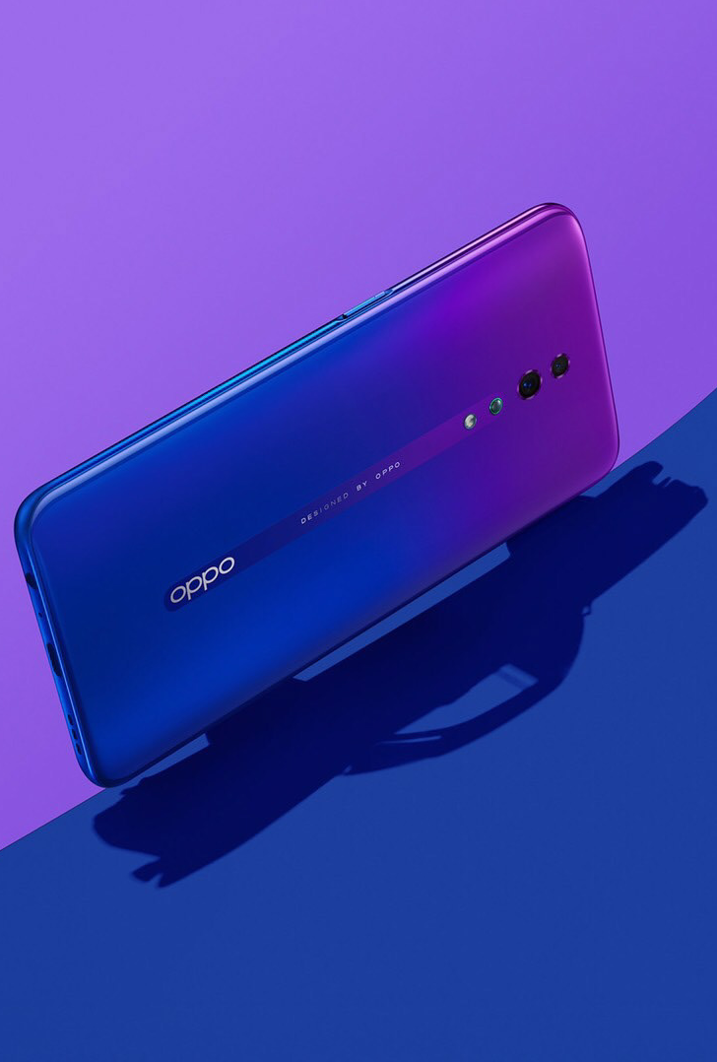

VISION
To Be A Sustainable Company That Contributes To A Better World.
MISSION
Let Extraordinary Users Enjoy The Beauty Of Technology.

Slide 6
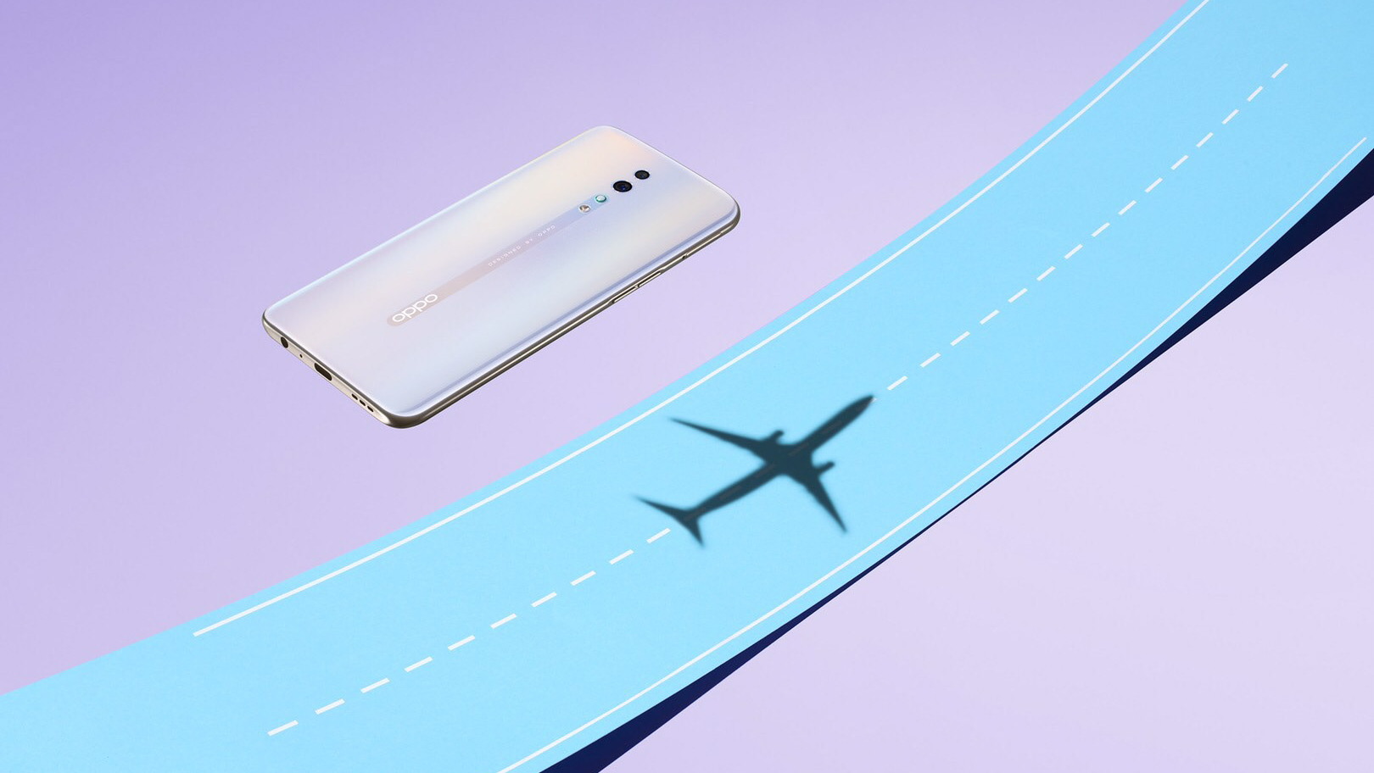
CAMBODIA
01, Nov, 2014

Slide 7
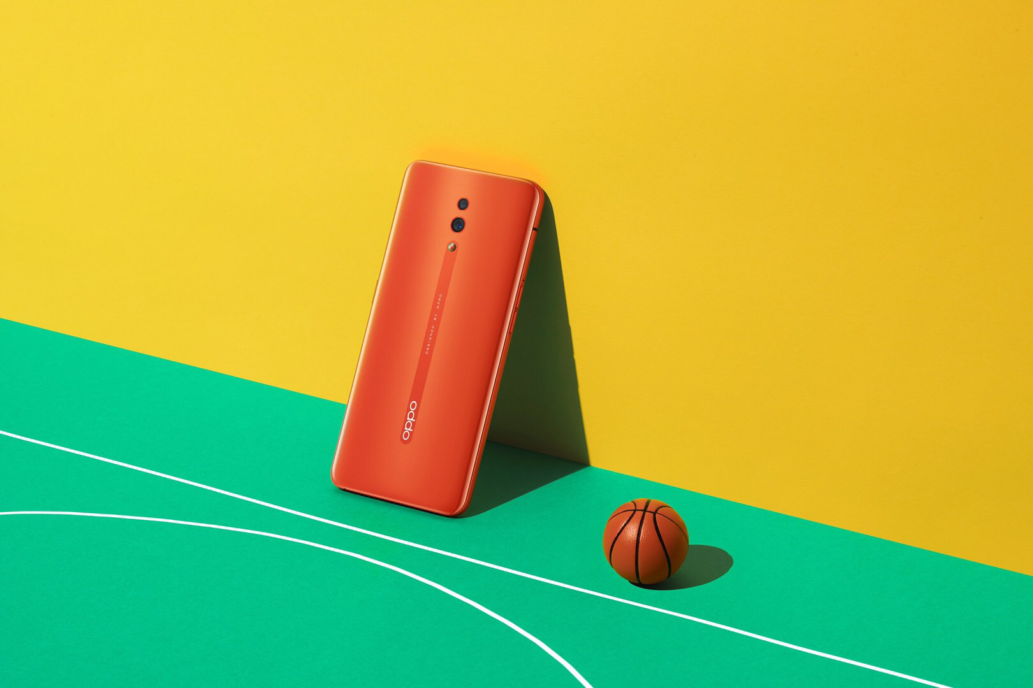
Oppo’s Market Share

Slide 8
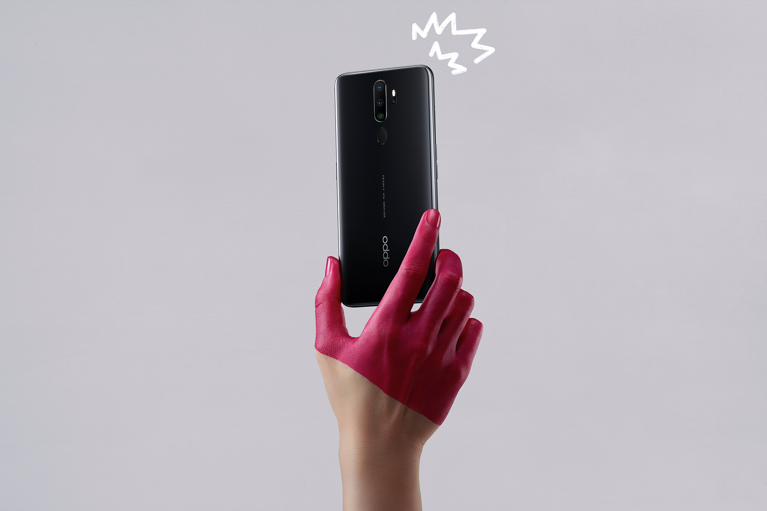
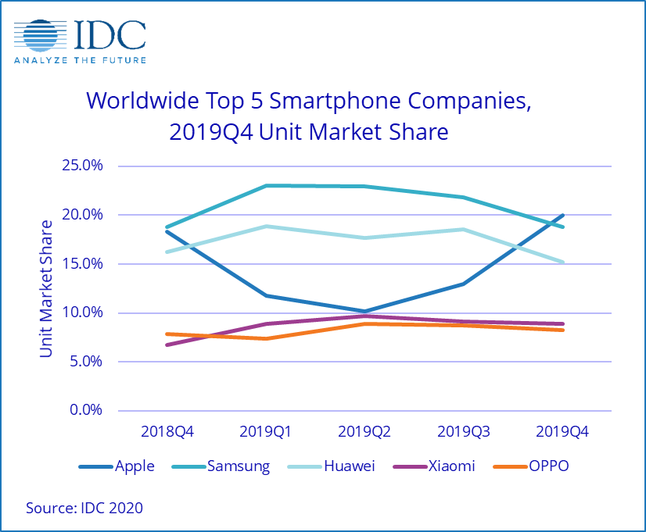
Global Smartphone market share 2019 q4
1.01% end of 2016 to 18.9% end of 2019
Annual vendor market share in Cambodia

Slide 9
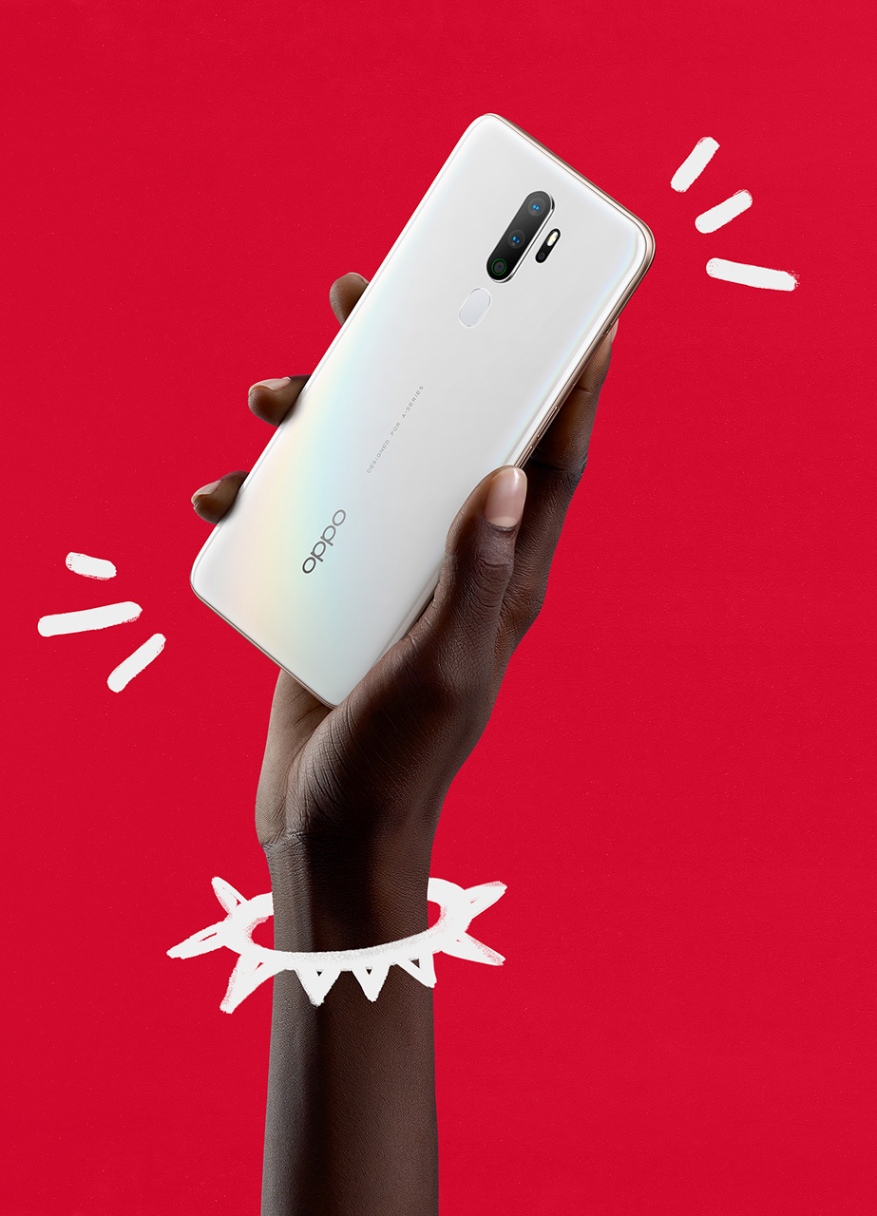
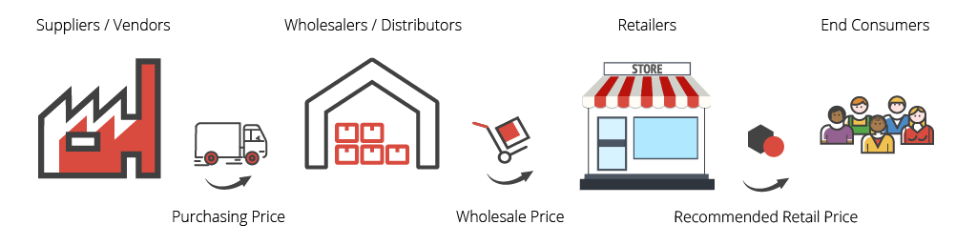
Monthly market share in 2020
OPPO surpassed Samsung at 0.06%, while Apple remains the 1st
MOP + SRP
Profit Margin
14%-15%
5%-6%

Slide 10
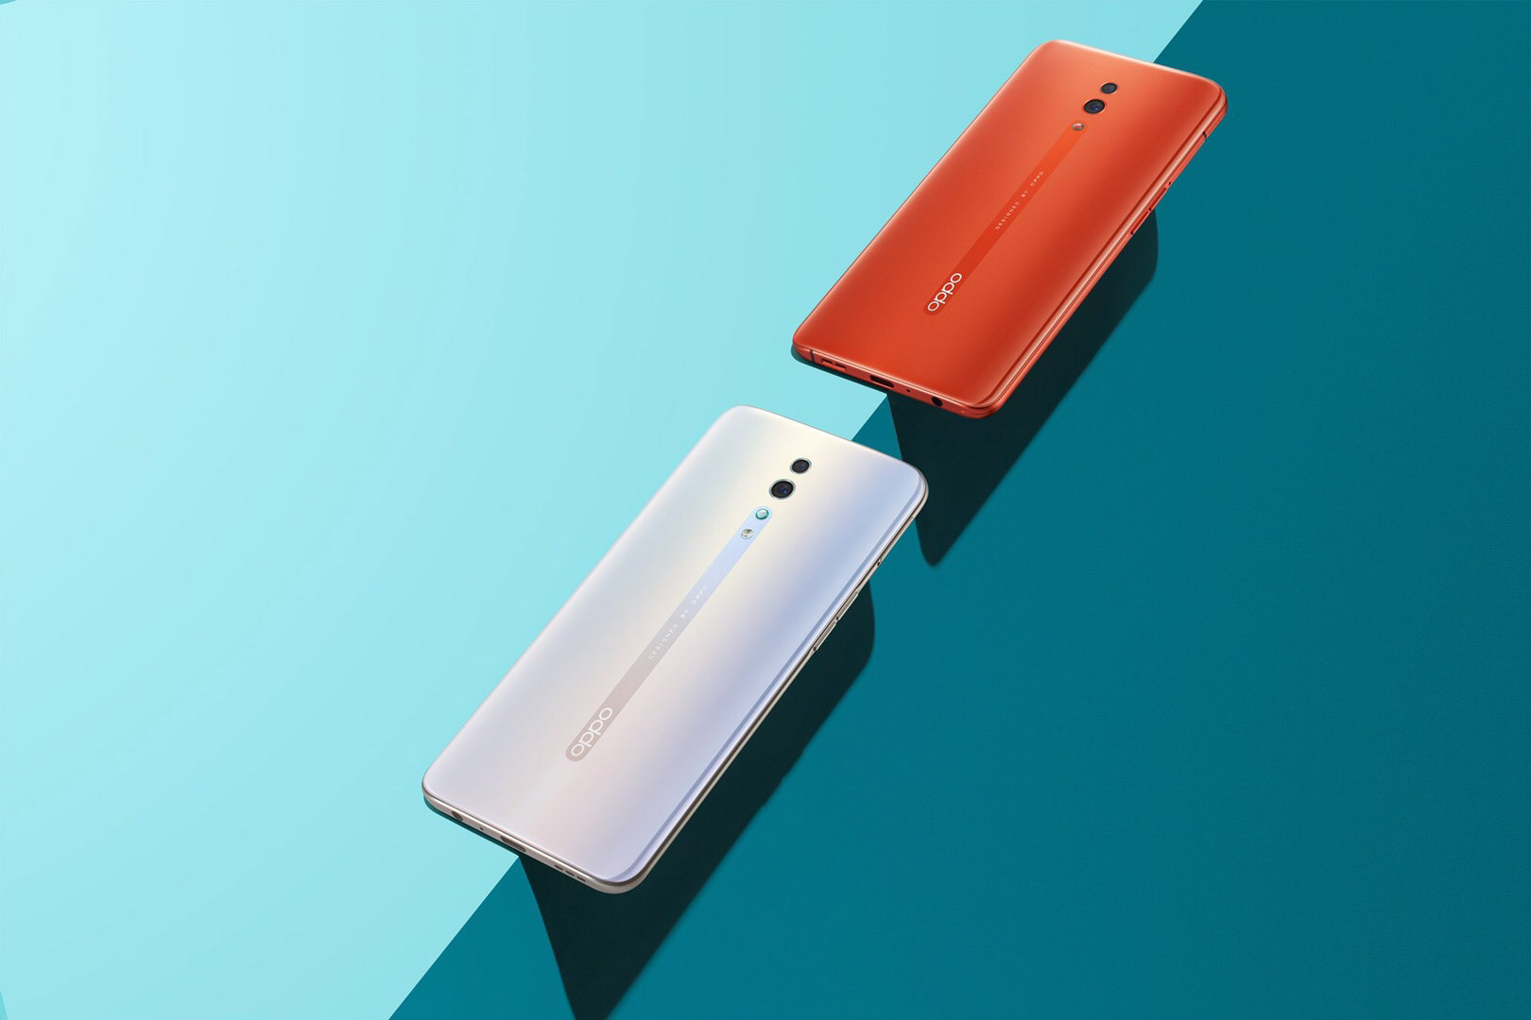
Oppo’s Pricing
Strategy

Slide 11
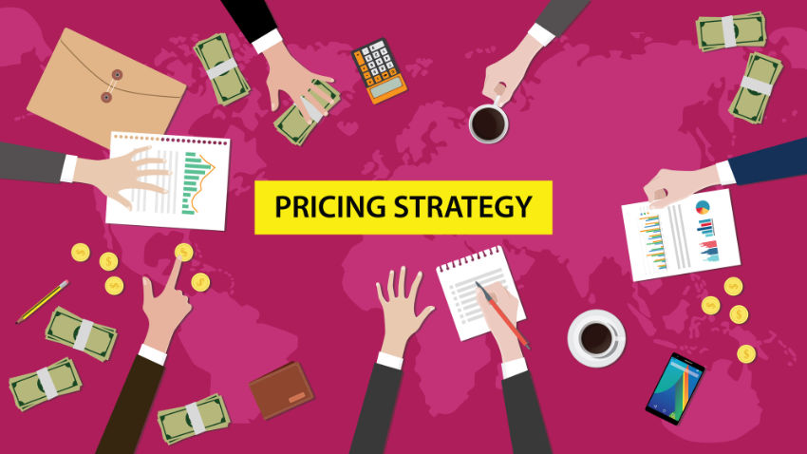

Slide 12
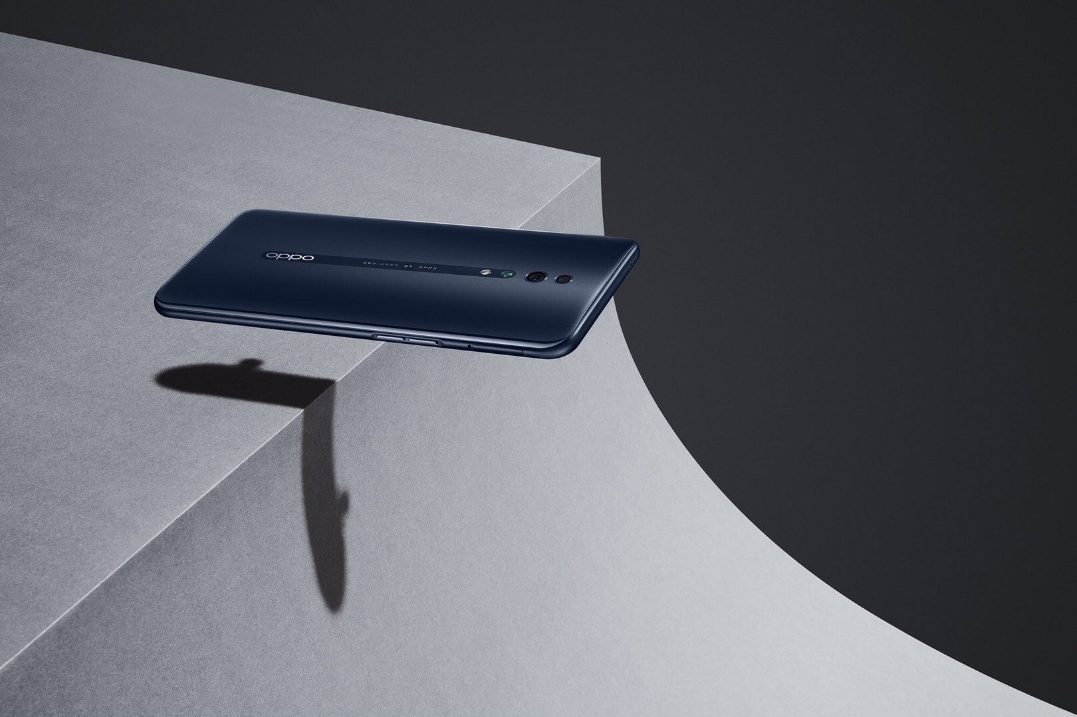

1.Consumer based pricing strategy
Oppo uses the consumer based or value based pricing strategy to set its products in the different markets.
Consumer wants and demands
Benefits offered to customers with the price that they are willing to pay

Slide 13
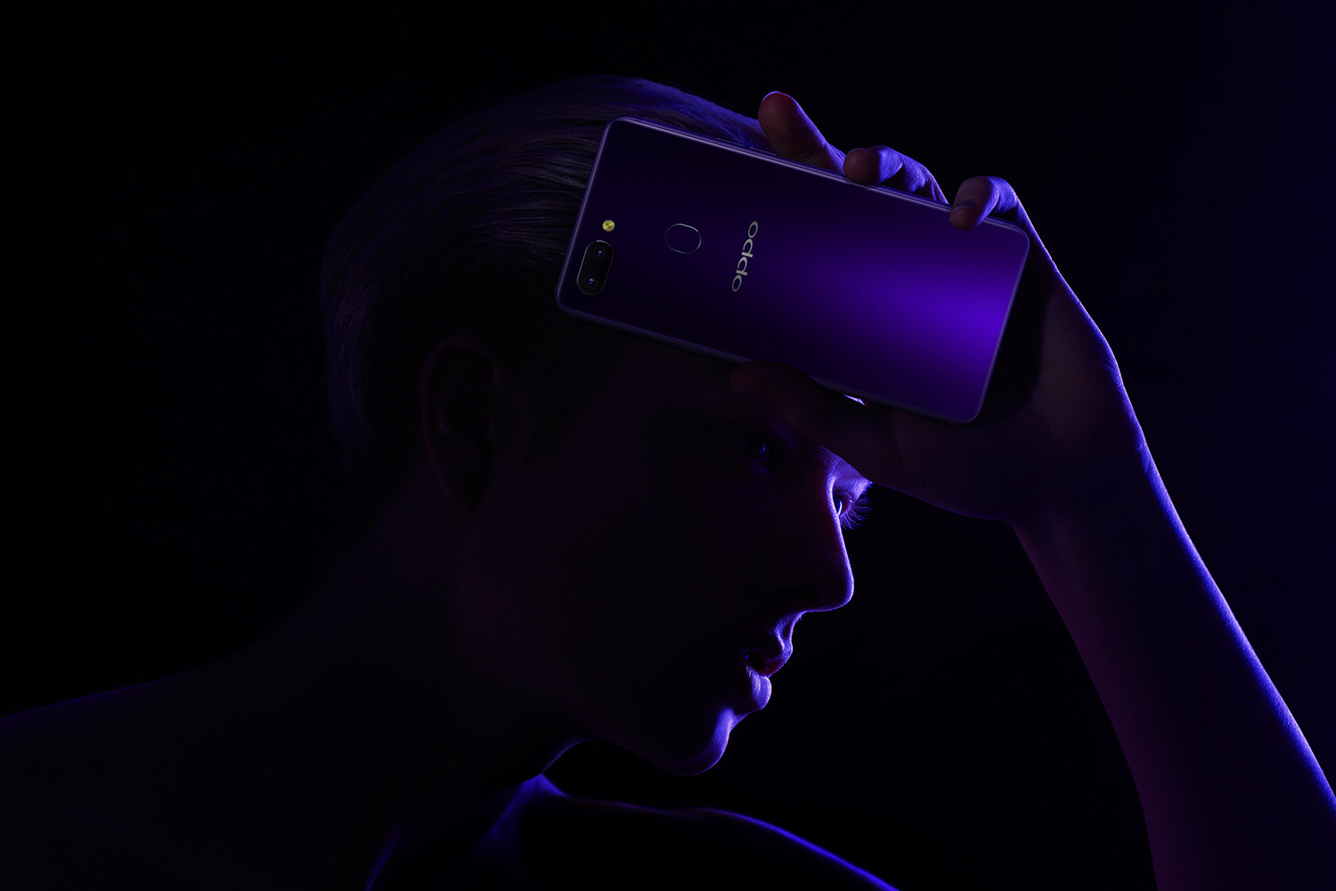
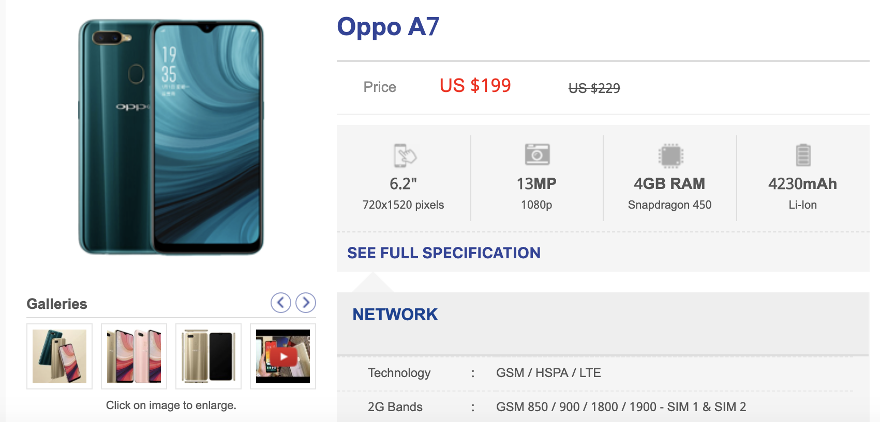
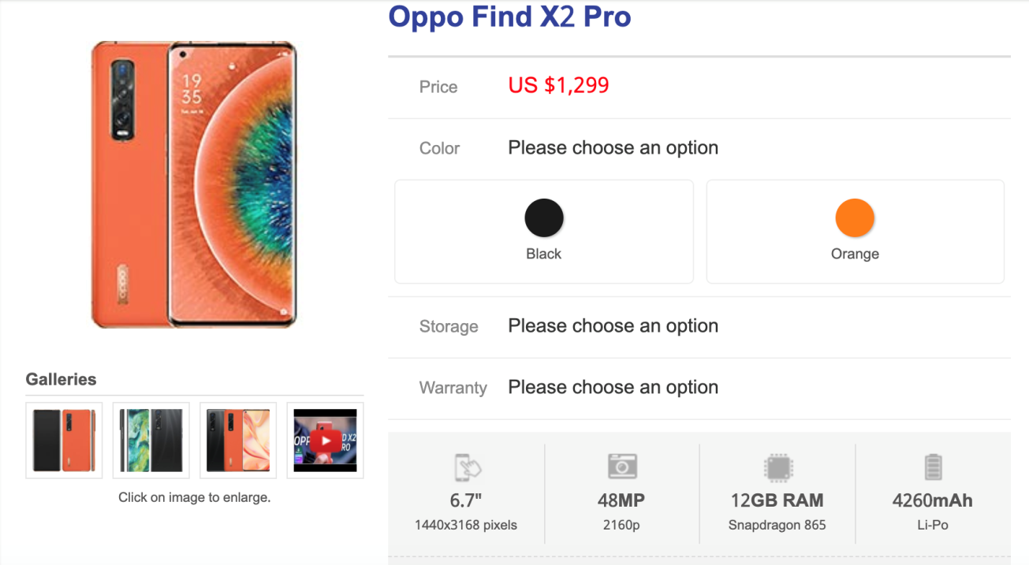
2. Penetration pricing
The main idea behind is to capture lot of consumer as the potential one.

Slide 14
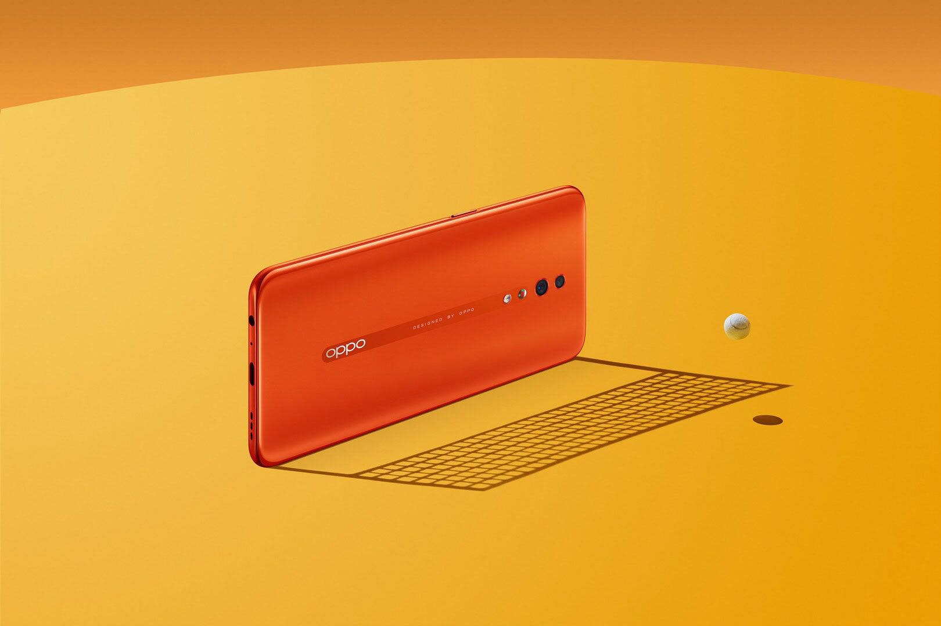
3. Psychological pricing (3type)
- Bundle pricing
- Promotional pricing
- odding pricing

Slide 15
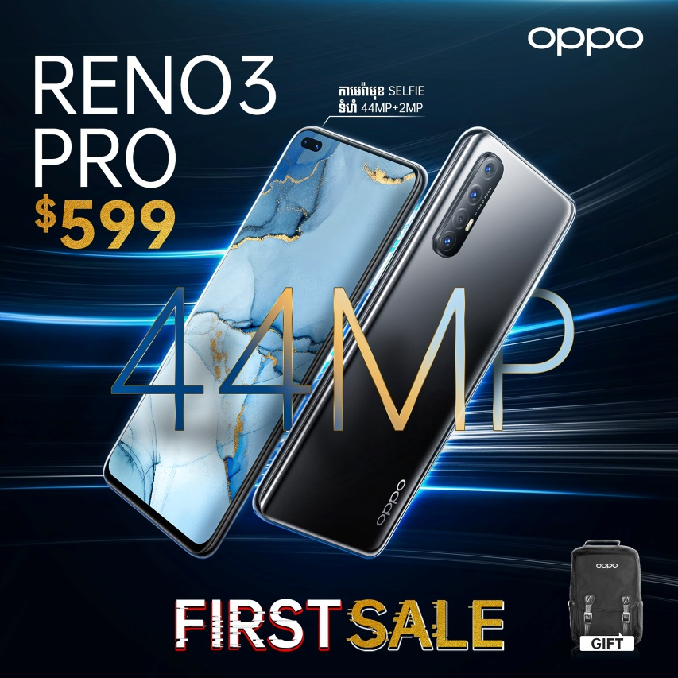
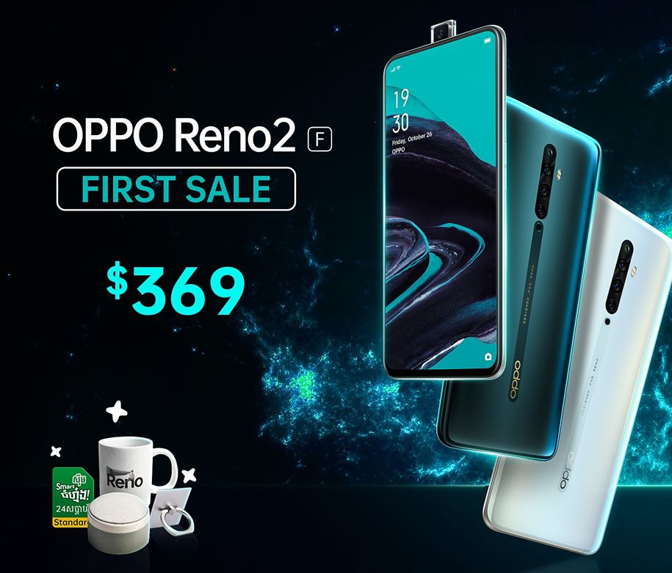
3. Psychological pricing (3type)
- Bundle pricing
Promotional pricing
With this pricing tactics, customer didn’t just buy a product but a package of it.
Attract consumer’s attention which seem to increase the volume of sales.

Slide 16
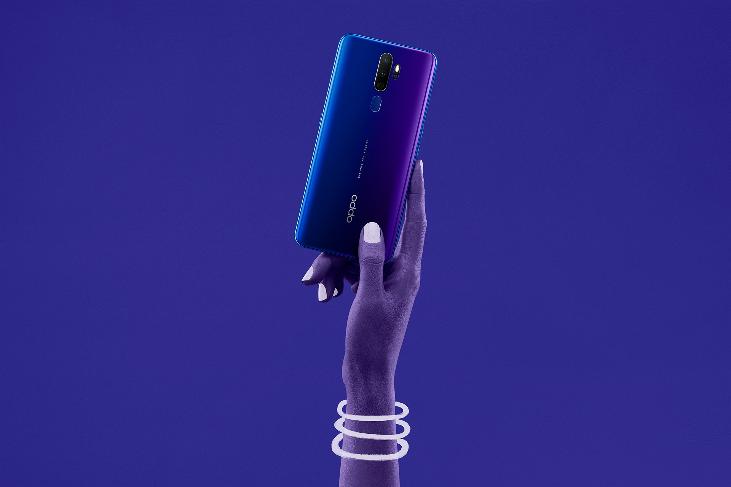
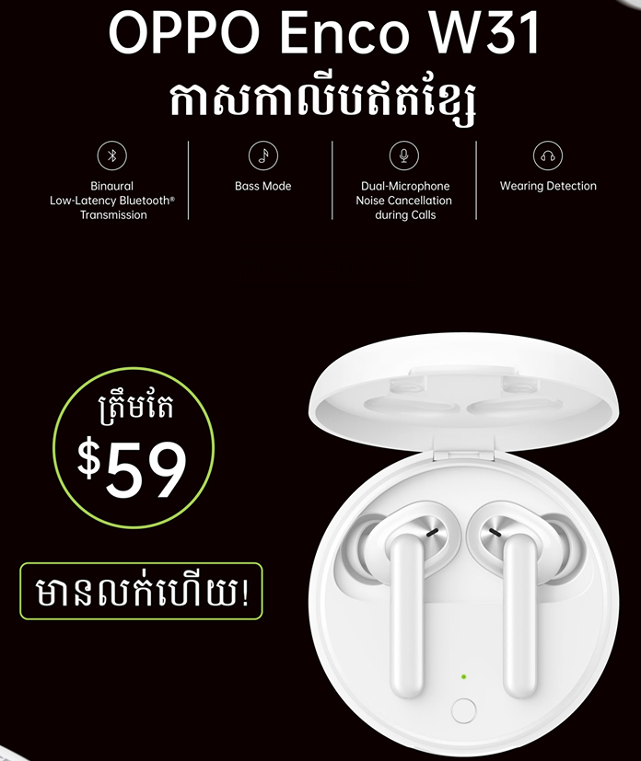
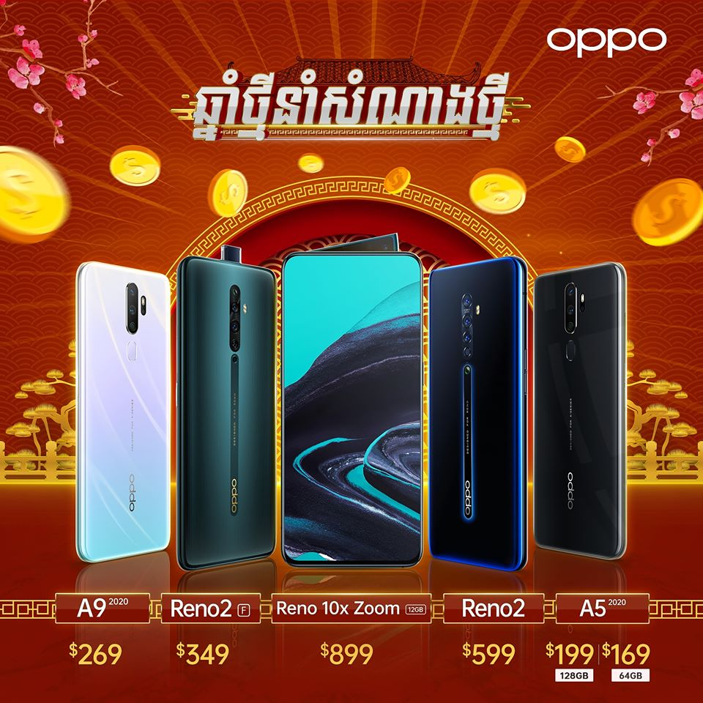
3. Psychological pricing (3type)
- odding pricing
Odd-even pricing is a psychological pricing tactic in which numeric value is utilize to impact the customer’s perceptions of product value

Slide 17
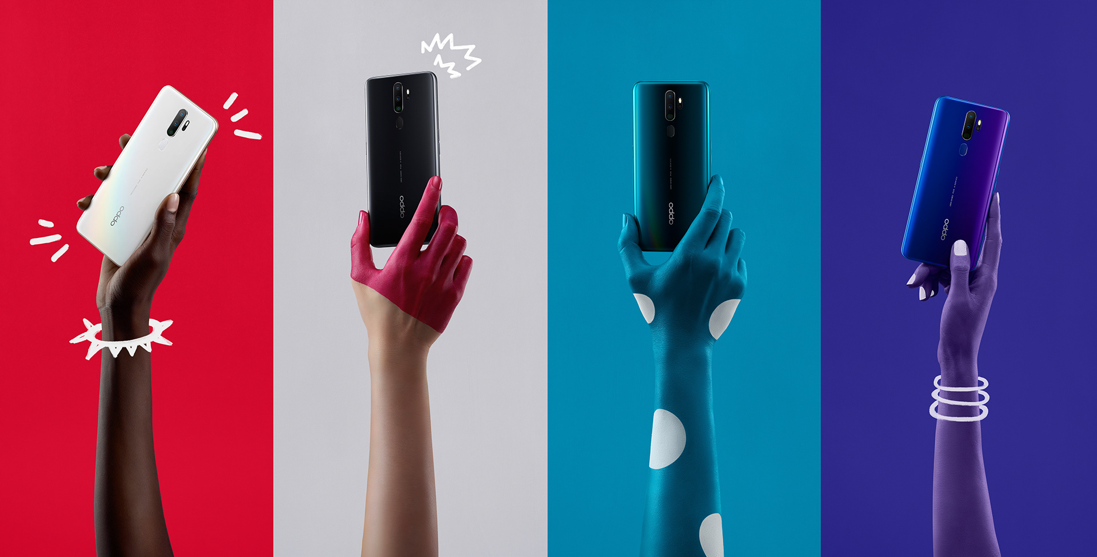

References

