Slide 1
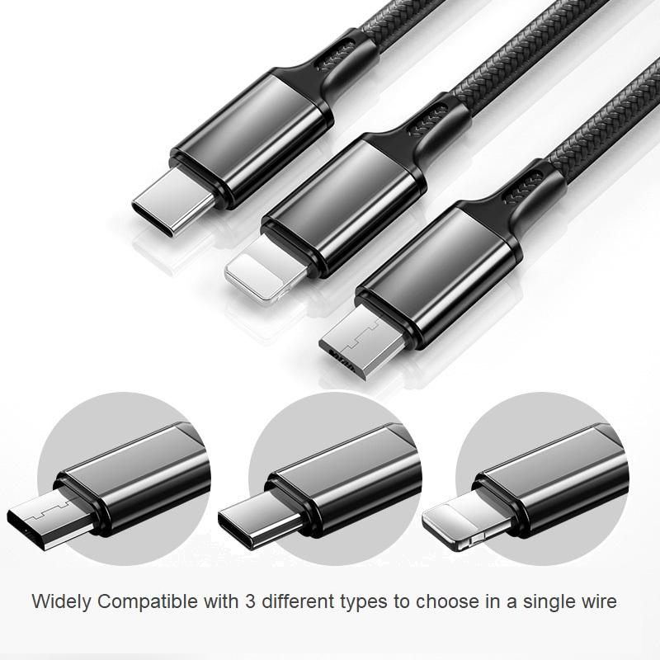

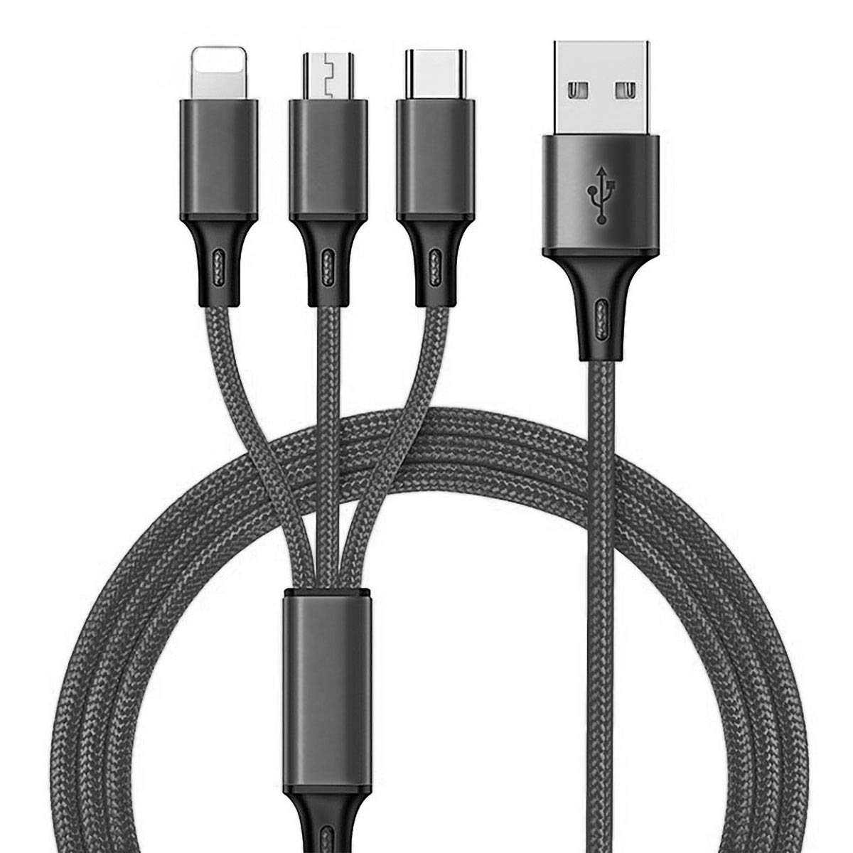
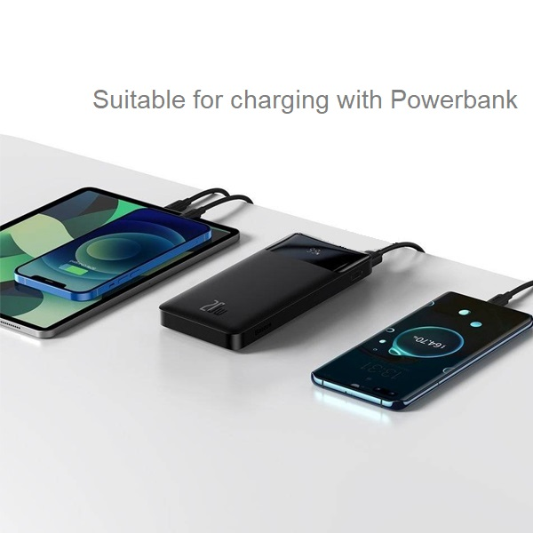
Kimhak Wire
Royal University of Law and Economics
M1 RMIBF & EPM 2021-2022
Course: Business Ethics
Professor: TUY Sopheak
Case Study: Sole Distributor
Date: 29/11/2021
Group 3
Group Members:
1. CHHORT Chhorravuth
2. KOU Kimhak
3. LAM Chiseng
4. LIM Seangleng
5. MAO Visal
6. PHOU Saumura
7. SOK Sotheara
8. VIN Sounratanak

Slide 2

Table of contents
01
02
03
04
Key Process of Import Task
Problematics of Importing Goods
Product Description
Demand and Competition
How to Get to Cambodia
Registration Process
Sourcing the Product
The Issues with Sourcing
Diplomatic Relation
Assumption & Key Findings
The Diplomatic Relationship
Market Research

Slide 3

01
Key Process of Import Task

Slide 4
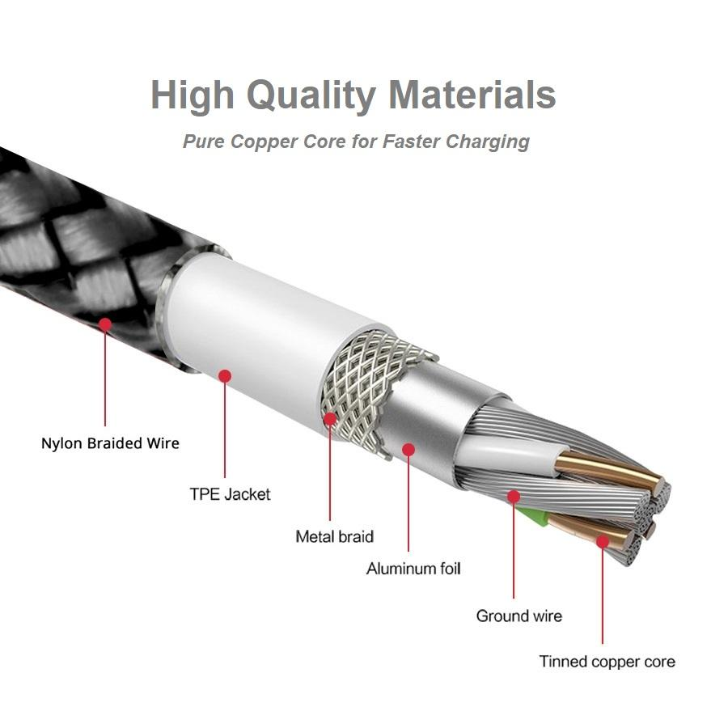
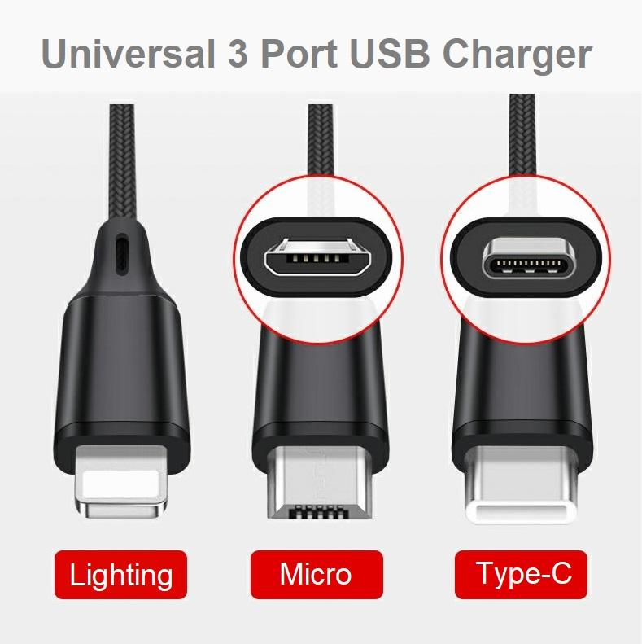
Product Descriptions

Slide 5
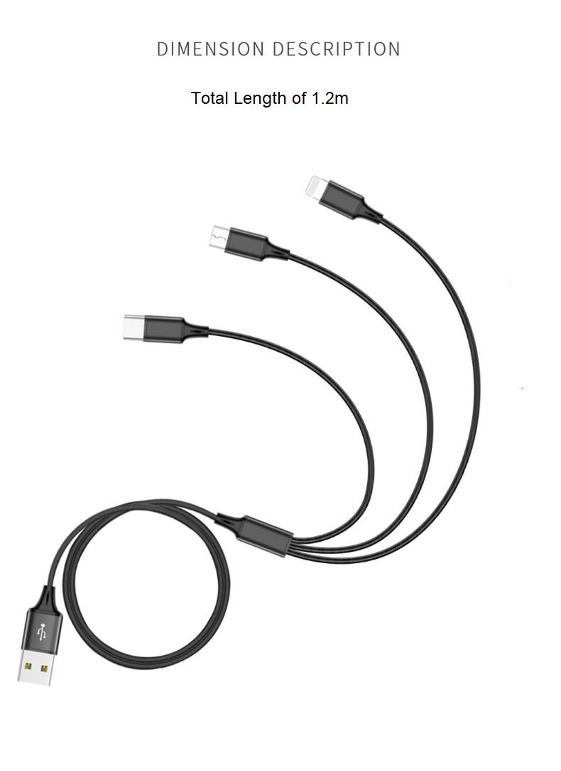
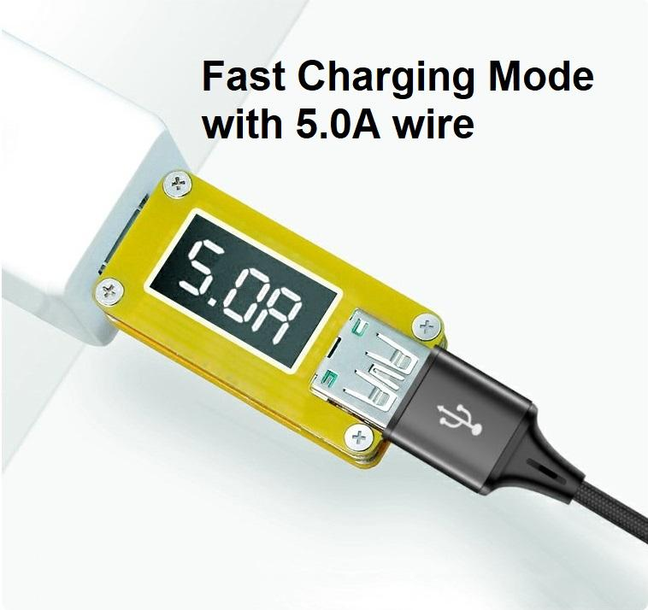
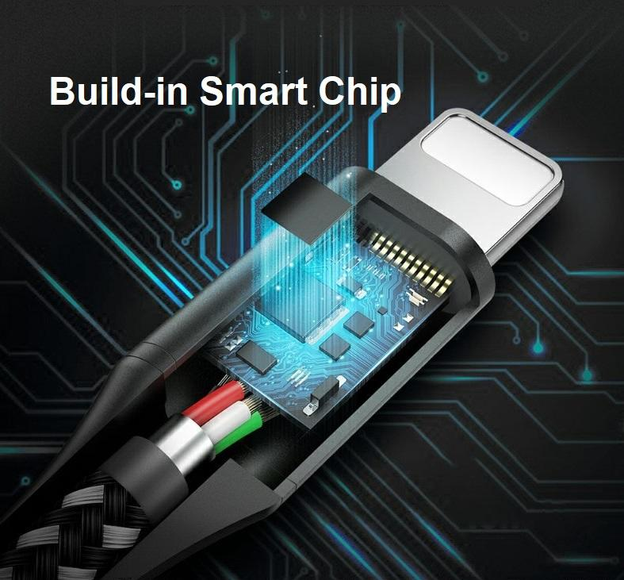
Product Descriptions (Continue)

Slide 6
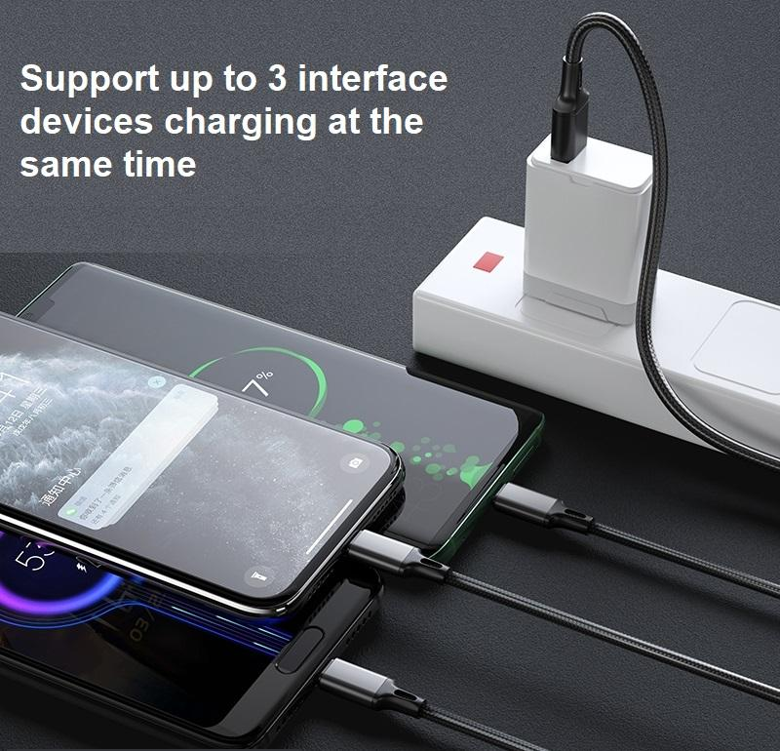
Reasons for Choosing It

Slide 7
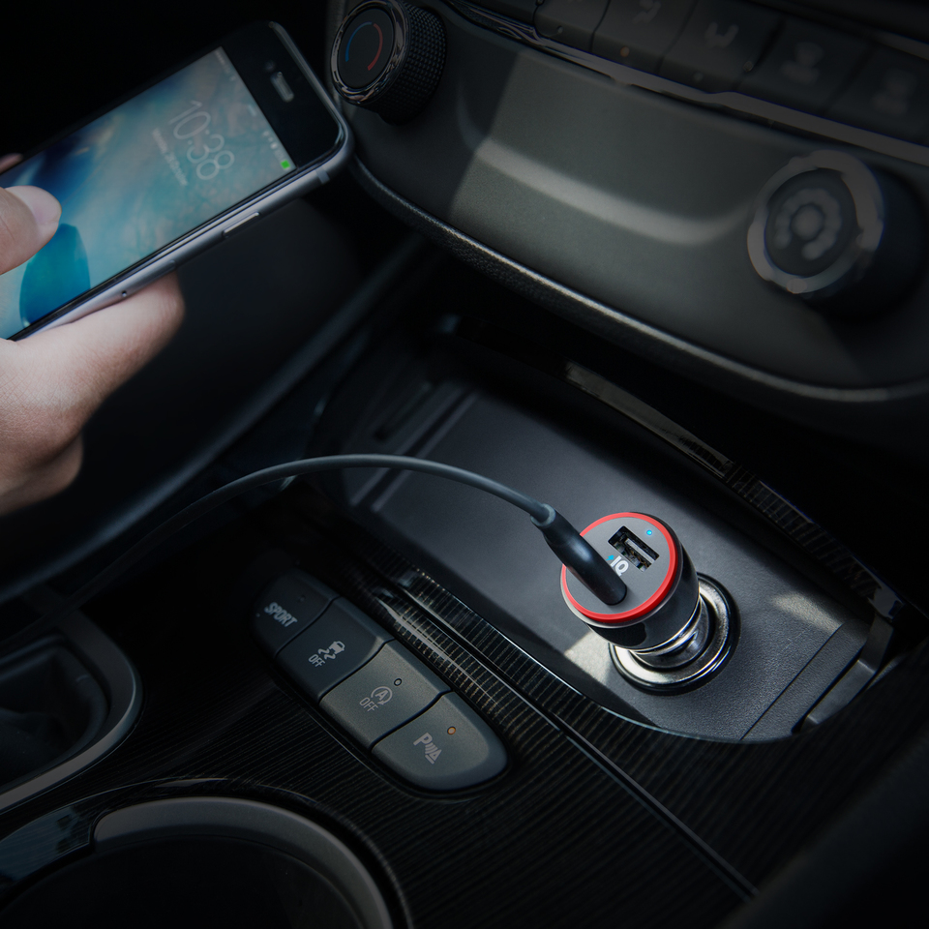
Reasons for Choosing It (Continue)

Slide 8
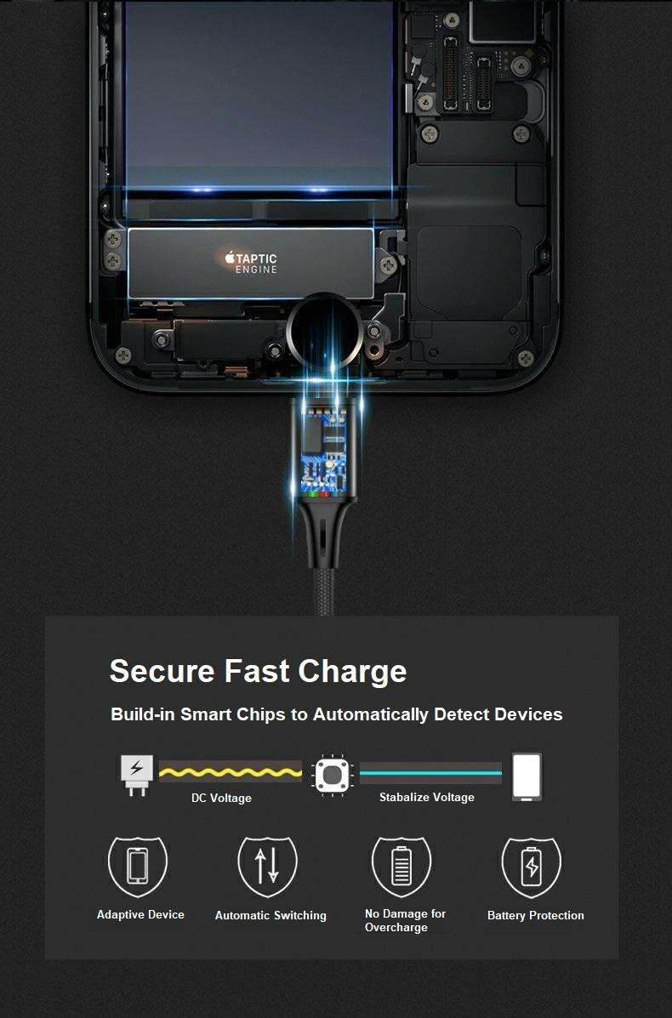
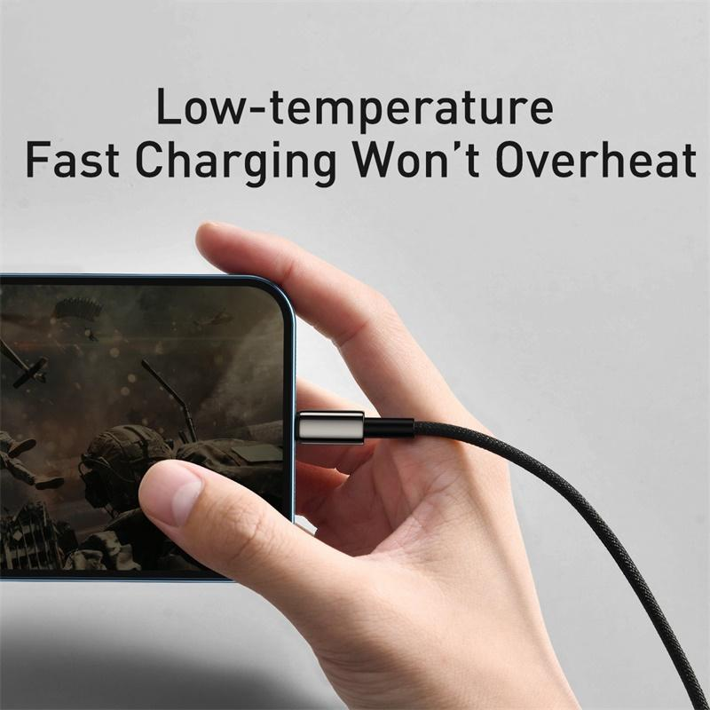
Reasons for Choosing It (Continue)

Slide 9
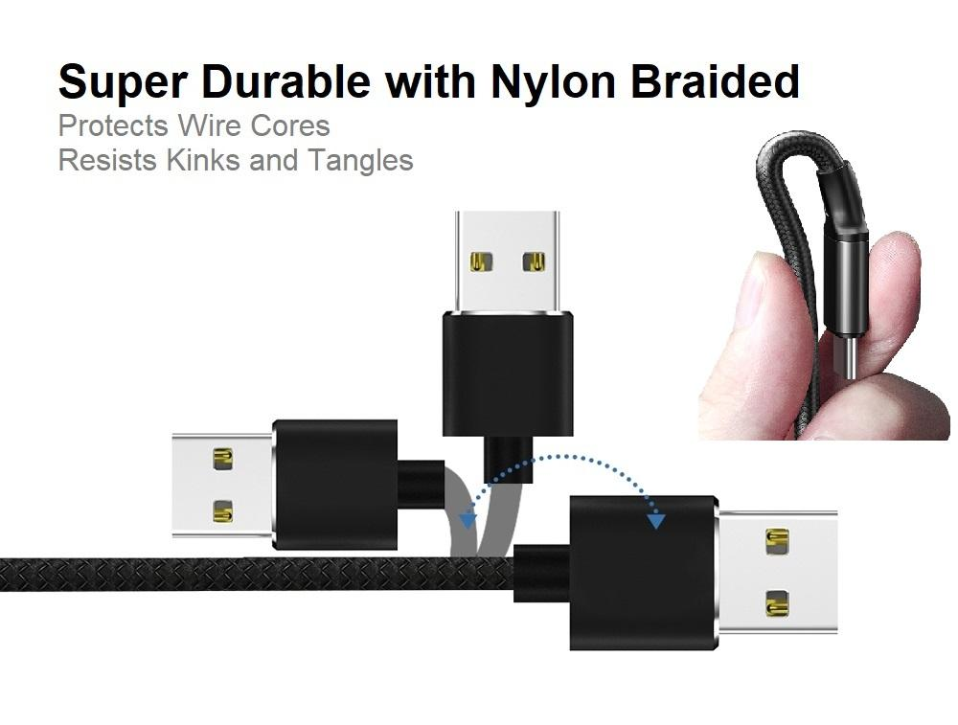
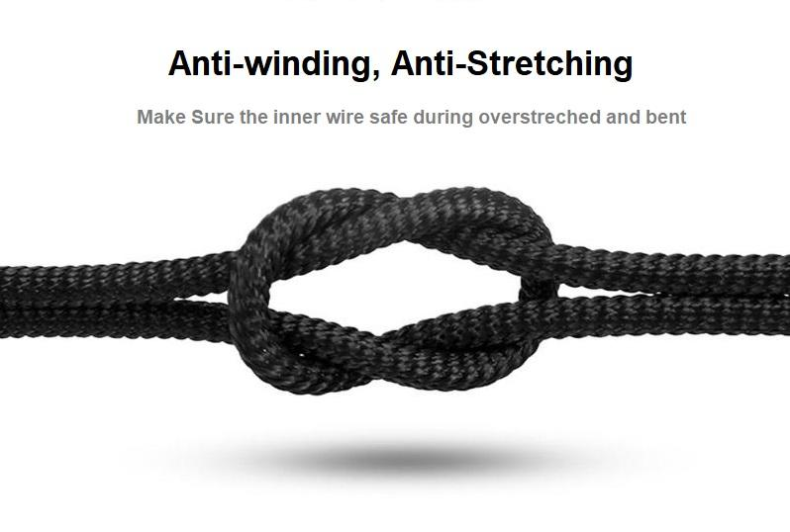
Reasons for Choosing It (Continue)

Slide 10

Understanding the Demand in the Market
Market Demand & Perspective
01 | Cambodia has 16.8M people (2.3M in Phnom Penh) with a median age of 25; of which 16M owns a phone, whereas 9M+ of them uses smartphone.
02 | Many people own different devices (e.g. iPhone & Android) and one household has at least multiple devices (e.g. Earphone, Speaker, PowerBank, Camera) which definitely indeed of our products.
03 | With the rising in income (GDP/capita $1.5K @2020) and smartphones become cheaper & better, hence the trend of smartphone consumption will inevitably increase and so the needs of our product as well.

Slide 11
Understanding the Suppliers
Key Players & Product Brands They Offer
The Key Players:
T-Shop
  Baseus
UFO Store
  Anker
Sombokit (សំបុកអាយធី)
  Mazer
Kunfulon
  Kunfulon
Gadget Stop
  Tronsmart
iOne
  J5Create
  Philips
Srolanh Smart Store
  Adam
Sokly Phone Shop
  King Kong
Others
  Rock
  Hoco
  WuW
  Best
  Remax

Slide 12
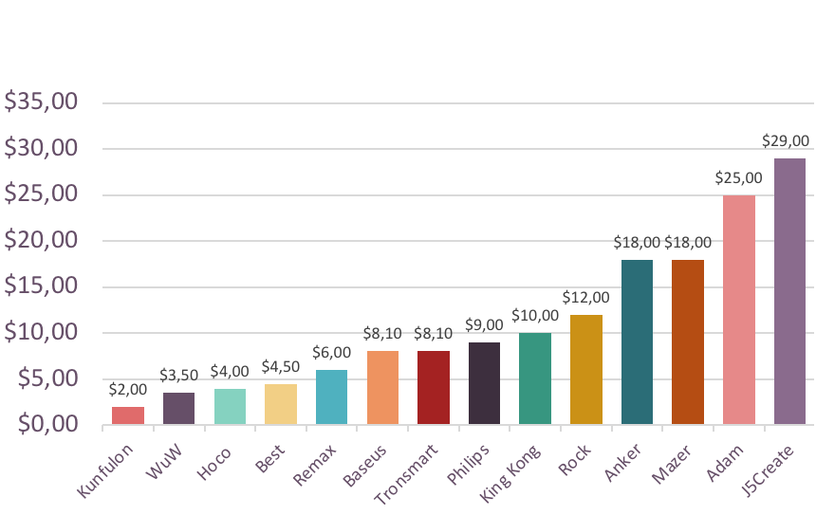
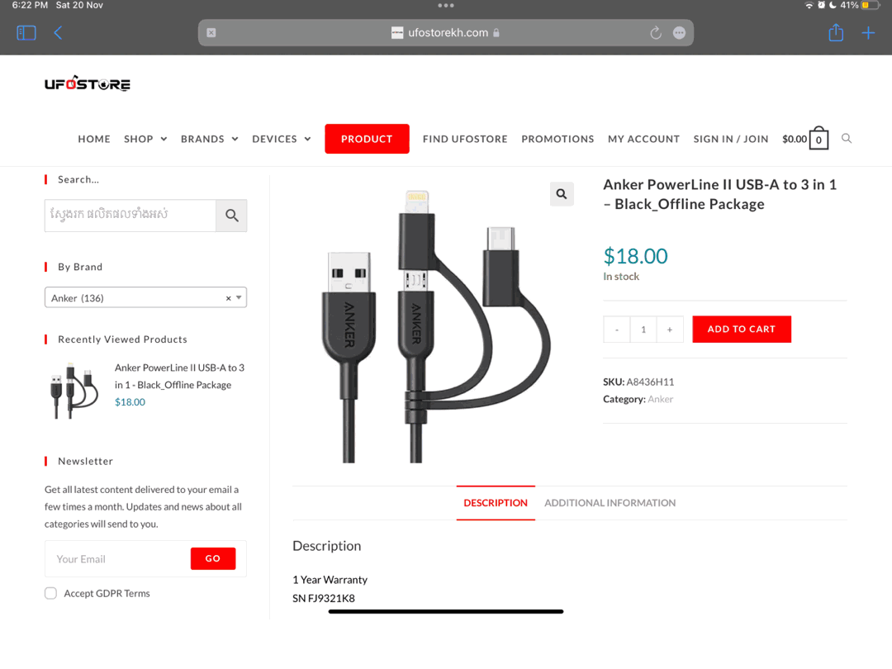
Understanding the Suppliers (Continue)
Product’s Price
Product’s Price by Type of Brand

Slide 13
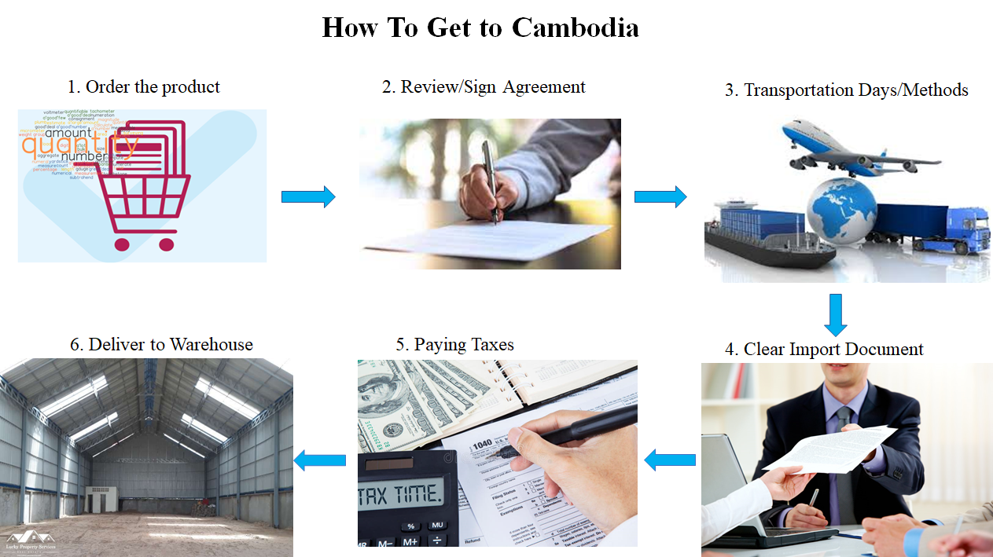
How to Get to Cambodia

Slide 14
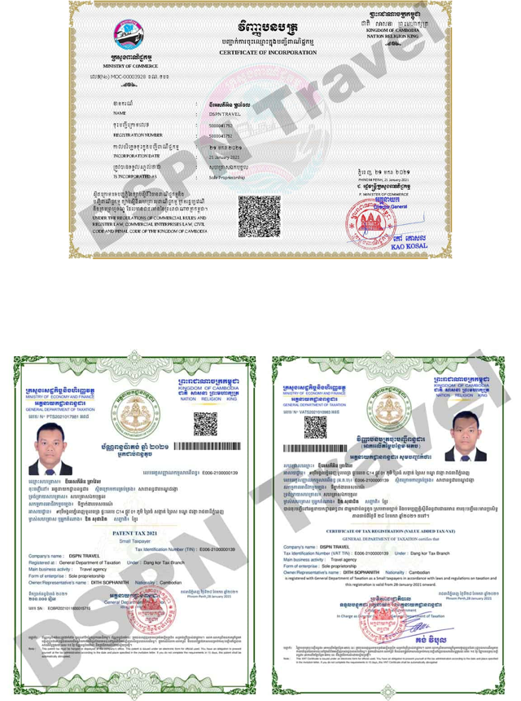
Registration Process
1) Register the business => Sole Proprietorship
(Cambodia’s department of Business registration, Ministry of Commerce)
Step 1. General Information
Proposed name: KIMHAK WIRE
Business activities: Supply Mobile Phone Charger with universal 3 Port USB
Step 2. Addresses and Contacts Information
Company Address: #12, St36, Teuk Tla, Sen Sok, Phnon Penh
Email: kimhakwire@gmail.com
Phone Number: (855) 15 555 999
Step 3. Owner Information
Kou Kimhak, Cambodian

Slide 15
Registration Process (Continue)
2) Tax Registration => Small Taxpayer
(General Department of Taxation, Ministry of Economy and Finance)
Certificate of Tax Registration (VAT certificate)
Patent Certificate
supporting document including approval letter or certificate, articles of association, valid ID card or passport, photographs, ownership certificate, bank account (Fee 50$+)

Slide 16

02
Problems
Problematics of Importing Goods

Slide 17

Sourcing the Products
Problem: Supplier Selection in China
Time Consuming in supplier shortlisting: online sourcing platforms, compare product and price
Solution: WeChat and phone number, faster
Middleman (not manufacturer):
Higher cost
Lack of expertise in the product field
Lack of economy of scale
Solution: Verify business license and VAT invoice

Slide 18
Other Challenges & How to Minimize the Risk
Problems | Solutions
Quality Standard of product | -Cross check reference on selected supplier -Walk-through production process -Bring an expert with us
Barrier of languages | -Study on how Chinese people do business -Interpreter
Possible failure of errors in the product | -Visit factory for testing samples first until correct quality and product
Long waiting time/ Shipment Delay | -Organizing importing process 3 months in advance
Custom check | -Contact agent to process for us

Slide 19

03
Diplomatic Relation

Slide 20




The Diplomatic Relationship
Since the goal of the company is to create its own brand, the final relationship with the supplier will be the “External Factory” for the company.
Kimhak Wire
Partnership (External Factory)
Factory

Slide 21
The Diplomatic Relationship (Continue)
Kimhak Wire
Stage 1
Stage 2
Initial Contact + Pilot Test
Trusted Partner

Slide 22


The Diplomatic Relationship (Continue)
Stage 1 relationship stages
WeChat
Supplier
Hello, I am Kimhak Wire from Cambodia. I am very interested in your product and would like to collaborate with you for business in Cambodia.
Initial Contact
Initial conversation with supplier
Personality Check
Hello, what kind of cable do you want? And how many will you order?
Product Check
I would like to order around 10,000 in the first batch. What requirement do you have to put my brand on the cable?
Negotiation
You will need to order 15,000 up and a contract of 1 year for many orders to get your brand on the cable.
Sign Contract

Slide 23
The Diplomatic Relationship (Continue)
Stage 2 relationship stages
Stage 2 is the period after 1 year, after you have worked together for awhile and it reaches the time to renew the contract.
If you decide to renew the contract, there will be a lot more options opened because it reaches the period where you and supplier trust each other.
Some new options include update on the hardware, first pick on new features, and some more adjustments according to your needs.
It will be the time to discuss some more confidential information about the industry related to the technology, the economy, also some tips from supplier.
Discount Price
Access to early technology
Insider info
Benefits of having trust with Supplier
Adjustments to demand
Some other quirks
Trust the quality

Slide 24
Market Research
Marketing research:
Pricing : 20-30% on original price plus external logistic
Type of purchase:
up to 1000 $ :30 %
1000- 3000 $: 25 %
3000-5000 $: 22 %
5000-10000 $: 20 %
Where to sell : direct sale : wholesale
Phone shop
Accessories store
Wet market
Lucky /mart

Slide 25

Market Research (Continue)
Target audience
Smartphone user
Low-middle income family
Worker
Student
Logistic
Sales team : distributor
Distributor will received 5% on the revenue
Distributor channel:
1. Phnom penh city
2. Main provinces: Siem Reap, Kompong Cham, battdombong , PSV
3. Provinces

Slide 26
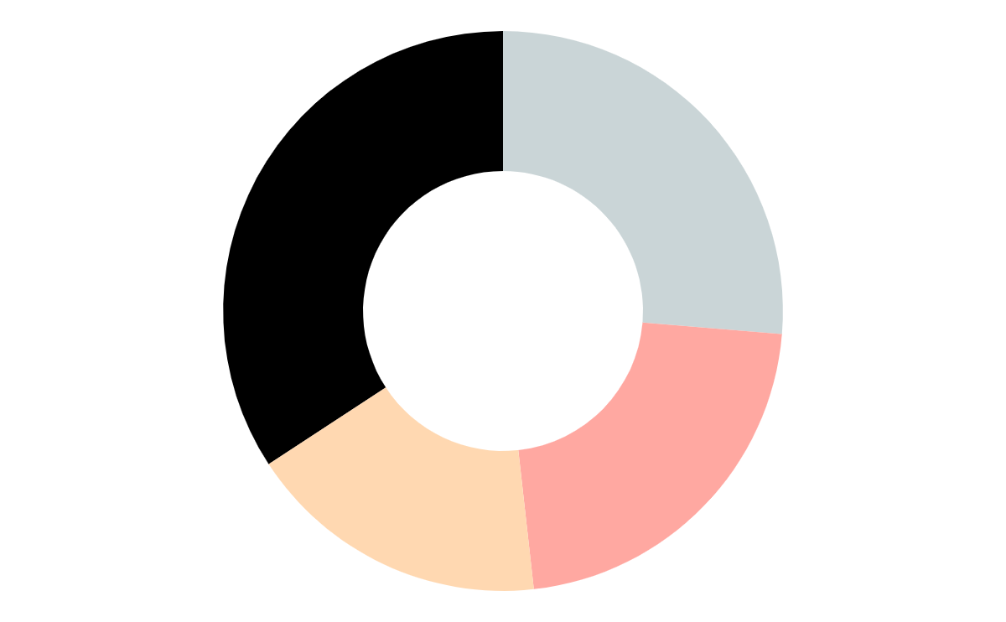
04
Assumption & Key Findings

Slide 27

Thanks!

