Slide 1
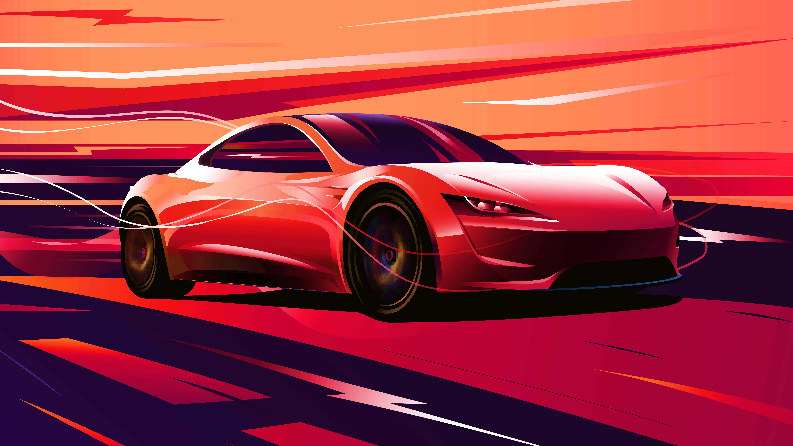



STRATEGIC
ANALYSIS
Presenters: SOK Sotheara
AN Sochetra
ANG Seavling
RIN Panha
NOU Sounan
Professor: SRUN Sopheak

Slide 2




INTRODUCTION
01
INTERNAL ANAYSIS
02
03
EXTERNAL ANALYSIS
04
SWOT ANALYSIS

Slide 3
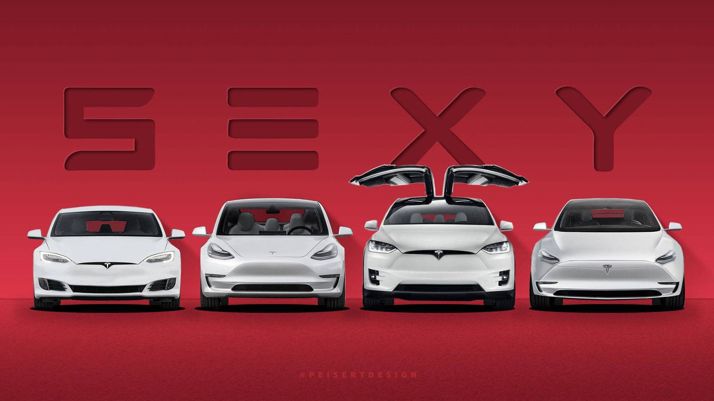

Slide 4

INTERNAL ANALYSIS

Slide 5






TESLA’S CULTURE
Reason from “First Principles”
Move Fast
Do the Impossible
Think Like Owners
Constantly Innovate
We are ALL IN

Slide 6





VALUE CHAIN
SUPPORT ACTIVATIONS
PROCUREMENT
TECHNOLOGY
HUMAN RESOURCE MANAGEMENT
FIRM INFRASTRUCTURE
PRIMARY ACTIVATIONS
INBOUND LOGISTICS
OPERATION
OUTBOUND LOGISTICS
MARKETING AND SALES
SALES

Slide 7
EXTERNAL ANALYSIS

Slide 8






PESTEL’S ANALYSIS
1
2
Political
Economic
Government Incentives for electric automobile
Decreasing battery cost
6
Legal protection of intellectual property
PESTEL
Increasing preference for renewable energy
3
Legal
Social
Tesla use sola panels to help utilize the sun abundant energy
Battery
5
4
Environment
Technology

Slide 9
PORTER’S FIVE FORCES ANALYSIS
Bargaining power of customers
Rivalry of existing firm
PORTER’S FIVE FORCES
Bargaining power of suppliers
Threat of substitute
Threat of new entrants

Slide 10




SWOT ANALYSIS
STRENGTHS
WEAKNESSES
STRENGTH
WEAKNESS
OPPORTUNITIES
OPPORTUNITY
THREAT
THREATS

Slide 11
SWOT ANALYSIS
STRENGTHS
WEAKNESSES
STRENGTH
WEAKNESS
OPPORTUNITIES
OPPORTUNITY
THREAT
THREATS

Slide 12
SWOT ANALYSIS
STRENGTHS
WEAKNESSES
STRENGTH
WEAKNESS
OPPORTUNITIES
OPPORTUNITY
THREAT
THREATS

Slide 13
SWOT ANALYSIS
STRENGTHS
WEAKNESSES
STRENGTH
WEAKNESS
OPPORTUNITIES
OPPORTUNITY
THREAT
THREATS

Slide 14
SWOT ANALYSIS
STRENGTHS
WEAKNESSES
STRENGTH
WEAKNESS
OPPORTUNITIES
OPPORTUNITY
THREAT
THREATS

Slide 15
SWOT ANALYSIS
STRENGTHS
WEAKNESSES
STRENGTH
WEAKNESS
OPPORTUNITIES
OPPORTUNITY
THREAT
THREATS

Slide 16
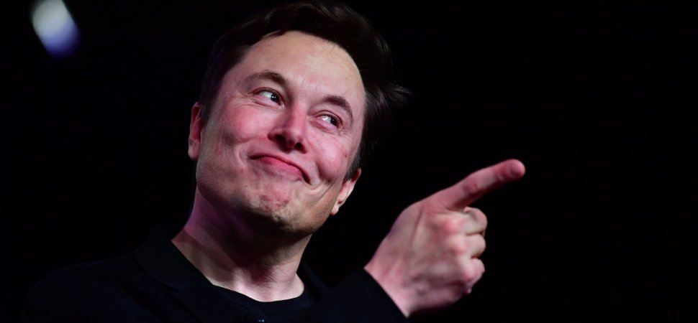
ANY QUESTIONS?

Slide 17
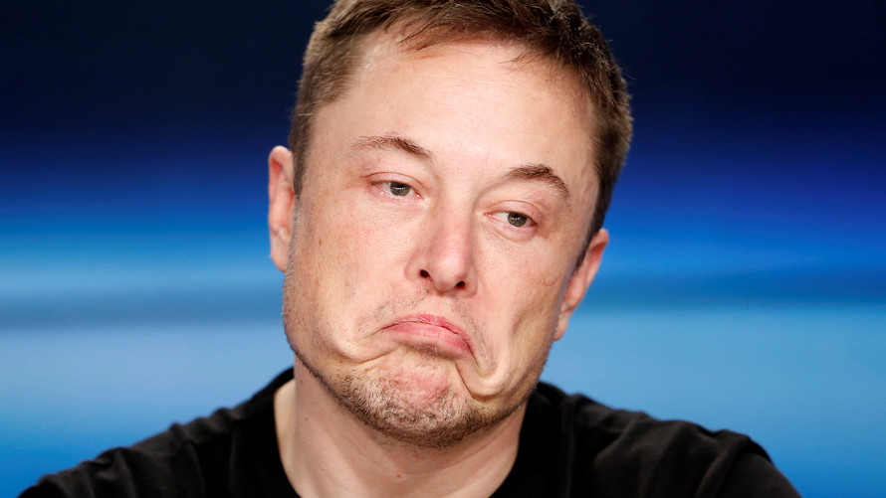
THANKS FOR YOUR QUESTION

